Slide 1
General Childhood responses to illness, injury and hospitalization
Prepared by:
Ms. Jamilah Allehaib
BSN, RN
Module 5, Special care situations

Slide 2
Learning Objectives :
■ List three common responses to illness, injury or hospitalization that children may show.
■ Explain the factors that can affect how a child responds to illness, injury or hospitalization.
■ Identify characteristic responses to illness, injury or hospitalization according to developmental level.
■ Describe the effect of chronic illness on children and families.
■ Discuss the concepts of family-centered care, atraumatic care and the ways a nurse assistant can address the responses of infants and children who are ill, injured or hospitalized.
■ Explain the ways a nurse assistant can maintain a child’s safety when ill, injured or hospitalized.
■ Discuss the use of play with infants and children and ways a nurse assistant can help family members deal with an ill, injured or hospitalized infant or child.

Slide 3
Introduction:
Imagine that you became ill or injured or needed to go to the urgent care center, emergency department or hospital. How would you respond?.
Now imagine that you were a child in the same situation. How do you think you might react?.
Typically, when you think about infants and children, you think about cute little babies cooing, giggling and crawling about, and boys and girls running around, playing on the playground and enjoying themselves.

Slide 4
CONT…
Rarely do you think about them becoming ill or injured.
Unfortunately, they do, and their responses, although similar in some respects to those of adults, are unique.
Infants and children continually grow and develop. They are not “mini-adults.” So you will need to adapt how you care for infants and children, both physically and emotionally, based on the child's stage of growth and development.

Slide 5
General childhood responses to illness, injury and hospitalization:
Common emotional responses to illness, injury and hospitalization include fear and anxiety, separation anxiety and a feeling of loss of control.

Slide 6
Fear and Anxiety:
Infants and children, like adults, commonly experience when affected by illness, injury or hospitalization.
For most children, the sights and sounds of emergency department are strange and unfamiliar.
There are bright lights, odd smells, large pieces of equipment and people dressed in unusual clothing.
The comfort and quiet of the home and a familiar routine are gone.
For example, the child may have a strange pain in his tummy or be awakened during the night to have his vital signs taken.
The child may not be allowed to eat or drink because of a planned procedure. Or the child may undergo a procedure that causes pain.
All of these situations can cause the child to experience fear and anxiety related to the unknown.

Slide 7
Separation Anxiety
Separation anxiety: is anxiety that is experienced when a child is away from her parents or guardians.
It is a normal stage of development that occurs during infancy and toddlerhood as the child becomes familiar with her surroundings and develops trust as she is being cared for by the parents or guardians.
The infant learns to recognize that her parents are safe and familiar.
Separation anxiety peaks between the ages of 8 and 18 months, when the child becomes frightened in new situations or with new people.
However, over time, the child learns that the parent keeps coming back, allowing the anxiety and fear to subside. As a result, the child begins to develop self confidence.
Separation anxiety usually disappears by the end of the toddler’s second year.

Slide 8
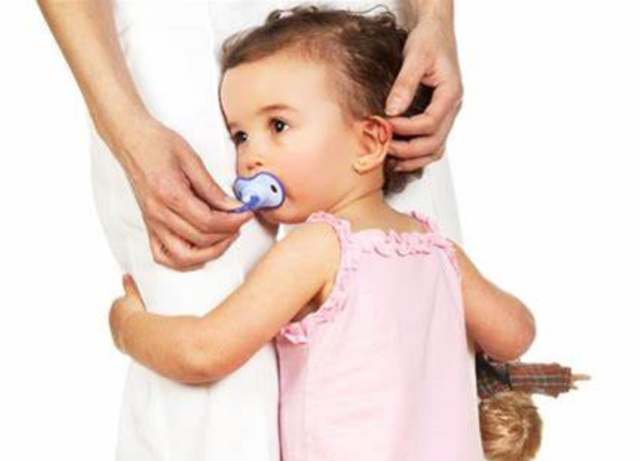
CONT…
Children can re-experience separation anxiety when they are faced with unfamiliar situations that cause stress.
These situations lead the child to seek the safety, comfort, protection and familiarity of the parent or guardian.
However, if the parent or guardian is not present, the child experiences upset and distress and may go through the three stages of separation anxiety (Table 21-1).

Slide 10
Loss of Control:
Consider a child’s usual routine. He usually follows a similar routine each day, such as getting up and getting dressed, eating meals, participating in activities and going to school or day care.
As the child grows, his level of independence in the routine increases, for example, bathing and dressing himself.
The child also begins to make decisions, such as what he wants to eat and wear or what activities to do.
The child is developing a sense of control over himself and his surroundings.
Unfortunately, illness, injury or hospitalization can disrupt the child’s routine and sense of control. The child often feels threatened by the loss, which leads to further anxiety and fear.

Slide 11
CONT…
Because of the effects of the illness or injury and the routines of the facility, an ill, injured or hospitalized child often cannot decide what he wants to do and when.
For example, a child who was injured may be required to remain in bed to allow the injury to heal. As a result, the child can no longer use the bathroom. Instead, the child must use a bedpan for elimination and get washed at the bedside.
Additionally, he may be unable to perform the care independently and will need to rely on others for help.
Loss of control is also reflected in decisions involving the body.

Slide 12
CONT…
Treatments and procedures often are necessary. In most cases, the child’s parents or guardians, not the child, are involved in the decision making along with the health care team. As a result, the child has little input. Additionally, many of these procedures or treatments are invasive, causing trauma to the child.
When children feel a loss of control, they often demonstrate regression, or a return to a previous stage of development.
Regression is one of the ways that a child copes.
For example, a toddler who has achieved toilet training may regress or go back to using diapers. A preschooler who is able to feed himself may need to be fed his meals as well.

Slide 13
Factors affecting a child response to illness, injury and hospitalization:
Each child responds to illness, injury or hospitalization differently based on a variety of factors.
These factors include the child’s developmental level; previous experiences with injury, illness or hospitalization; recent stresses and changes; and the family’s response to the situation.
In addition, a child’s response can be affected by whether the condition is acute or chronic.

Slide 14
Developmental Level:
A child responds to situations such as illness or hospitalization based on his developmental level (Table 21-2).
The child’s ability to think and understand what is happening around him influences how he perceives the actual situation. This perception, in turn, affects how the child responds.
For example, a preschooler is egocentric (that is, the child is centered on himself). In addition, preschoolers often engage in “magical thinking.” The stress associated with illness or hospitalization often leads the preschooler to imagine that he did something to cause the problem.
The preschooler also has limited understanding of words and is unable to tell the difference between sound-alike words or words with double meanings.
For example, the words “dye” and “die” sound alike but mean totally different things. The preschooler may hear the word “dye” but interpret it as “die.”
Consider the word “dressing.” As an adult and a nurse assistant, you know that “dressing” could refer to clothing or to bandaging. However, a preschooler does not have this ability. The child may wonder why he or she is going to be naked or without clothes, when in fact, the child’s bandage is being changed. This misinterpretation adds to the stress that the child is already experiencing.

Slide 16
Previous Experiences:
A previous experience with illness, injury or hospitalization can go a long way in helping a child deal with a current similar situation.
This is true if the experience was a positive one. For example, a child’s previous experience with a hospital may have been for the birth of a little brother or sister, which would be viewed as a positive experience. Thus the child may think back on that time and experience less stress when faced with her own current situation.
However, a previous negative experience, such as one involving a serious illness or the death of a loved one, would most likely be viewed as negative, leading the child to perceive the current situation negatively as well. The child may respond by kicking, screaming, crying loudly, clinging to her parents or having a temper tantrum. Or the child may push others away and withdraw into herself.

Slide 17
Recent Stresses and Changes:
A child who is ill or injured already may be experiencing numerous changes and stresses that further affect his ability to cope with the situation.
Children are vulnerable because they lack physical and emotional maturity. This vulnerability increases as stresses and changes increase.
For example, a child with a serious illness may have to be hospitalized in an intensive care unit. In addition to coping with the stress of the illness, the child also must cope with environmental stresses, such as bright lights, loud sounds and strange smells. The child’s senses may become overloaded.
As a result, the child might become irritable, agitated or visibly angry. Or the child might become indifferent or uninterested, and withdraw because he is not able to cope

Slide 18
Family’s Response:
Children do not exist in isolation. Rather, caring for children always involves caring for the family, which includes parents or other primary caregivers, siblings (brothers and sisters) and members of the extended family.
Illness, injury or hospitalization of a child can create a crisis situation for the family (Figure 21-1). All members of the family are affected, as are their roles and routines.
Children often look to their parents for clues about what is happening and how to respond.
The reactions of parents may range from disbelief, fear, irritability, agitation and anger to guilt, uncertainty, confusion, denial, helplessness and hopelessness. These reactions can be heightened by other stresses, such as financial problems, separation from the rest of the family or just the physical and emotional stress that accompanies any illness.

Slide 19
CONT…
The responses of siblings, like those of the ill or injured child, vary based on the child’s developmental stage.
Consider a hospitalized school-aged child with a sister who is a preschooler. The sister may have wished for the older child to “go away.” With the older child’s hospitalization, the preschooler’s wish came true. Subsequently, the preschooler may actually believe that she caused the situation and feel guilty for doing so.
Additionally, the sibling may feel neglected because of the focus placed on the ill child. A child’s illness can result in separation of family members from one another (for example, if one parent travels with the ill child to a distant hospital to receive specialized treatment, while the other parent stays home with the other children).

Slide 20
CONT…
Even if travel is not involved, the situation of having an ill or injured child will naturally lead to more attention being given to that child.
The child’s siblings may misinterpret the parents’ concern for the ill child, thinking that the ill child is better than or more important than they are.
The siblings may be left to feel that they are not loved as much as the ill child. The siblings may become jealous, clingy, demanding or withdrawn.
Moreover, with changes in family routines and roles, siblings may be required to take on additional family responsibilities, such as household chores.
Siblings may become angry and possibly come to resent the ill child because of the increased workload or restrictions placed on them.
For example, an adolescent sibling might be needed to stay home with an ill brother or sister on a Friday night because both parents are tied up with work. The adolescent is missing a party that all of his friends are attending. As a result, the adolescent is upset at missing the party and blames his ill sibling.

Slide 21
Acute Versus Chronic Illness:
Children often face illnesses or injuries that are acute, such as a broken arm. For most children, that means the condition arises suddenly, requires some type of treatment, and then resolves and disappears.
many children are faced with chronic illness. Chronic illness is commonly defined as any health problem that lasts over 3 months.
Examples of common chronic illnesses in children include asthma, diabetes, cerebral palsy, sickle cell anemia, epilepsy and congenital heart conditions.
In addition, acute conditions, such as a traumatic injury to the brain or spinal cord, may lead to problems that require long term follow up and treatment.

Slide 22
CONT…
A child with a chronic illness typically has times when he feels well and times when he feels ill. However, even during the periods when the child feels well, he is living and dealing with the illness.
He must cope with the understanding that the condition is lifelong, permanent, possibly incurable in some cases, and may get worse over time.
Chronic illness affects the child in numerous ways.
Children with chronic illnesses often need frequent visits to physicians or other primary care providers for follow-up to evaluate their condition. They also may require more frequent testing, which may be painful or frightening.

Slide 23
CONT…
The need for frequent testing and follow-up can impact the child’s school attendance, leading to missed time at school and at school activities.
Strict schedules such as for medications or procedures may take priority over routine childhood activities. In addition, certain restrictions may lead to the child’s being unable to participate in certain activities, such as sports or school field trips. As a result, the child may feel different and begin to withdraw from others, this adds to further isolation and loneliness.
Chronic illness also places a tremendous amount of stress on parents and families. Parents and families must learn about the illness and come to terms with it. This may be especially difficult if the illness is inherited. Parents may be overwhelmed with guilt, as they are the “cause” of the illness. To compensate for the guilt, they may respond by over protecting the child.

Slide 24
CONT…
Family routines are disrupted because the focus is on the ill child.
Parents may inadvertently neglect one another as they care for the ill child, becoming overly fatigued and overstressed.
Parents also may inadvertently neglect other children in the home or they may have unrealistic expectations for them.
Siblings often “blend into the woodwork” unless they demand attention. At times, siblings may act out to get attention.

Slide 25
Caring For Infants and Children:
Two major concepts provide the foundation for the care of infants and children:
Family-centered care.
Emphasizes an open, working relationship among health care providers, the child and family members.
Component this care include: open 24 hours visitation to the hospital unit, sibling involvement, family conferences, family presence during procedures and family participation in care and decision making.
Atraumatic care.
Focuses on reducing the negative effects associated with illness and injury by minimizing the physical and emotional stress the child and family members experience
The decision making involves input from the health care team, the family is ultimately in control of the decisions that are made on behalf of the child.
Focuses on three areas:
1.Identifying stresses for the child and family.
2.Minimizing the separation of the child from parents or guardians.
3.Minimizing or preventing pain.

Slide 26
Addressing Overall Childhood Reactions:
Children, regardless of their age, become frightened and anxious in new situations.
For many children, experiencing illness, injury or hospitalization is a new experience.
You can help reduce these feelings by being attentive to the child and family and by promoting a sense of control in the child and family.
Table 21-3 summarizes some actions that you can take to address the child’s fear, anxiety and loss of control.

Slide 28
Addressing Responses Developmentally:
Each child is unique in his or her responses.
Those responses are, in part, determined by the child’s developmental level.
When you are providing care to an ill, injured or hospitalized child, you need to adapt your care based on the stage of the child’s development and his or her primary fears.

Slide 29
Infants:
Typically infants experience fear, anxiety, loss of control and separation anxiety.
When providing care to infants, be consistent. Learn to recognize the infant’s cues and respond accordingly.
For example, change the infant’s diaper or offer the infant a bottle when she cries.
Doing so allows the infant to develop trust that someone is there to meet her needs. As a result, the infant may experience less stress and thus less trauma.
An infant experiences satisfaction through sucking. However, the infant may not be allowed anything by mouth. In these situations, offer a pacifier to satisfy her needs. A pacifier can help to calm and soothe the infant as well as meet her need for sucking.
assign you to care for the infant so that she receives consistent care and is exposed to the fewest number of caregivers as possible.

Slide 30
Toddlers:
Caring for a toddler can be challenging because the toddler needs structure and routine.
However, toddlers also need to be able to explore their surroundings to satisfy their curiosity.
Toddlers are attempting to establish their independence as they explore the world around them. Thus, a loss of control is a major issue for this age group. In addition, toddlers have a fear of strangers.
Always introduce yourself to the child and explain your role in terms that the child can understand. Use simple, concrete terms and speak to the child at his eye level. However, do not be surprised if the toddler does not respond immediately to you. . Remember, he views you as a stranger.
In addition, try to follow the child’s normal routines. Perhaps the child has a snack of milk and cookies before going to bed. Or his parents read him a bedtime story. Regardless of what the routine is, try to follow it, if possible, because you will be helping to restore the toddler’s feeling of control.

Slide 31
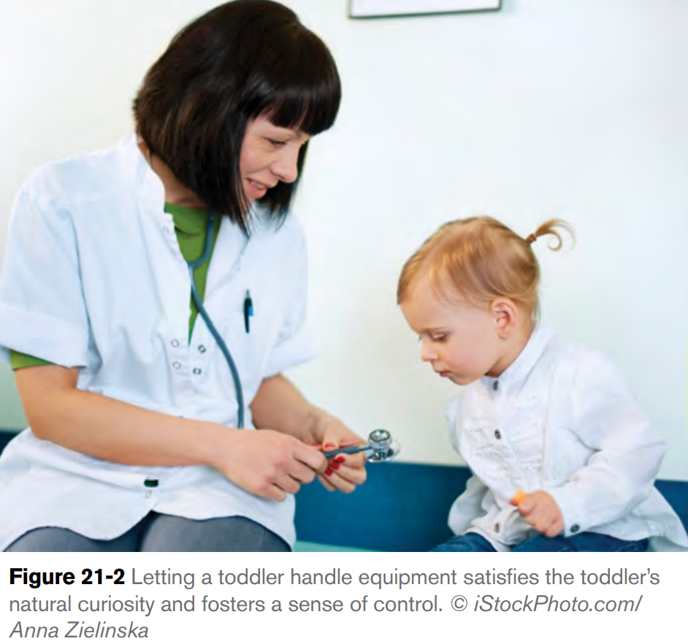
CONT…
Toddlers, although able to talk, have difficulty putting their feelings into words.
In addition, their ability to understand what is happening to them is limited. As a result, they may act out, have temper tantrums or regress to a previous level of functioning to cope.
You can help the toddler cope with the situation by spending time with the toddler and helping him understand what is happening.
Use the child’s natural sense of curiosity at this stage as an aid (Figure 21-2). For example, allow the child to handle or touch the stethoscope before taking vital signs.
The child can pretend to listen to his own heart or the heart of a doll. Or let the child put a bandage on the arm of a stuffed toy or doll before or after an invasive procedure.
Additionally, you can encourage the child to play with things that he routinely plays with when well.
For example, if the child enjoys miniature cars or has a favorite doll, have the parents bring the toy to the hospital with the child.
Not only does this bring the child pleasure, it also helps to promote some consistency, which helps the child to feel as if he has some control over the situation

Slide 32
Preschoolers :
Preschoolers are engaged in fantasy and creativity and have a view of the world as revolving around them.
Their level of understanding is better than that of a toddler. As a result, they can probably understand that they are sick.
However, they are usually unable to understand the cause of the illness or injury or the issues involved. They take information literally.
So, when talking with the child, use words that the child will understand and avoid words that sound alike, such as “die” and “dye,” or that have double meanings.
Think about the word “stool.” To you, it would probably imply a bowel movement. However, a preschooler would interpret “stool” to mean a small chair. In this case, use words that would be familiar to the child, such as “poop.” Find out from the child’s parents what words the child typically uses for routine activities such as going to the bathroom, eating lunch or going to bed.

Slide 33
CONT…
Preschoolers have a fear of body mutilation.
When caring for a child who will need invasive procedures, assist with preparing the child beforehand.
Keep the information simple, direct and honest, remembering that this age group interprets things literally.
Do not tell the child that the test or procedure will not hurt if it will.
Instead, let the child know what she might feel (for example, some pressure, a short pinch or tightness).
Work with the nurse on how to minimize the child’s risk for pain.
As with toddlers, encourage the preschooler to “play” with any materials or equipment that may be used.
When appropriate, allow the child to make simple decisions about her care, such as picking out an adhesive bandage to place over the site or choosing a special snack. Doing so promotes feelings of control.

Slide 34
CONT…
Children in this age group enjoy pretending.
Encourage the child to express her feelings through play with dolls, stuffed toys or puppets.
Preschoolers will often talk through puppets or dolls as a safe way to express their feelings.
Drawing or coloring is also helpful in encouraging the child to express her feelings.
Fear of the dark and nighttime are common fears in this age group.
Adhere to the child’s typical bedtime routine as much as possible.
Reading the child a story or offering the child a small snack may be helpful.
Keep a small night light on or dim the lights for sleep.
If the child is hospitalized, keep the room door slightly ajar to allow light from the hallway to enter, but close blinds or curtains on windows to prevent any strange reflections or sights.

Slide 35
School-age children:
School-age children are developing increased self confidence as they participate in the school environment and expand their skills and abilities.
In addition, their ability to understand information, reasons and explanations is growing.
They are expanding socially, both with friends and interests.
Illness, injury or hospitalization can limit this expansion.
When caring for school-age children, remember that they are gaining confidence in their abilities and like to be involved.
They have the mental ability to understand what is happening and are able to follow directions.
Talk with the child, using terms that he will understand. Answer the child’s questions honestly. Never make promises or statements that you cannot support.
If a child asks you a question for which you do not know the answer, be honest and tell the child that you do not know but that you will talk with the nurse and find out. Doing so will help to develop trust with the child and reduce fears of injury, pain and disability.

Slide 36
Role while take care school age children:
Encourage
Encourage the child to participate in his care.
Break down
Break down tasks into simple steps that the child can accomplish to promote feelings of confidence and control.
Allow
In addition, allow the child to make decisions about his care.
Encourage
For example, encourage the school-age child to choose what foods he wants to eat based on his specific diet.
Let
Let the child decide if he wants to get washed before or after breakfast.
Demonstrate
School-age children like to demonstrate their independence but may have difficulty if they need help with something that they previously were able to do by themselves. In these situations, allow the child to do as much as he can for himself.

Slide 37
CONT…
Focus
on the child’s ability to perform the task, rather than on the fact that he needed assistance.
For example
You can tell the child, “You really did well getting dressed this morning. We couldn’t have gotten your arm through the pajama sleeve without your help.”
Offer
praise and rewards for activities and tasks well done.
Encourage
Friends and peers are important to the school-age child, encourage the child to talk with his friends as often as possible and to have his friends visit.
Access
If access to the Internet is available, encourage social networking or visual websites, such as Skype, to maintain contact.
Meet
If the child is hospitalized, arrange for the child to meet other children of the same age.
Facilty
The facility’s activity room (often called a playroom) may be the optimal place for socializing with other children.
Privacy
As the school-age child nears the teenage years, privacy becomes an important issue. Respect the child’s privacy. Closing the curtain around his bed, closing the door and knocking before entering the bathroom are some common examples.

Slide 38
Adolescents:
Adolescents are striving for identity, questioning authority and feeling invincible.
They are struggling between wanting to be treated as adults while still having some fears about being completely independent.
Body image and how they are perceived by others are very important to them. As a result, adolescents can become very distressed by injury or disability, especially if the illness or injury causes a change in body image.
Additionally, they may feel embarrassed and self-conscious about their changing bodies, so make every effort to ensure their privacy.
. These feelings also may arise when adolescents need assistance with tasks such as bathing.
In some cases, they may be afraid or refuse to ask for help for fear of being viewed as a child.
They may try to act tough or respond with anger to hide these underlying feelings.
Your best action is to provide support and listen to the adolescent. Remain impartial. Allow the adolescent to voice his opinions. Doing so demonstrates that you value the adolescent as an individual.

Slide 39
CONT…
Loss of control is also a major problem for this age group as they work to establish independence.
Adolescents may attempt to test limits as they assert their independence.
Maintain a firm yet non-judgmental approach.
As adolescents mature, their level of understanding about abstract concepts improves. Therefore, explain the rules with the adolescent and reinforce those that are absolute.
Discuss behavioral issues with the nurse, and together with the adolescent, work together on finding a way to meet the adolescent’s needs while following necessary rules.
The adolescent age group places a high value on peer relationships (Figure 21-3). Illness, injury or hospitalization can isolate the adolescent from friends.
Use similar techniques as you would for a school-age child to promote social interaction and contact with peers.

Slide 40
Maintaining Safety and comfort:
Children are constantly growing and, as they become more mobile and agile, they become more vulnerable to injury.
Therefore safety of the child is extremely important.
Each age group faces different risks to safety.
Box 21-1 summarizes some of these risks and what you can do to ensure the child’s safety.

Slide 42
Promoting Play:
Play is often referred to as a “child’s work.” It provides the child with a mechanism for coping, learning and trying out new skills.
Unstructured play includes activities that the child routinely engages in to have fun, such as playing with blocks, stuffed animals, coloring books, videos, and board or video games.
With this type of play, the child is in control and the play acts as a diversion.
Remember to make sure that the play is appropriate for the child’s age and level of development.

Slide 43
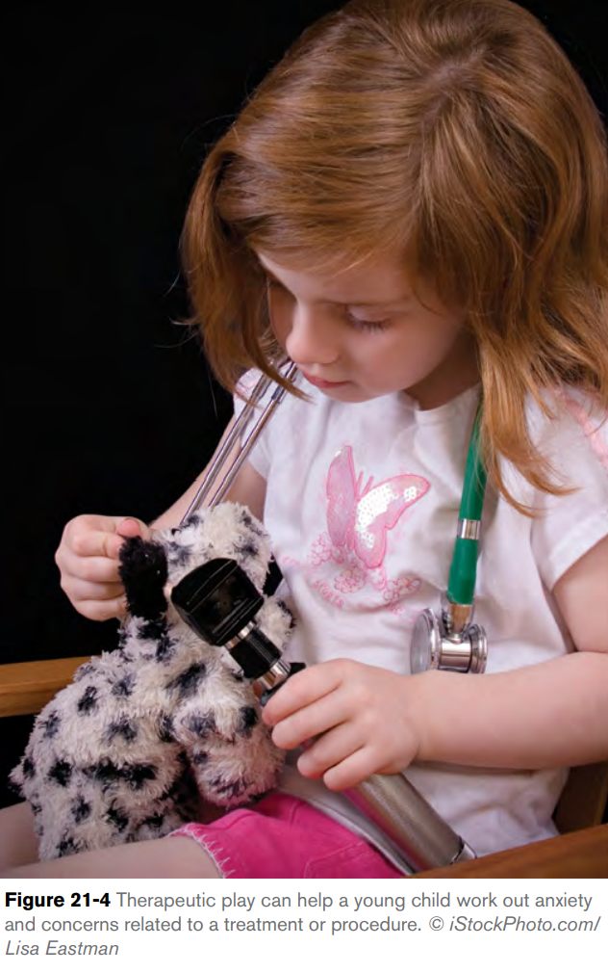
Therapeutic play:
Therapeutic play is goal-directed by another person.
Therapeutic play can help a young child work out anxiety and concerns related to a treatment or procedure.
Such as the nurse, to assist the child in coping with her illness, injury or hospitalization, it also provides the child with information to reduce the stress of the unknown.
For example, a child is scheduled to undergo an invasive procedure. The nurse uses a doll to explain the procedure to the child. The child then is encouraged to act out the procedure on the doll while the nurse watches (Figure 21-4).
As a nurse assistant, you can continue to reinforce what the child learned through the play experience and also encourage the child to continue to play out the procedure (with supervision).

Slide 44
CONT…
You can also incorporate play into tasks and activities you perform with the child. For example, you may ask a child who needs to improve his lung function to participate in a game of blowing cotton balls across a table.
You can set a goal distance that you want the child to reach. Each time the child blows, he can attempt to reach the spot. When he does, you can offer the child a reward.
A child with a broken leg can maintain upper body strength by tossing a soft sponge ball back and forth with you.
Without realizing it, the child is exercising his arm muscles. In addition, such activity helps to divert the child’s attention away from his condition.

Slide 45
Assisting Family Members:
Having an ill, injured or hospitalized child can create a crisis situation for the family.
All members of the family are affected, as are their roles and routines.
As a nurse assistant, you can help the family by being an active listener. Allow the parents and siblings to talk about how they are feeling. Sometimes just allowing a person to talk helps to promote positive steps to coping.
Be honest with the family. If they ask you a question who you do not know the answer to, explain that you do not know but will do your best to find out.
Encourage active participation in the child’s care.
Emphasize to the parents that they are the ones who know their child the best.
Ask them to share with you any specifics about the child’s likes or dislikes so that you can provide the child with the best possible care. Parents will most likely feel more in control when sharing this information

Slide 46
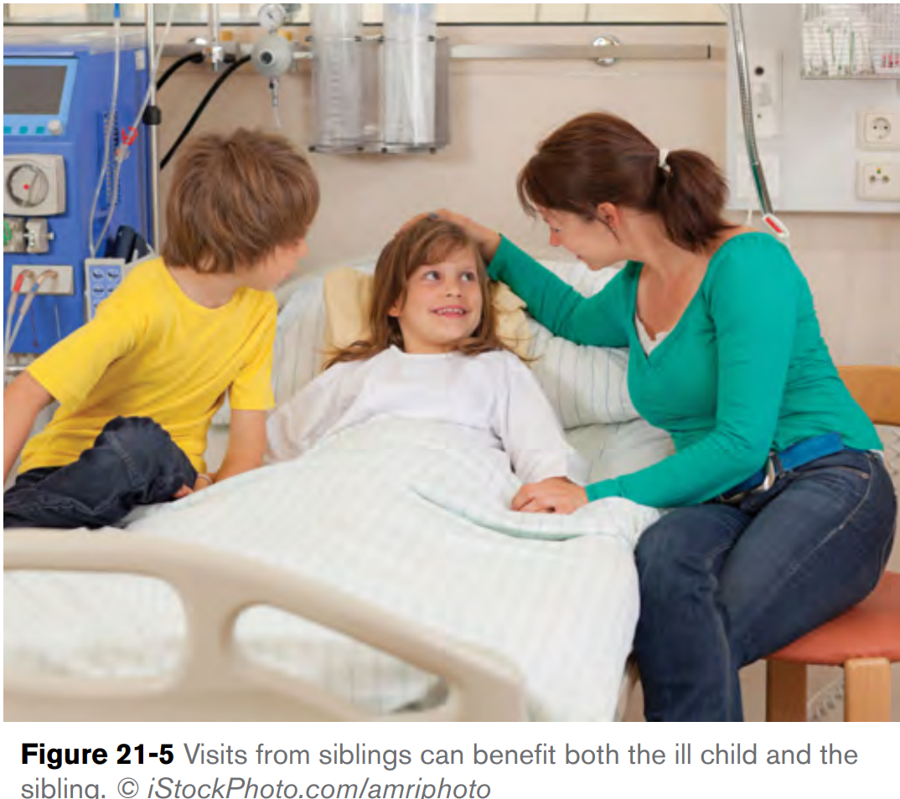
CONT…
Encourage siblings, too, to talk about how they are feeling and what effect the child’s condition is having on them.
Also encourage frequent visitation, if appropriate (Figure 21-5).
Visiting can help correct misunderstandings about the severity of the child’s condition and the cause.
However, remember to respect a sibling’s wishes and feelings if he does not want to visit.
Talk with the nurse about what you observe with the family. It may be necessary to have the family speak with a social worker or counselor or be referred to a support group.

Slide 47
References:
American Red Cross (2013). American Red Cross Nurse Assistant Training Textbook: Third Edition.United States of America: Krames Stay Well Strategic Partnerships Division. ISBN: 978-1584805823,

Slide 48
Any Questions ?

Slide 49
Thank you !

