Slide 1

MODULE 3
POST FALL , SHARPS SAFETY & EFFECTIVE COMMUNICATION
MADA ALSEDRAH
BSN.MSN,RN

Slide 2
OUTLINE:
Post fall intervention & management strategies
Sharps safety & safe injection practices
Improving effective communication among health care workers

Slide 3
Post fall intervention & management strategies

Slide 4

FALL
*Unintentionally coming to rest on the ground, floor, or other lower level.
هذه الصورة بواسطة كاتب غير معروف مرخصة بالاسم CC BY-SA

Slide 5
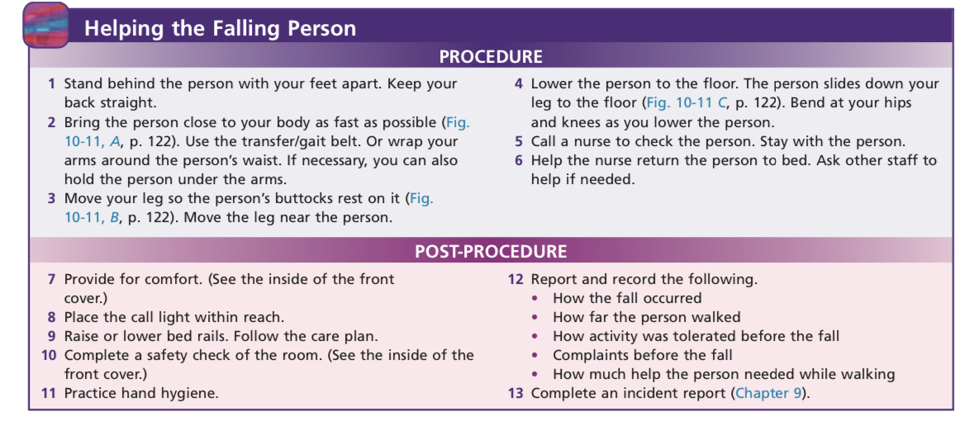
Strategies

Slide 6
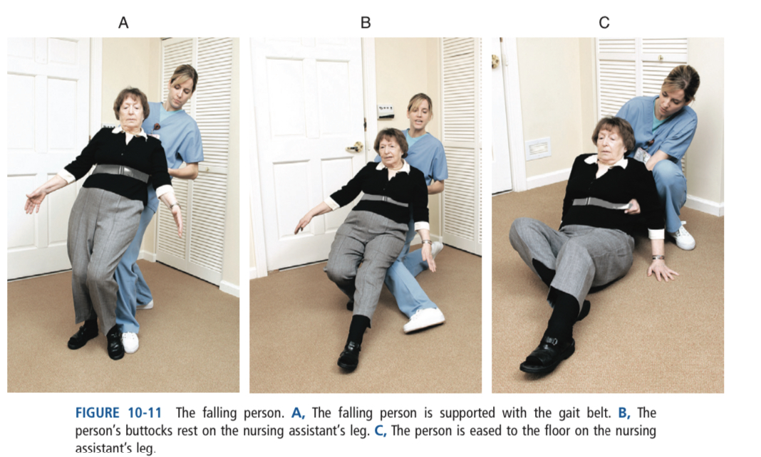

Slide 7
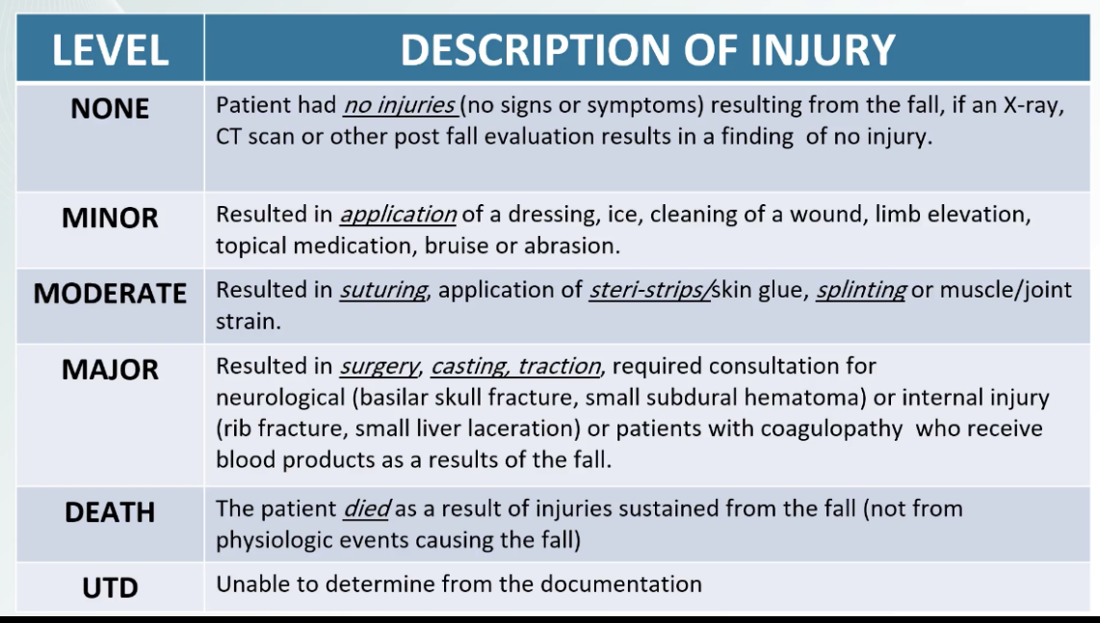

Slide 8
Sharps safety & safe injection practices

Slide 9

Sharps
Are medical devices like needles, scalpels, and other tools that cut or go into the skin.

Slide 10
Guidelines when you work with sharps.
Do not uncover or unwrap the sharp object until it is time to use it.
Keep the object pointed away from yourself and other people at all times.
Never recap or bend a sharp object.
Keep your fingers away from the tip of the object.
If the object is reusable, put it in a secure, closed container after you use it.
Never hand a sharp object to someone else or put it on a tray for another person to pick up.
Tell the people you are working with when you plan to set the object down or pick it up.

Slide 11
Sharps Disposal
Make sure the disposal container is made for disposing of sharp objects. Replace containers when they are two-thirds full.
Other important tips include:
Never put your fingers into the sharps container.
If the needle has tubing attached to it, hold the needle and the tubing when you put it in the sharps container.
Sharps containers should be at eye level and within your reach.
If a needle is sticking out of the container, do not push it in with your hands. Call to have the container removed. Or, a trained person may use tongs to push the needle back into the container.
If you find an uncovered sharp object outside of a disposal container, it is safe to pick it up only if you can grasp the non-sharp end. If you cannot, use tongs to pick it up and dispose of it.

Slide 12
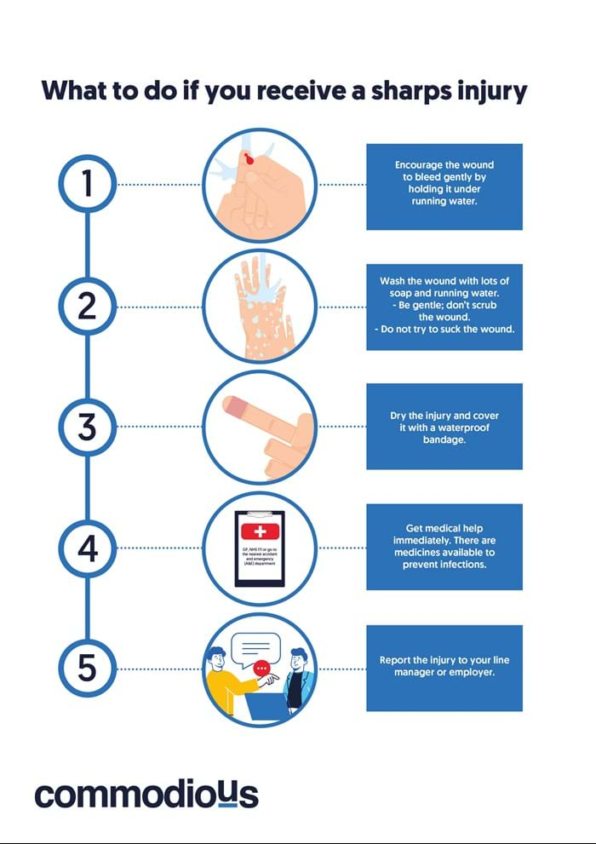

Slide 13
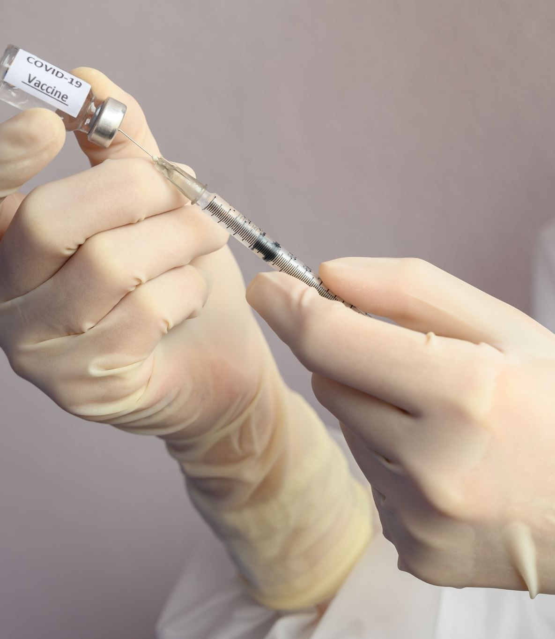
Safe Injection Practices
Safe injection practices are intended to prevent transmission of infectious diseases between one patient and another .

Slide 14
▪ Choosing the correct vial of medication
▪ Checking the name on the medication vial against the written order to verify the correct medication is given to the correct patient
▪ Checking the expiration date on the vial of medication
▪ Preparing injections only when they are ready to be administered
▪ Examining the vial for contamination including discoloration, particulates and if necessary, ability to be re-suspended
▪ Removing the dust cover off the vial and cleansing the rubber stopper with a new single sterile pre-packaged alcohol pad that is at least 60% alcohol
▪ Using one new, sterile, individually wrapped needle and syringe one time for one patient
▪ Performing hand hygiene before and after preparing and administering an injection even if wearing gloves for the procedure
▪ Discarding the needle and syringe immediately after use in designated container
▪ Discarding a single dose vial after withdrawing one dose from the vial, even if there is some fluid left in the vial

Slide 15
Improving effective communication among health care workers

Slide 16
Communication is the process of giving and receiving information.
Good communication skills are essential to providing quality care.
As a nurse assistant, you must be able to communicate effectively with those in your care, as well as other members of the health care team.

Slide 17
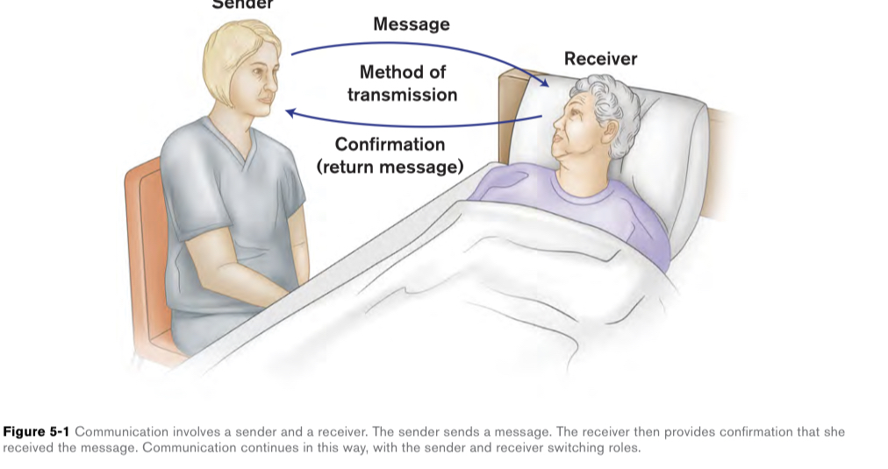
Communication Model

Slide 18
Communication Methods
People express themselves both verbally and nonverbally.

Slide 19
Strategies for Effective Communication
Make sure your message is clear.
Provide and seek confirmation.
Be an active participant in the conversation.
Be mindful of the nonverbal messages you are sending.
Remember the importance of touch.

Slide 20
References
Centers for Disease Control and Prevention website. Sharps safety for healthcare settings. www.cdc.gov/sharpssafety/index.html. Updated February 11, 2015. Accessed October 20, 2023.
Injection Safety Best Practices (state.mn.us)
Sorrentino, S. A., Remmert, L., & Wilk, L. S. (2020). Mosby's Textbook for Nursing Assistants (10th ed.). St. Louis, MO: Elsevier.)
American Red Cross (2013). American Red Cross Nurse Assistant Training Textbook: Third Edition.United States of America: Krames Stay Well Strategic Partnerships Division. ISBN: 978-1584805823,

Slide 21

ANY Questions?

Slide 22
THANK YOU

