Slide 1



Standard precautions
Mada alsedrah
BSN.MSN,RN.

Slide 2
Objectives :
Define of key terms
Discuses hand hygiene and hand rub
Explain use of personal protective equipment (PPE)
Understand Respiratory hygiene

Slide 3
Hand Washing\hand hygiene
Washing the hands is the most important thing we can do to control the spread of microbes.
We should wash our hands whenever they are visibly soiled with dirt or body fluids, and at specific times throughout the day.
If the hands are not visibly soiled with dirt or body fluids, we may use an alcohol-based hand rub to decontaminate your hands instead of washing with soap and water.

Slide 4
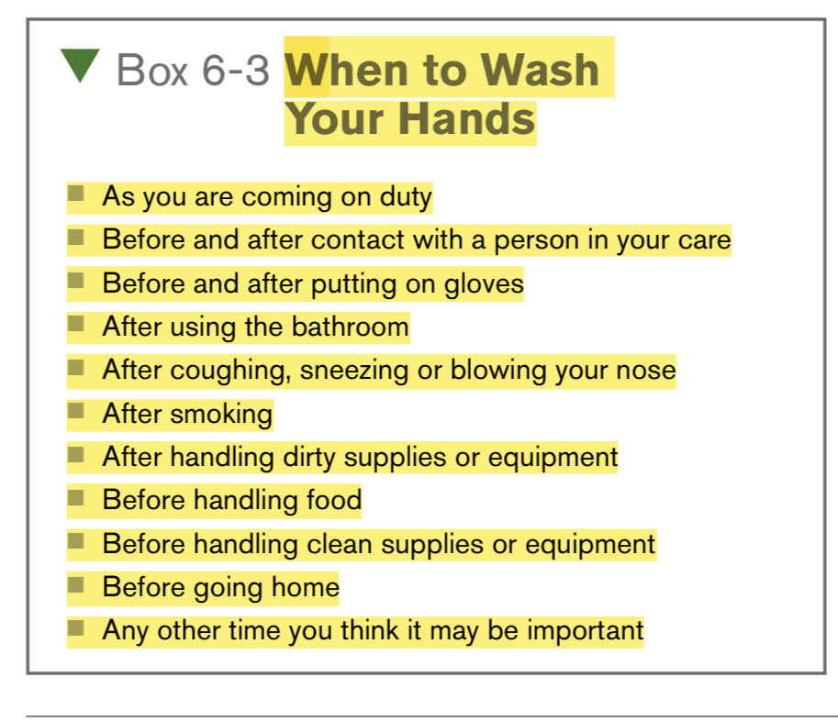

Slide 5
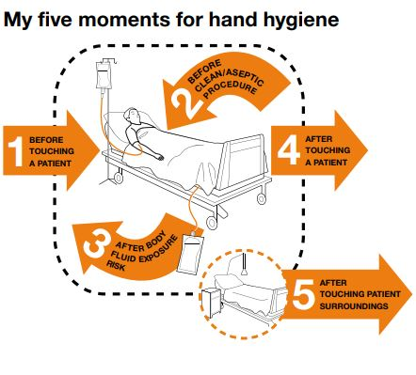

Slide 6
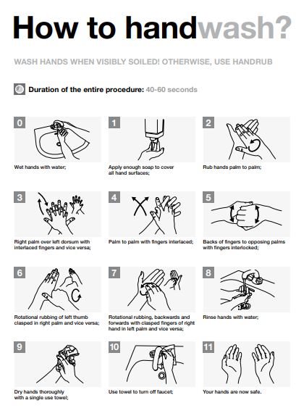

Slide 7
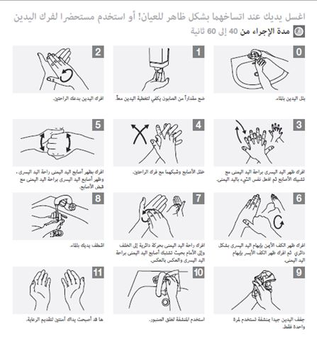

Slide 8
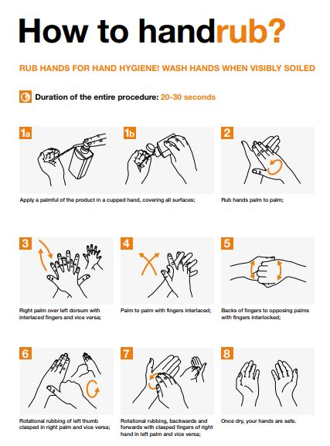

Slide 9
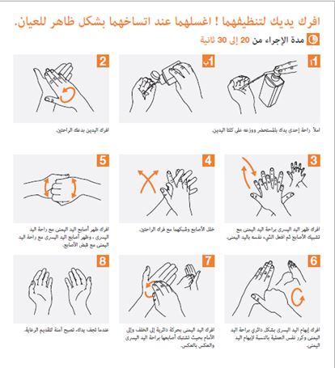

Slide 10

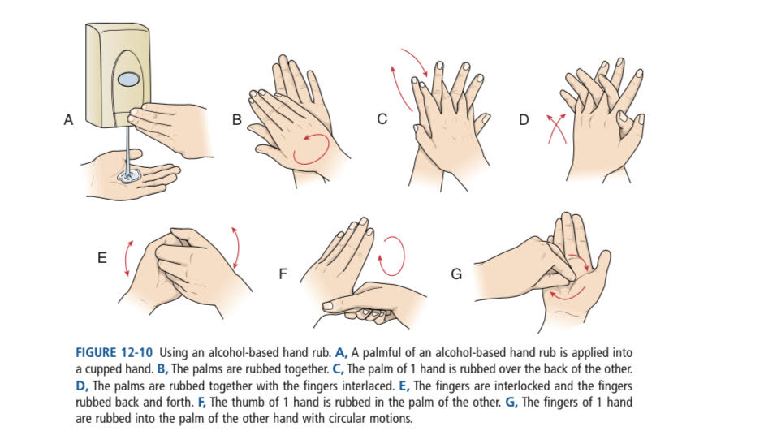

Slide 11
Keeping Objects and Surfaces
Clean
An unused item is considered to be clean until it comes in contact with a person or his environment. It is then considered dirty and cannot be reused for another person. In a hospital or nursing home, clean, unused supplies (such as linens and dressings) are stored in the clean utility room. Used supplies that must be cleaned or laundered are returned to the dirty utility room.
When it is necessary to destroy all of the microbes on an object or surface, sterilization is used.

Slide 12

Using Personal Protective
Equipment
Personal protective equipment (PPE) is used to prevent microbes from contaminating the uniform, skin or mucous membranes. Properly using PPE eliminates a portal of entry for potential pathogens and helps to keep you safe from infection. PPE includes gloves, gowns, masks and eyewear.

Slide 13
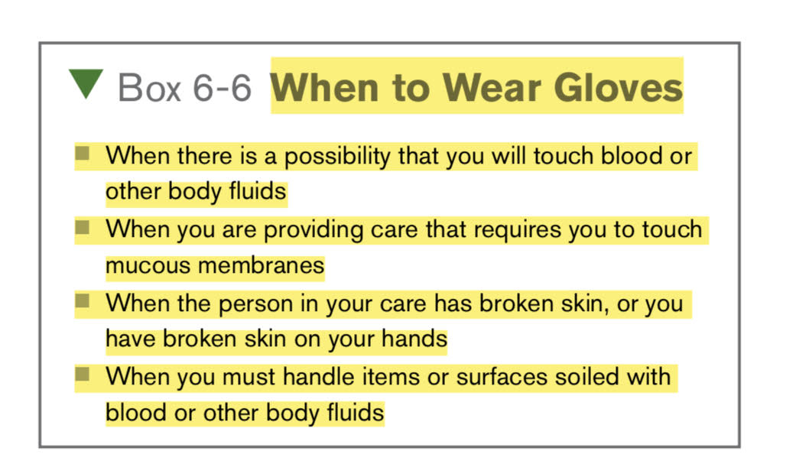
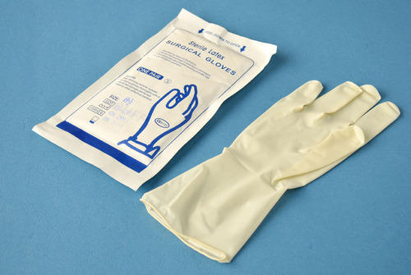
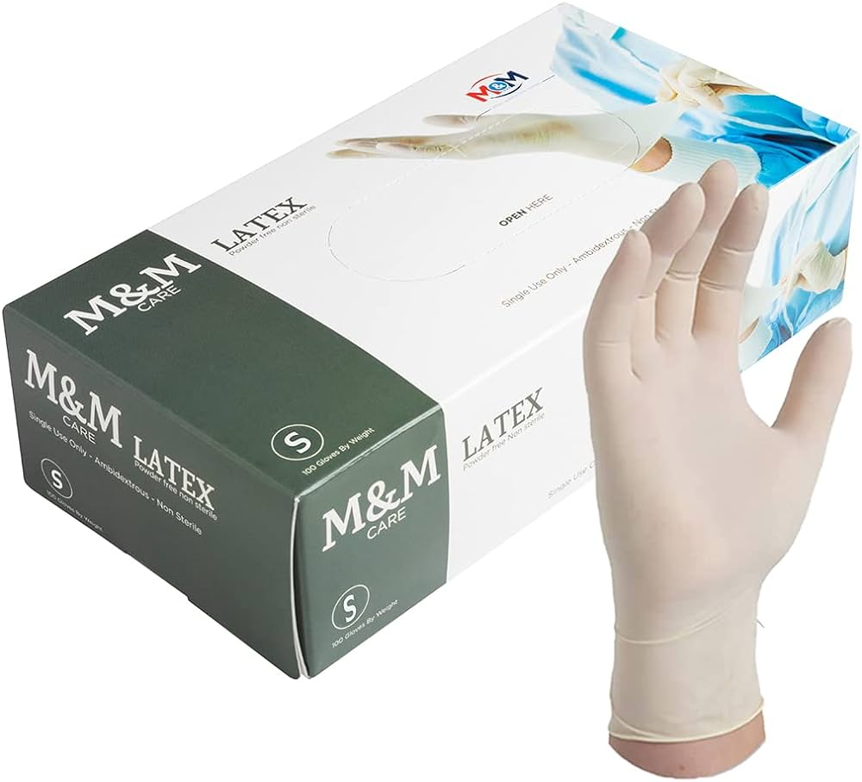

Slide 14
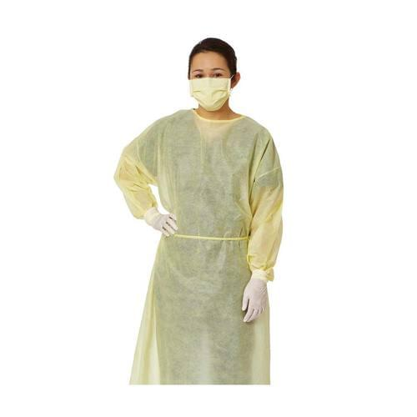
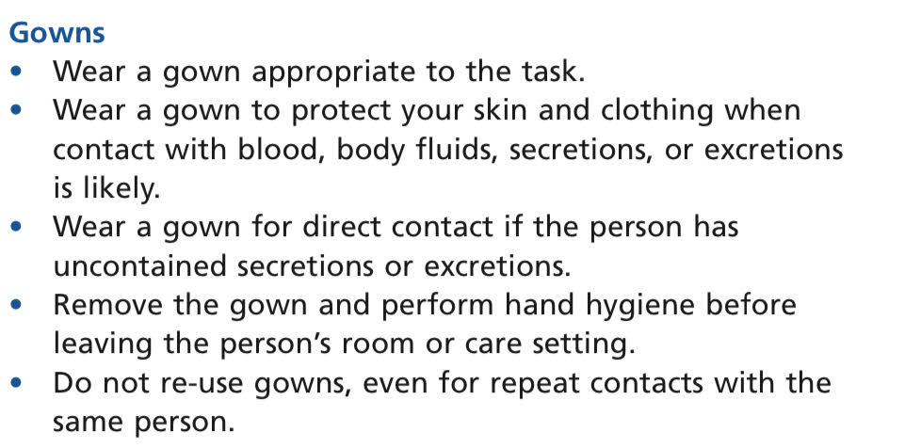
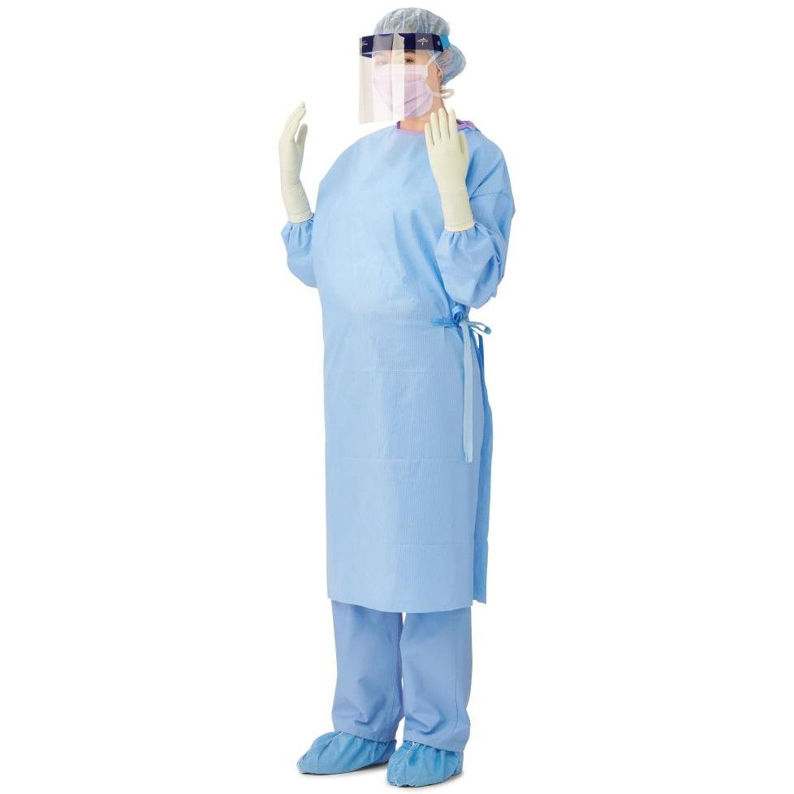

Slide 15
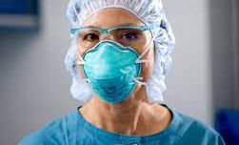

Masks
A mask covers your nose and mouth to protect you from inhaling pathogens into your lungs. You may also wear a mask when it is important to protect the person from pathogens you may exhale. The mask should fit .Use a mask only once.
There are two types of masks you may use. A surgical
(face) mask is most commonly used and high-efficiency particulate air filter (HEPA) mask .

Slide 16
Protective eyewear\eye shield
Wear protective eyewear, such as goggles or a face shield, to keep body fluids from splashing into your eyes when cleaning items or disposing of fluids. Protective eyewear may be reusable or disposable.

Slide 17
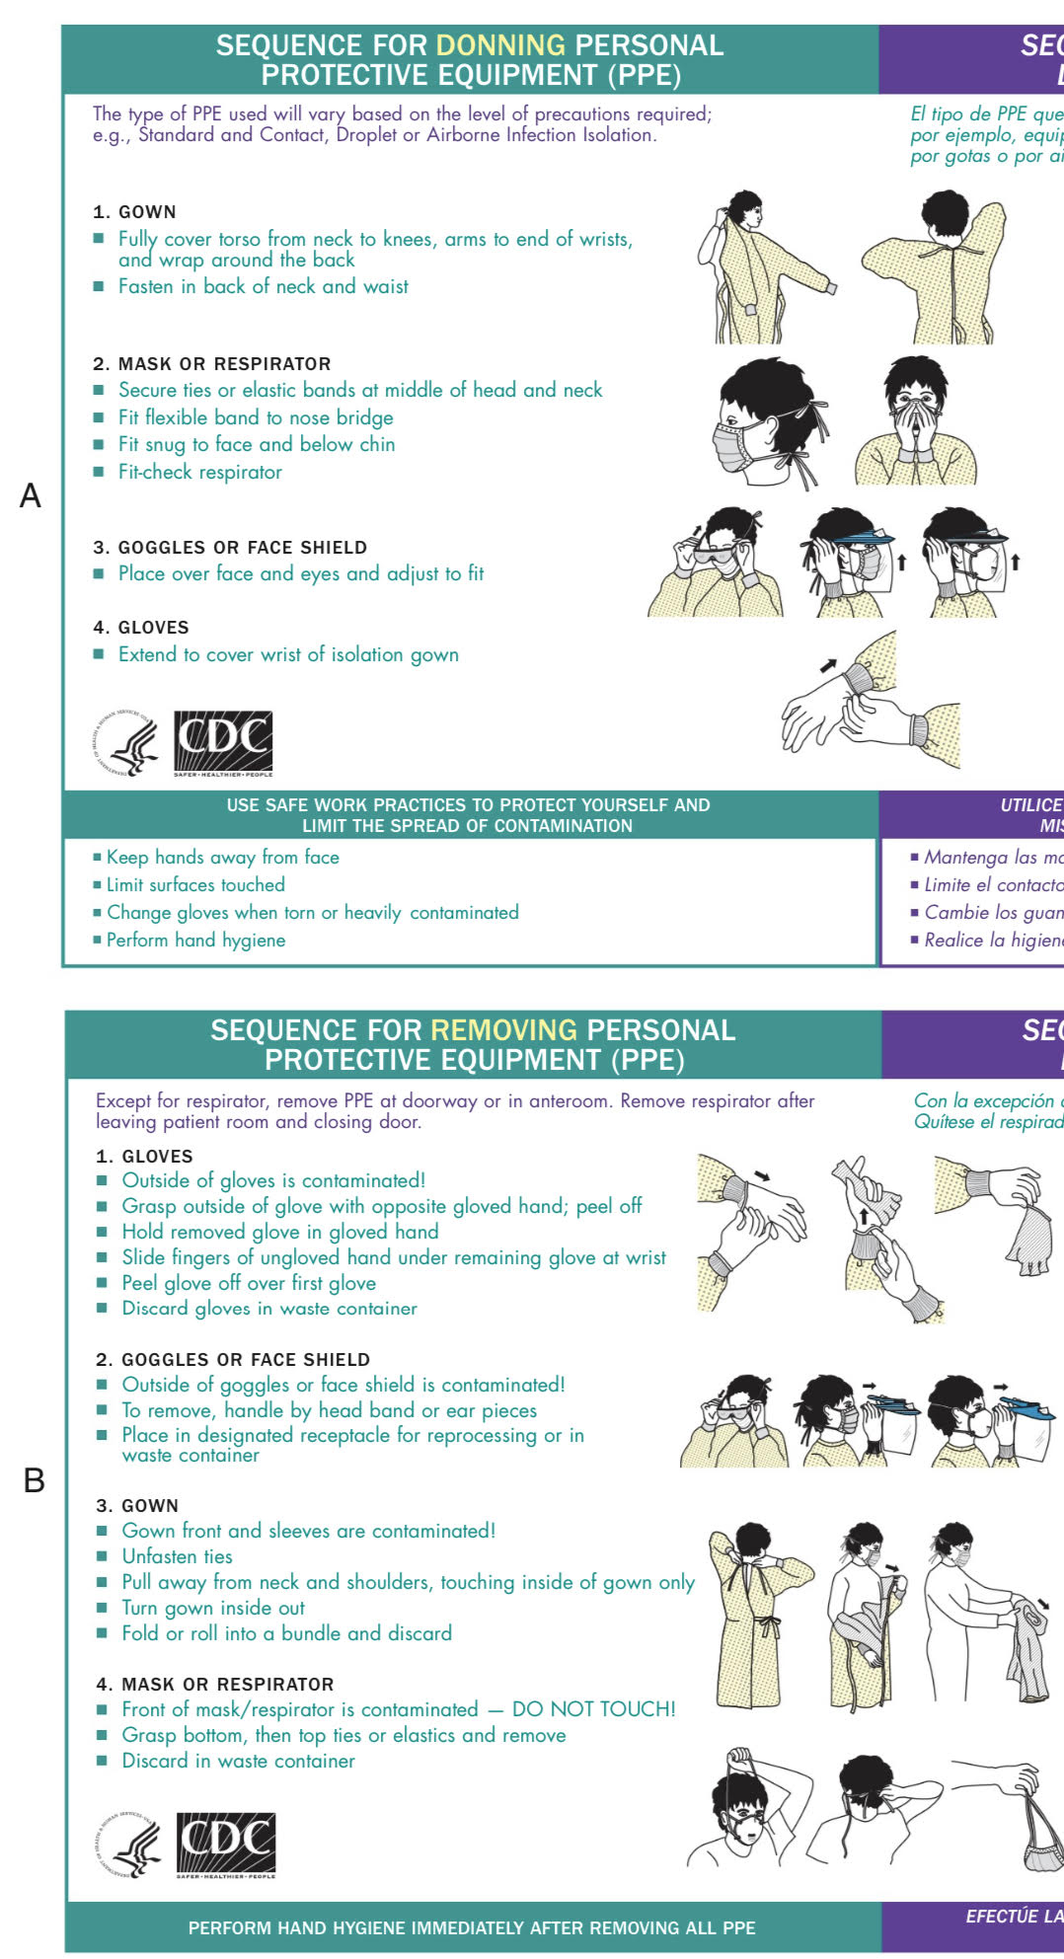

Slide 19
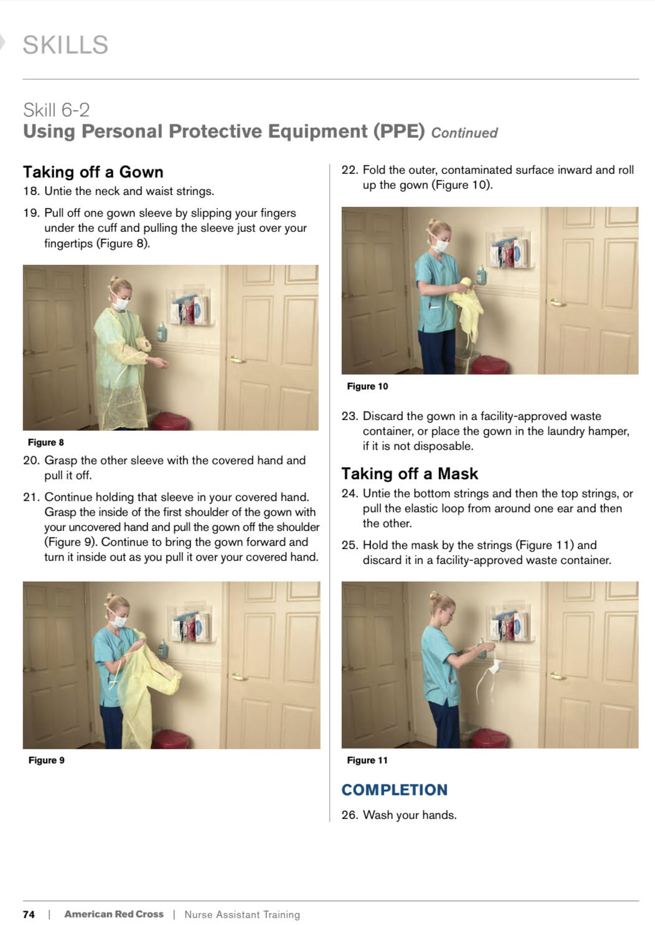

Slide 20
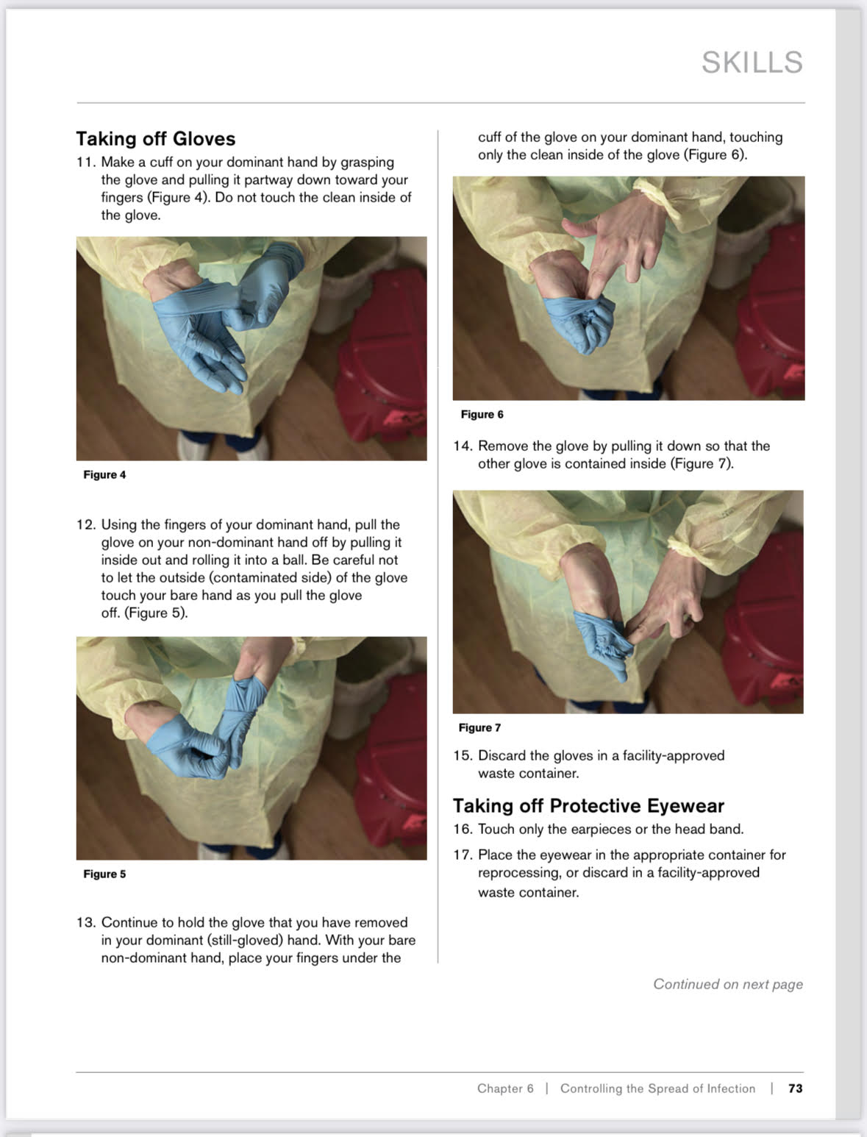

Slide 21
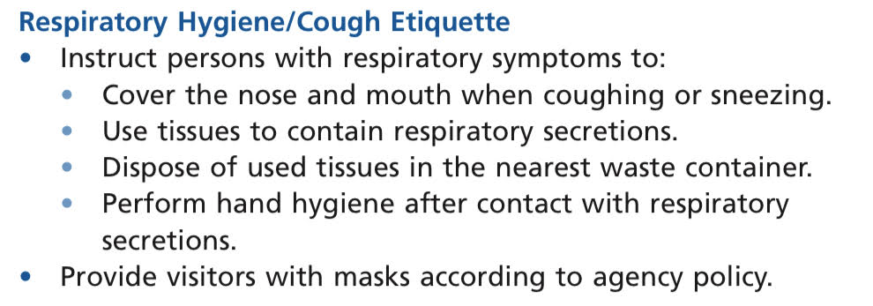

*Cover your nose and mouth when coughing, sneezing or blowing your nose. If without tissues, cough or sneeze into your upper arm . Do not cough or sneeze into your hands.

Slide 22
VIDEO
Basic Infection Control Skills License BICSL – YouTube

Slide 23

And questions ?

Slide 24
References :
1. Sorrentino, S. A., Remmert, L., & Wilk, L. S. (2020). Mosby's Textbook for Nursing Assistants (10th ed.). St. Louis, MO: Elsevier.)
2. American Red Cross (2013). American Red Cross Nurse Assistant Training Textbook: Third Edition.United States of America: Krames Stay Well Strategic Partnerships Division. ISBN: 978-1584805823,

Slide 25
Thank you

