Slide 1
Module 3: Promoting Safety in Health Care Settings
IPSG
MADA ALSEDRAH
BSN.MSN,RN

Slide 2
OBJECTIVES:
DEFINE SAFETY
EXPLAIN OF IPSG
IDENTIFI PATIENT POPLATIONS AT RISK OF SAFETY HAZARDS
DISCUSES PROTECTING VULNERABLE PATIENTS FROM SAFETY HAZARDS
RECOGNIZE CORRECT PATIENT’S IDENTIFICATION

Slide 3
INTRODUCTION
Safety is a basic need. Patients and residents are at great
risk for accidents and falls. Some accidents and injuries cause death.
We must protect patients, residents, visitors, co-workers,
and ourself. The safety measures apply to all health care settings and everyday life.
The goal is to decrease the person’s risk of accidents and
injuries without limiting mobility and independence.

Slide 4
International patient safety goals (IPSG)
IPSGs help accredited organizations address specific areas of concerns in some of the most problematic areas of patient safety .
Patient safety was defined by the IOM
(Institute of Medicine) as
“THE PREVENTION OF HARM TO PATIENTS.”

Slide 5
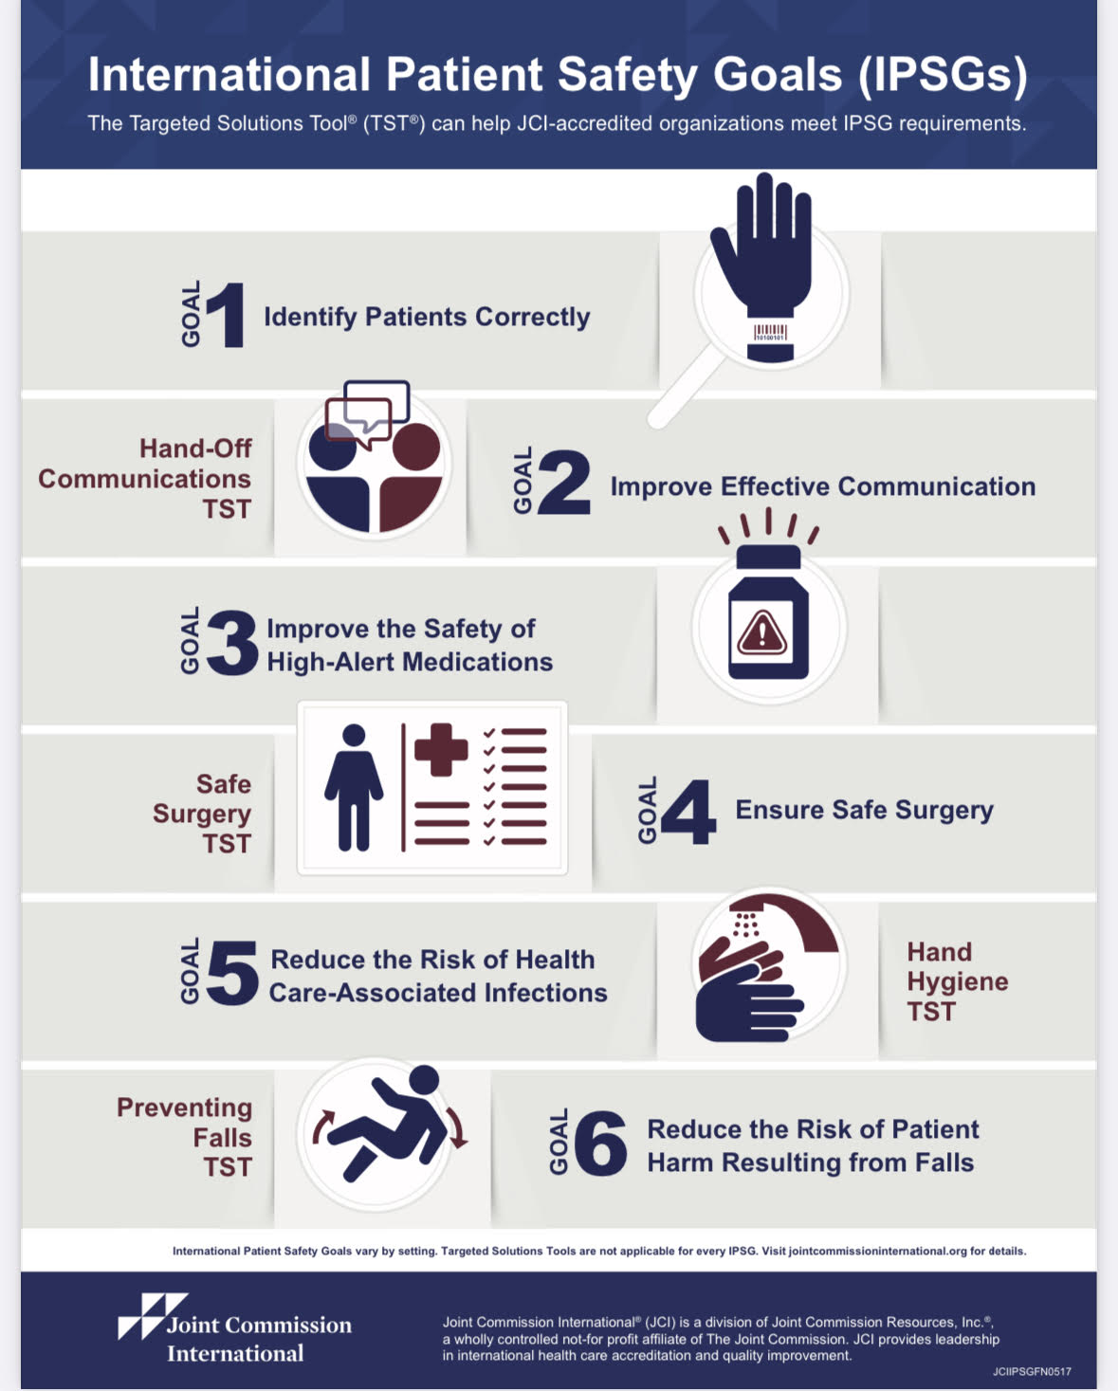

Slide 6
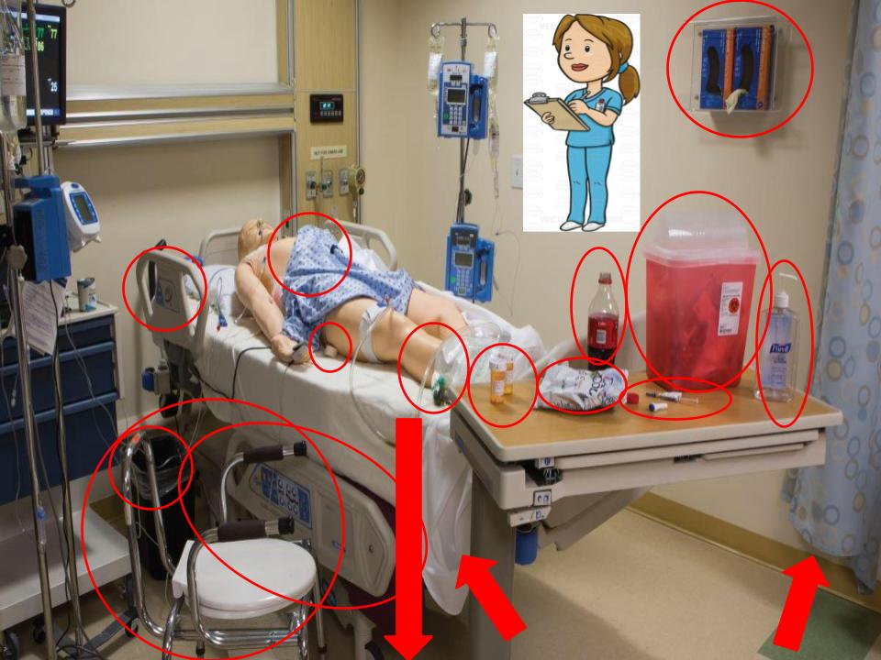
PATIENT POPLATIONS AT RISK OF SAFETY HAZARDS
A hazard is something that could cause injury or illness. Examples include spills, loose handrails, unanswered call lights, burnt-out bulbs, and unsafe equipment.

Slide 7
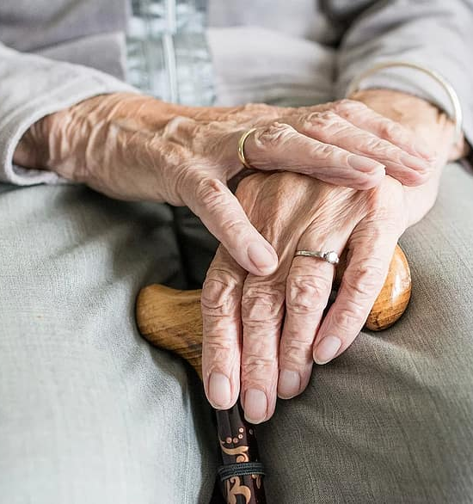
ACCIDENT RISK FACTORS:
-Age: Body changes occur with aging. Many older persons have decreased strength, move slowly, and are unsteady. Often balance is affected. Older persons also are less sensitive to heat and cold. They have poor vision, hearing problems, and a dulled sense of smell. Confusion, poor judgment, memory problems, and disorientation may occur .Children are also at risk for injuries.

Slide 8
Cont…
-Awareness of surroundings: Coma is a state of being unaware of one’s setting and being unable to react or respond to people, places, or things. The person relies on others for protection. Confused and disoriented persons may not understand what is happening to and around them.
-Agitated and aggressive behaviors: Pain can cause these behaviors. So can confusion, decreased awareness of surroundings, and fear of what may happen.

Slide 9
Cont…
-Vision loss: Persons with poor vision may not see toys, rugs, equipment, furniture, and cords. Some cannot read labels on containers. Poisoning can result.
-Hearing loss: Persons with hearing loss have problems hearing explanations and instructions. They may not hear warning signals or fire alarms. Some cannot hear approaching meal carts, drug carts, stretchers, or people in wheelchairs. They do not know to move to safety.
-Impaired smell and touch :Illness and aging affect smell and touch. The person may not detect smoke or gas odors. Burns are a risk from impaired touch. The person has problems sensing heat and cold. Some people have a decreased sense of pain. They may be unaware of injury.

Slide 10
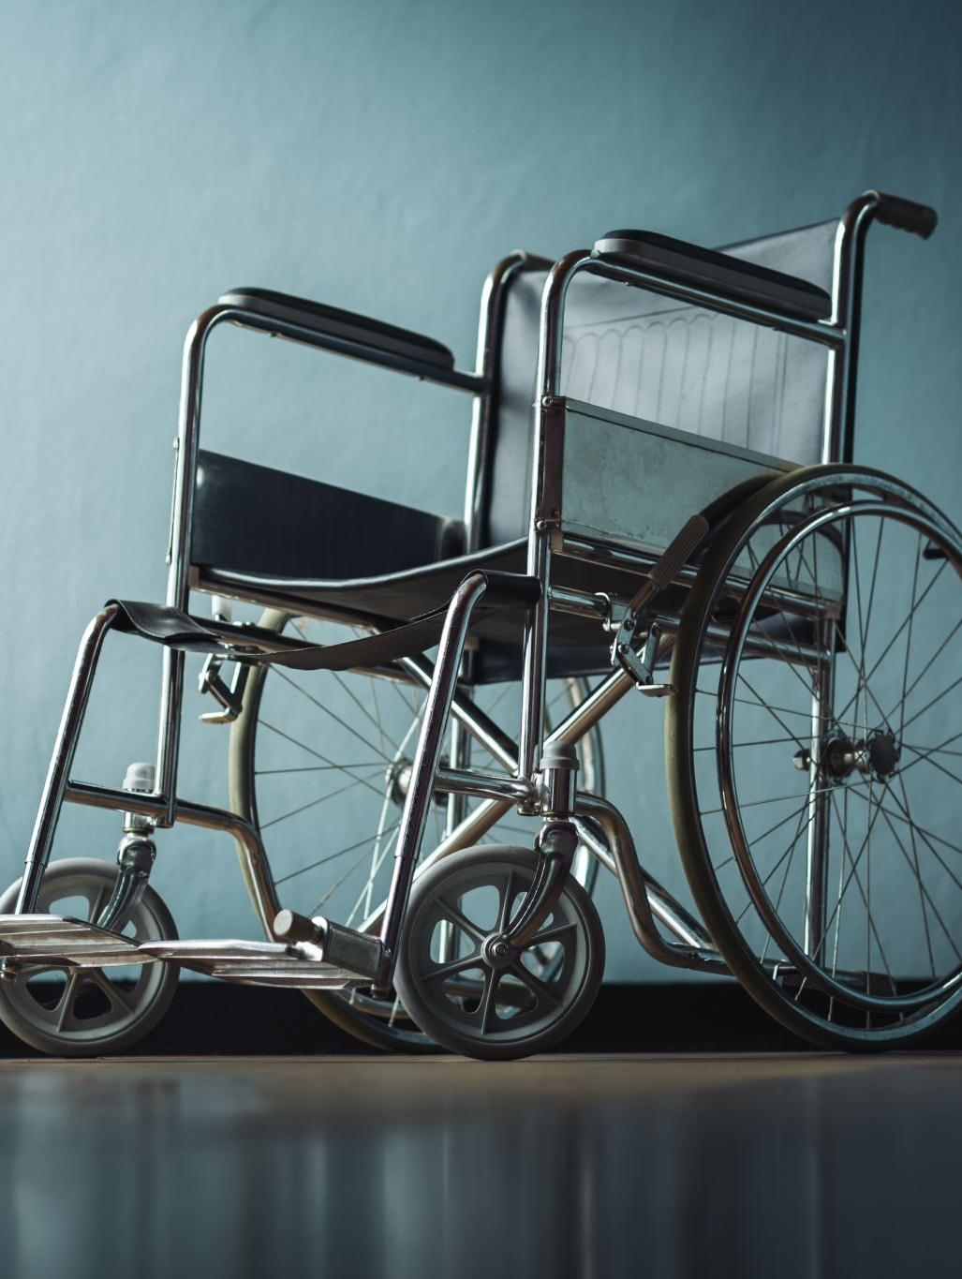
Cont…
-Impaired mobility: Some diseases and injuries affect mobility. A person may know there is danger but cannot move to safety. Some persons cannot walk or propel wheelchairs. Some persons are paralyzed. Paralysis means loss of muscle function, sensation, or both.
-Drugs: Drug side effects may include loss of balance, drowsiness, and lack of coordination. Reduced awareness, confusion, and disorientation occur.

Slide 11
PROTECTING VULNERABLE PATIENTS FROM SAFETY HAZARDS

Slide 14
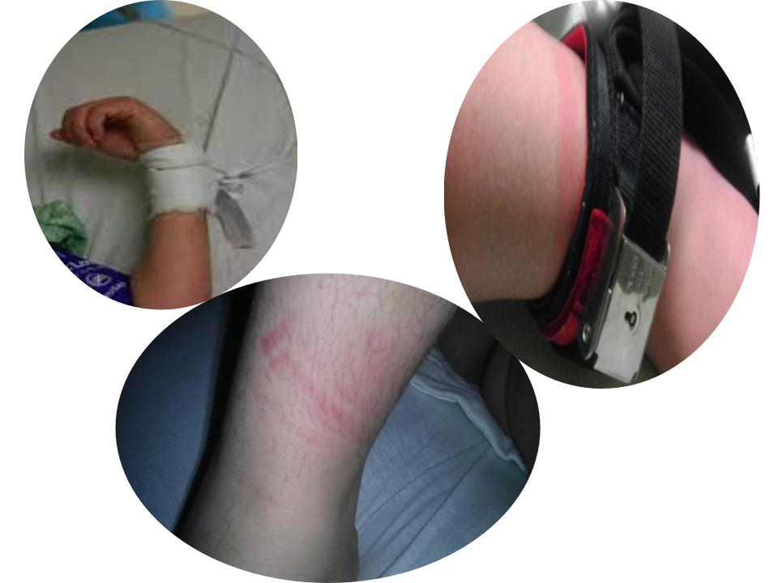

Slide 16
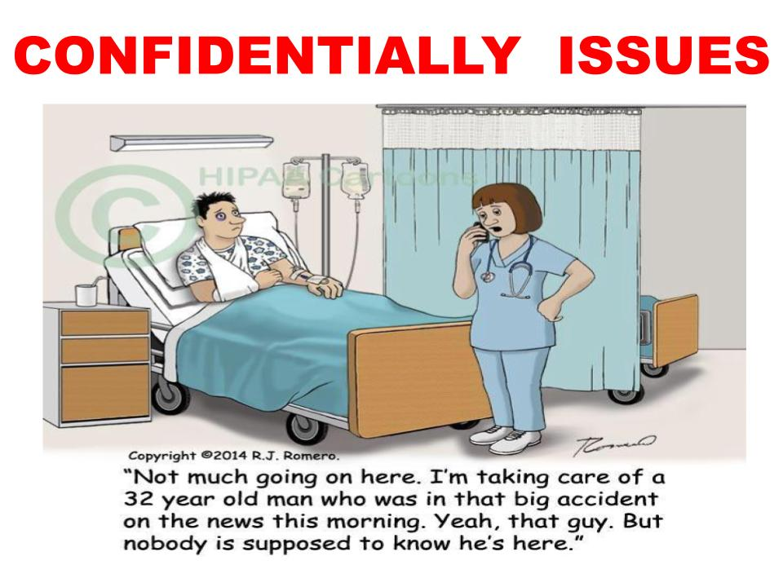

Slide 17
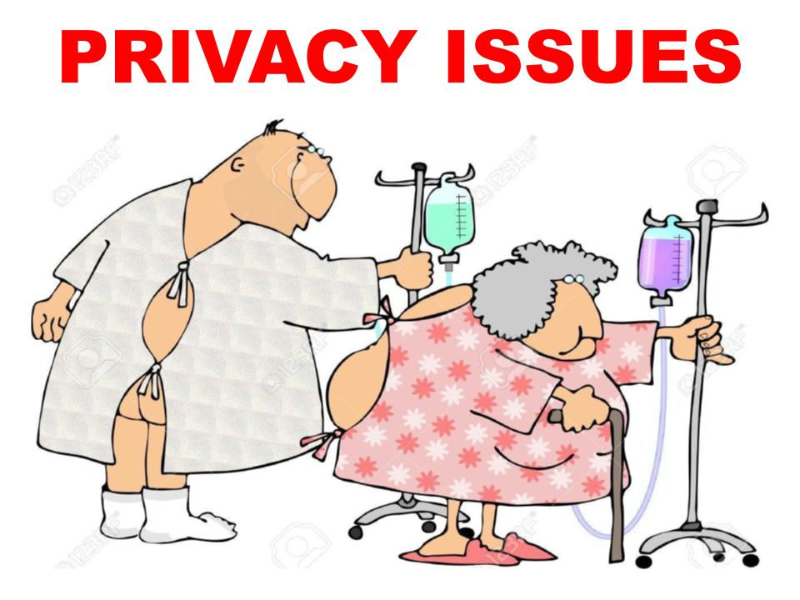

Slide 19
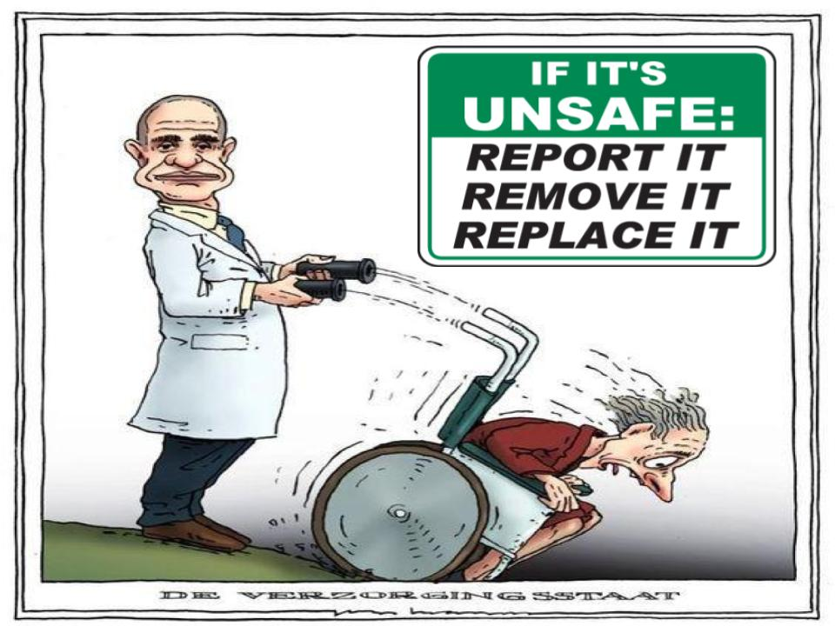

Slide 20
IPSG 1- Identify patients correctly
Each person has different treatments, therapies, and activity limits. Life and health are threatened if the wrong care is given.
The person may receive an identification (ID) bracelet when admitted to the agency (The bracelet has the person’s name, room and bed number, birth date, age, doctor, and other identifying information.

Slide 21
CONT…

Slide 22
Cont…
Always follow agency policy.
Call the person by name when checking the ID bracelet. This is a courtesy given as you touch the person and before giving care. Just calling the person by name is not enough to identify him or her. Confused, disoriented, drowsy, hard-of-hearing, or distracted persons may answer to any name.
Patients are identified using two identifiers (Patient Full Name and Medical Record Number)

Slide 34
References :
1. Sorrentino, S. A., Remmert, L., & Wilk, L. S.(2020). Mosby's Textbook for Nursing Assistants (10th ed.). St. Louis, MO: Elsevier.)
https://www.jointcommissioninternational.org/standards/international-patient-safety-goals/
KFSH-B POLICY & PROCEDURES

Slide 35
ANY QUESTIONS ?

Slide 36
THANK YOU

