Slide 1
Respiratory system and common disorders
Module 5, special care situations
Prepared by:
Ms. Jamilah Allehaib
BSN, RN

Slide 2
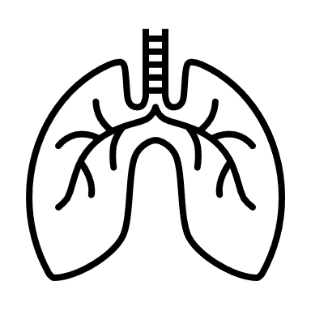
Learning Objectives:
Review the respiratory body system structure and function.
Mention Respiratory disorders.
Describe chronic obstructive pulmonary disease (COPD) sign and symptoms and plan of care .
Explain Asthma sign and symptoms and measure care.
Mention Sleep Apnea
Explain pneumonia sign and symptoms and measure care.

Slide 3
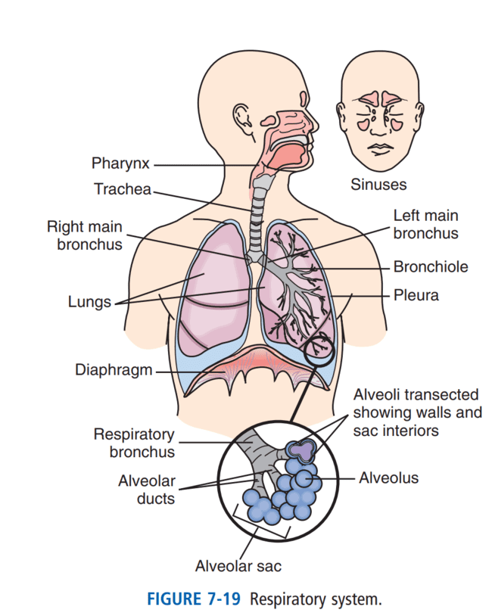
Respiratory system:
Oxygen is needed to live, every cell needs oxygen.
Air contains about 21% oxygen. This meets the body’s needs under normal conditions.
The respiratory system (Fig. 7-19) brings oxygen into the lungs and removes carbon dioxide.
Respiration: is the process of supplying the cells with oxygen and removing carbon dioxide from them.
Respiration involves inhalation (breathing in) and exhalation (breathing out).
The terms inspiration (breathing in) and expiration (breathing out) also are used.

Slide 4
Process of Respiration:
Air enters the body through the nose.
The air then passes into the pharynx (throat). It is a tube-shaped passageway for air and food.
Air passes from the pharynx into the larynx (voice box). A piece of cartilage, the epiglottis, acts like a lid over the larynx.
The epiglottis prevents food from entering the airway during swallowing.
During inhalation the epiglottis lifts up to let air pass over the larynx. Air passes from the larynx into the trachea (windpipe).
The trachea divides at its lower end into the right bronchus and the left bronchus.
Each bronchus enters a lung.
Upon entering the lungs, the bronchi divide many times into smaller branches called bronchioles.
Eventually the bronchioles subdivide. They end up in tiny one-celled air sacs called alveoli.
Plied by capillaries. Oxygen and carbon dioxide are exchanged between the alveoli and capillaries.
Blood in the capillaries picks up oxygen from the alveoli.
Then the blood is returned to the left side of the heart and pumped to the rest of the body. Alveoli pick up carbon dioxide from the capillaries for exhalation.

Slide 5
Structure of the lungs:
The lungs are spongy tissues.
They are filled with alveoli, blood vessels, and nerves.
Each lung is divided into lobes.
The right lung has 3 lobes; the left lung has 2.
The lungs are separated from the abdominal cavity by a muscle called the diaphragm.
Each lung is covered by a 2-layered sac called the pleura.
One layer is attached to the lung and the other to the chest wall.
The pleura secretes a very thin fluid that fills the space between the layers.
The fluid prevents the layers from rubbing together during inhalation and exhalation
A bony framework made up of the ribs, sternum, and vertebrae protects the lungs.

Slide 6
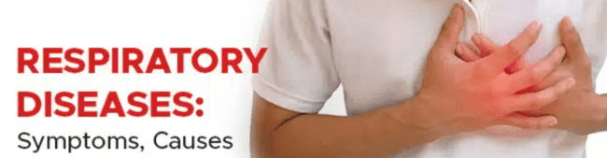
Respiratory System Disorders:
The respiratory system supplies the body with oxygen and rids the body of carbon dioxide.
The respiratory system brings O2 into the lungs and removes carbon dioxide (CO2) from the body.
Respiratory disorders interfere with this function and threaten life.
Disorders interfere with O2 and CO2 exchange in the lungs. They obstruct air flow. Less air gets into the lungs; less air leaves the lungs. Lung function is gradually lost.
Disorders of the respiratory system include influenza (flu), pneumonia, chronic obstructive pulmonary disease (COPD) and asthma.

Slide 7
Chronic Obstructive Pulmonary Disease (COPD):
Chronic obstructive pulmonary disease (COPD): is a term used to describe lung disorders that make it difficult for air to enter or leave the lungs.
There are different forms of COPD;
One form occurs when alveoli (tiny air sacs where gas exchange takes place in the lungs) are damaged.
The alveoli break and lose their ability to expand with air.
As a result, air gets trapped in the lungs.
Another form occurs when the airways are constantly inflamed and irritated (for example, by cigarette smoke).
The irritation and inflammation cause the airways to produce excessive mucus, which clogs them and makes it difficult for air to pass through.

Slide 8
Chronic Obstructive Pulmonary Disease (COPD):
Chronic obstructive pulmonary disease (COPD): involves 2 disorders—chronic bronchitis and emphysema.
Chronic Bronchitis: Chronic bronchitis occurs after repeated episodes of bronchitis.
Bronchitis means inflammation (itis) of the bronchi (bronch).
Smoking is the major cause.
Smoker’s cough in the morning is often the first symptom.
At first the cough is dry. Over time, the person coughs up mucus.
Mucus may contain pus. The cough becomes more frequent.
The person has difficulty breathing and tires easily.
Mucus and inflamed breathing passages obstruct airflow into the lungs.
The body cannot get normal amounts of O2. The person must stop smoking.
Oxygen therapy and breathing exercises are often ordered.
Respiratory tract infections are prevented. If one occurs, the person needs prompt treatment.

Slide 9
CONT…
Emphysema: In emphysema, the alveoli enlarge.
They become less elastic.
They do not expand and shrink normally with breathing in and out.
As a result, some air is trapped in the alveoli when exhaling.
Trapped air is not exhaled. Over time, more alveoli are involved.
O2 and CO2 exchange cannot occur in the affected alveoli.
As more air is trapped in the lungs, the person develops a barrel chest (Fig. 28-27).
Smoking is the most common cause.
The person has shortness of breath and a cough.
At first, shortness of breath occurs with exertion.
Over time, it occurs at rest.
Sputum may contain pus.
Fatigue is common.
The person works hard to breathe in and out. And the body does not get enough O2. Breathing is easier when the person sits upright and slightly forward (Chapter 26).
The person must stop smoking. Respiratory therapy, breathing exercises, oxygen, and drug therapy are ordered.

Slide 10
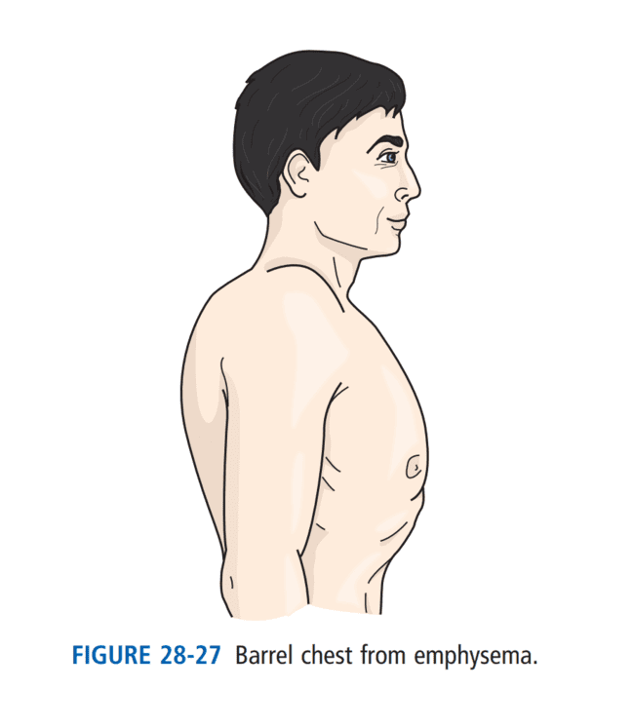

Slide 11
Signs and symptoms and risk factors of COPD:
A person with COPD often has a great deal of trouble breathing, which can be very frightening.
Because the person is not getting enough oxygen, she tires easily.
She may carry herself with bent posture, with her shoulders elevated and her lips pursed.
Because these measures make breathing easier.
The person’s chest may be enlarged and rounded, like a barrel.
Because over several years, the air trapped in the lungs causes the chest cavity to enlarge.
The person may have a poor appetite. As her condition worsens, the person will require supplemental oxygen.
Cigarette smoking is the most important risk factor. Pipe, cigar, and other smoking tobaccos are also risk factors. So is exposure to second-hand smoke.
Not smoking is the best way to prevent COPD.

Slide 12
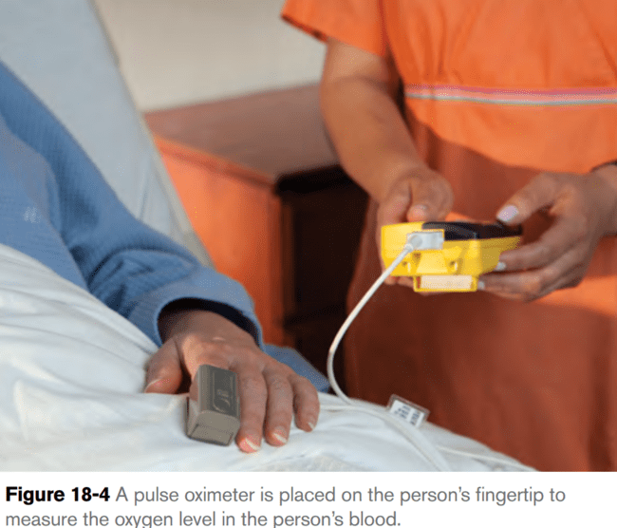
Measures care of COPD:
When you provide care for a person who has COPD:
Encourage the person to relax and breathe slowly but as deeply as possible.
Relaxation and slow, deep breathing increase the flow of oxygen to the lungs and help maintain flexibility in the chest wall. The person may have special exercises to do to improve her ability to relax and breathe slowly. If so, encourage the person to do these exercises as prescribed.
Provide good mouth care.
Breathing through the mouth and supplemental oxygen therapy can make mouth tissues dry and uncomfortable.
Obtain pulse oximetry readings as requested or specified in the person’s care plan. (Pulse oximetry readings are often taken along with the person’s vital sign measurements.) A pulse oximeter is a device that is clipped to the fingertip to measure the oxygen level of the blood (Figure 18-4).

Slide 13
Measures care of COPD:
Provide a portable commode when the person needs it.
Sometimes using the commode is easier than getting to the bathroom when the person needs to conserve energy or has shortness of breath. A commode is also more comfortable than a bedpan.
Offer small, frequent meals to reduce fatigue associated with eating and help ensure that the person receives adequate nutrition
Encourage the person to cough to help clear air passages of excess mucus.
To promote infection control and maintain the person’s dignity, keep tissues and trash containers within the person’s reach.
Raise the head of the bed for comfort.
COPD has no cure.
Follow the guidelines in Box 18-1 for caring for a person who is receiving oxygen therapy.

Slide 15
Asthma:
Asthma is an illness in which certain substances or conditions called triggers, cause inflammation and constriction of the airways, making breathing difficult.
With asthma, the airway becomes inflamed and narrow.
Extra mucus is produced, dyspnea results.
Wheezing and coughing are common.
So are pain and tightness in the chest.
Asthma usually is triggered by allergies.
Common triggers include exercise, temperature extremes, allergies, irritants (such as dust, smoke or pollution),
Other triggers include air pollutants and irritants, smoking and secondhand smoke, respiratory infections, exertion, and cold air. Sudden attacks (asthma attacks) can occur.
There is shortness of breath, wheezing, coughing, rapid pulse, sweating, and cyanosis.
The person gasps for air and is very frightened.
perfume or cologne, and stress or anxiety.

Slide 16
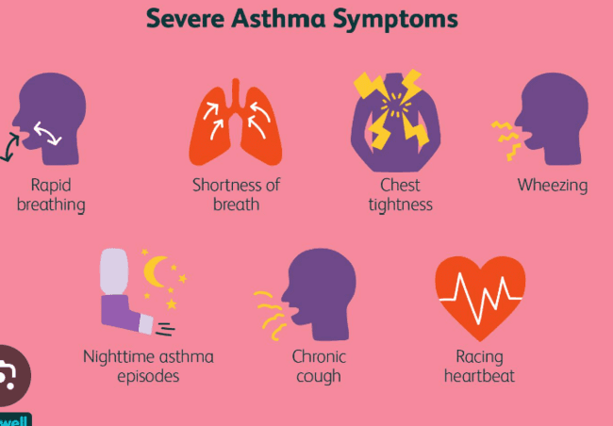
Signs and symptoms of Asthma:
Symptoms are mild to severe.
However, when an asthma attack does occur, it can be very frightening for the person.
Signs of an asthma attack include wheezing; rapid, shallow breathing (or difficulty breathing); sweating; and an inability to talk.

Slide 17
Measure Care of Asthma:
Asthma is treated with drugs.
Severe attacks may require emergency care.
People who have asthma usually know what can trigger an attack and take measures to avoid these triggers.
Many people who have been diagnosed with asthma also take medication on a regular basis to prevent asthma attacks.
A person who has been diagnosed with asthma may take two forms of medication.
Long-term control medications are taken every day, whether the person has symptoms or not. These medications help prevent asthma attacks.
A person who is experiencing an acute asthma attack may also need to take a quick-relief (or rescue) medication to open the airways right away.
Both long-term control medications and quick-relief medications may be given through an inhaler or orally.

Slide 18
Sleep Apnea:
Sleep apnea is a sleep disorder that can affect anyone.
People who suffer from sleep apnea repeatedly start and stop breathing while they sleep.
There are two types of sleep apnea:
obstructive sleep apnea (more common) and central sleep apnea.
Generally, sleep apnea is diagnosed by a general practitioner who would refer you to a sleep disorder center for a nocturnal polysomnography, or sleep study test. Similar tests can also be performed at home.

Slide 19
Pneumonia:
Pneumonia: is inflammation of the lungs.
Because of the inflammation, the air sacs in the lungs begin to fill with fluid.
Oxygen has trouble reaching the bloodstream.
Pneumonia may be caused by infection with bacteria, viruses or fungi and is often a complication of the flu.
A person may also develop aspiration pneumonia, which occurs when foreign material (such as food, fluid or vomit) is inhaled into the lungs.
The foreign material can damage the lung tissue or introduce bacteria that can cause an infection.
People who are in a coma or who are receiving nutrition through a feeding tube are especially at risk for developing aspiration pneumonia
Position for this person it is semi-fowler position.

Slide 20
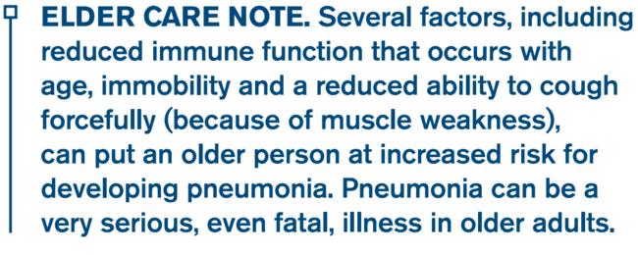

Slide 21
American Red Cross (2013). American Red Cross Nurse Assistant Training Textbook: Third Edition.United States of America: Krames Stay Well Strategic Partnerships Division. ISBN: 978-1584805823.
quikaid.article/sleep-apnea-disability
Sorrentino, S. A., Remmert, L., & Wilk, L. S. (2014). Mosby's Textbook for Nursing Assistants (5th ed.). St. Louis, MO: Elsevier.)

