Slide 1
C H A P T E R 5 0 Digestive and Endocrine Disorders
MADA ALSEDRAH

Slide 2
OBJECTIVES
• Define the key terms and key abbreviations.
• Describe the care required for gastro-esophageal reflux disease ,vomiting, and inflammatory bowel disease.
• Describe the care required for hepatitis and cirrhosis.
• Describe the care required for diabetes.

Slide 3
KEY TERMS
Heartburn A burning sensation in the chest or throat; acid reflux.
Jaundice yellowish color of the skin or whites of the eyes
Vomitus food and fluids expelled from the stomach through the mouth
Hyper-glycemia high (hyper) sugar (glyc) in the blood (emia) ↑
Hypo-glycemia low (hypo) sugar (glyc) in the blood (emia) ↓

Slide 4
Key Abbreviations

Slide 5
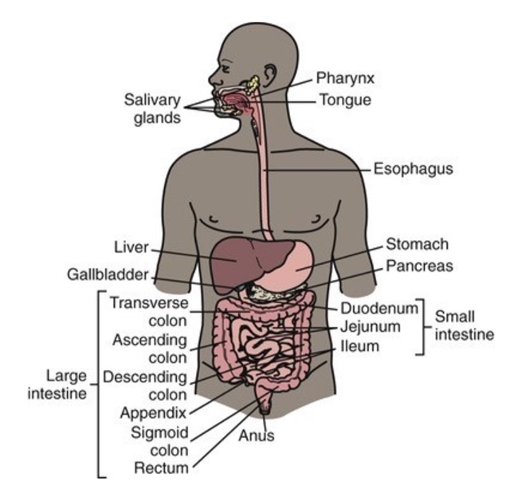
Body Structure and Function
Problems can develop in any part of the digestive system (gastro-intestinal [GI] system). This includes the accessory organs of digestion—liver, gallbladder, and pancreas.
Pancreas part of endocrine system
The digestive system breaks down food into nutrients for the body to absorb. Solid wastes are eliminated.

Slide 6
Digestive Disorders
• Diarrhea—the frequent passage of liquid stools
• Constipation—the passage of hard, dry stool
• Flatulence—the excessive formation of gas or air in the stomach and intestines
• Fecal incontinence—the inability to control the passage of feces and gas through the anus
• Ostomy—the surgically created opening that connects an internal organ to the body's surface

Slide 7
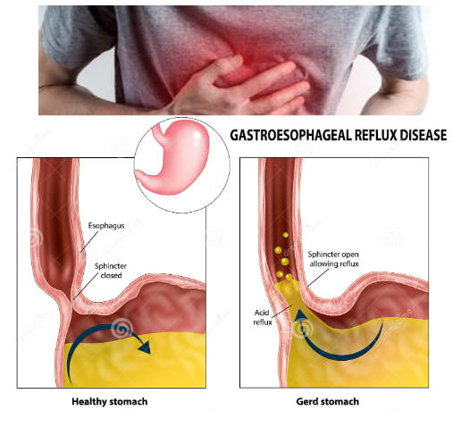
Gastro-esophageal reflux disease (GERD)
Occurs when a muscle at the end of the esophagus does not close properly. Stomach (gastro) contents flow back up (reflux) into the esophagus (esophageal).
Stomach contents contain acid that can irritate and inflame the esophagus lining. This is called esophagitis—inflammation (itis) of the esophagus.
Heartburn is the most common symptom. Heartburn (acid reflux) is a burning sensation in the chest or throat.

Slide 8
Signs and symptoms of GERD
Include:
• Pain in the chest or upper abdomen
• Hoarseness or sore throat
• Dysphagia (difficult or painful swallowing)
• Dry cough
• Bad breath
• Nausea and vomiting

Slide 9
Risk factors
Include being over-weight,
alcohol
coffee use,
pregnancy,
and smoking.

Slide 10
Prevention and Management
The doctor may order drugs to prevent stomach acid production or to promote stomach emptying.
Surgery may be needed.
Life-style changes include:
No smoking or drinking alcohol
Losing weight
Eating small meals and eating slowly
Wearing loose belts and loose-fitting clothes
Not lying down for at least 3 hours after eating
Raising the head of the bed 6 to 9 inches so that
The head and shoulders are higher than the stomach

Slide 11
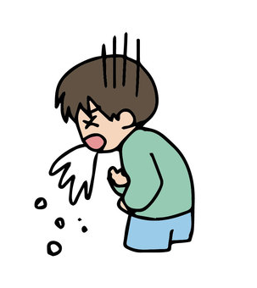
Vomiting
Vomitus (emesis) is the food and fluids expelled from the stomach through the mouth. Vomiting signals illness or injury.
Aspirated vomitus can obstruct the airway.

Slide 12
Management
• Follow Standard Precautions and the Bloodborne Pathogen Standard.
• Turn the person's head well to 1 side if the person is supine. This prevents aspiration.
• Place a kidney basin under the chin.
• Move vomitus away from the person.
• Provide oral hygiene. This helps remove the bier taste of vomitus.
• Eliminate odors.
• Provide for comfort.

Slide 13
Cont…
• Report your observations.
• Observe vomitus for blood, color, odor, and undigested food.
• Measure, report, and record the amount of vomitus and your observations.
• Save a specimen for laboratory study.
• Dispose of vomitus after the nurse observes it.

Slide 14
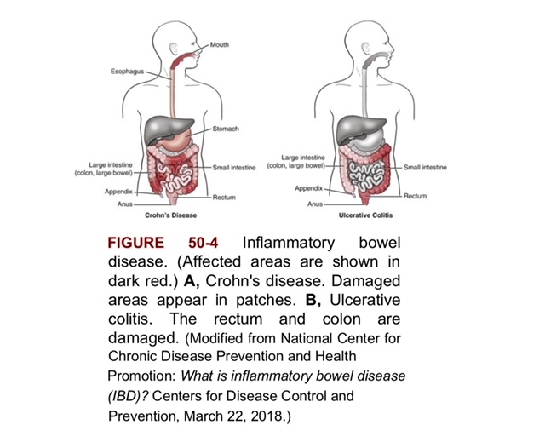
Inflammatory Bowel Disease
Inflammatory bowel disease (IBD) involves chronic inflammation of the GI tract.
Types
Crohn's disease
Ulcerative colitis

Slide 15
Cont…
• Crohn's disease. Any part of the GI tract from the mouth to the anus can be affected. Part of the small intestine is usually involved before the large intestine.
• Ulcerative colitis. The large intestine and rectum are affected.

Slide 16
Signs and symptoms
• Persistent diarrhea
• Abdominal pain and cramping
• Fever
• Rectal bleeding and bloody stools
• Appetite: loss of
• Weight loss

Slide 17
Risk factors
IBD often occurs before 30 years of age.
Family history of ibd,
Cigar smoking,
Some drugs,
And a diet high in fat and refined foods.

Slide 18
Complications
Bowel obstruction,
Ulcers in the GI tract (including the mouth and anus),
Colon cancer,
Osteoporosis,
And liver disease.

Slide 19
Treatment
Diet changes and drug therapy for inflammation, infection, diarrhea, pain, and nutrition.
Surgery may be needed to remove damaged parts of the small intestine or colon. A colostomy or ileostomy may be necessary.

Slide 20
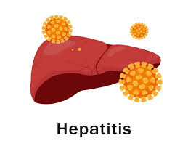
Hepatitis
Hepatitis is inflammation (itis) and infection of the liver (hepat) caused by a virus.
There are 5 major types of hepatitis.

Slide 21
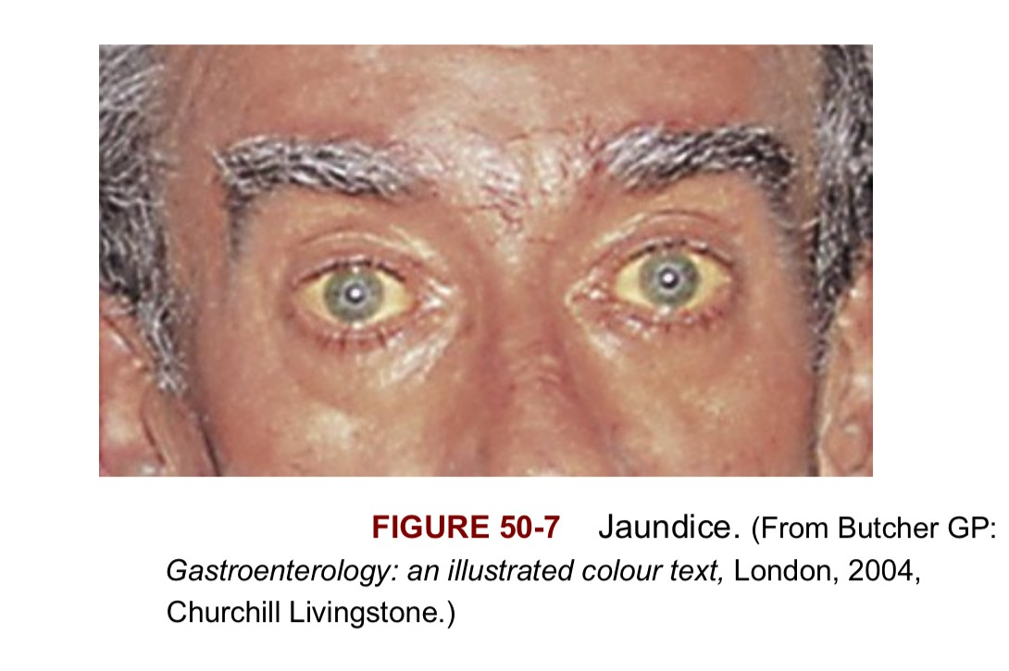
*Some people have no symptoms.

Slide 22
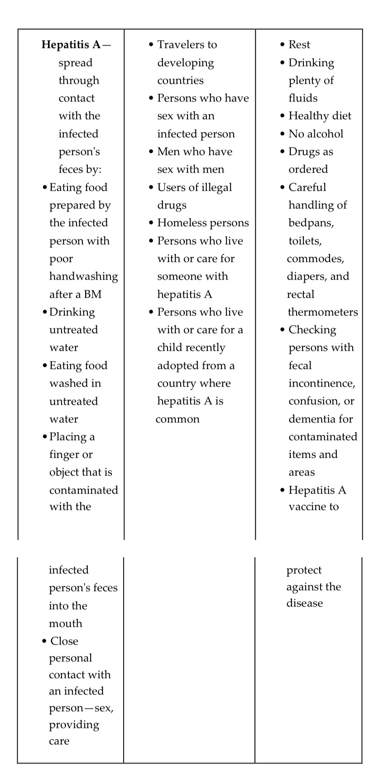

Slide 29
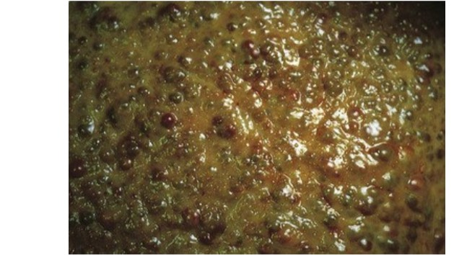
Cirrhosis
Cirrhosis is a liver condition caused by chronic liver damage.

Slide 30
Chronic alcohol abuse, chronic hepatitis B and C, and extra fat in the liver are common causes. Obesity is becoming a common cause.

Slide 31
Signs and symptoms may occur as the disease progresses.
• Weakness and fatigue
• Loss of appetite and weight loss
• Nausea and vomiting
• Ascites—abdominal bloating from fluid buildup in the abdomen (Fig. 50-9)
• Edema (swelling) in the feet and legs
• Itching (severe)
• Spider-like blood vessels on the skin
• Jaundice
• Pain or discomfort in the right upper abdomen

Slide 33
Complications. Infection, bruising, and bleeding occur.
Toxins build up in the brain, causing confusion, personality changes, and memory loss.
Treatment is aimed at treating the cause
A low-sodium diet is needed for edema and ascites.
Diuretic drugs (water pills) are ordered to remove fluid.
Antibiotics are ordered for infection.
The person must avoid alcohol and may need a liver transplant.

Slide 34
General Care
• Follow the care plan to prevent complications from bed rest—pneumonia, blood clots, pressure injuries.
• Provide good skin care and prevent itching.
• Follow the care plan for what cleanser to use.
• Apply lotion to the skin.
• Discourage the scratching of itchy skin.
• Provide mouth care before meals and every 2 hours.
• Follow diet and fluid restriction orders.
• Turn the person at least every 2 hours or as noted on the care plan.
• Promote comfort and the ability to breathe.
• Semi-Fowler's or Fowler's position
• Pillows under the arms for support
• Coughing and deep-breathing exercises
• Assist with ambulation and activities of daily living (ADL) as needed.

Slide 35
Measurements and Observations
• Observe vomitus, urine, and BMs for blood.
• Observe for signs of decreased mental function — confusion, memory loss, behavior changes, and so on.
• Measure vital signs every 2 to 4 hours.
• Measure intake and output (I&O).
• Measure weight daily.
Safety
• Use bed rails according to the care plan.
• Keep the call light and other needed items within reach.
• Complete a safety check before leaving the room.

Slide 36
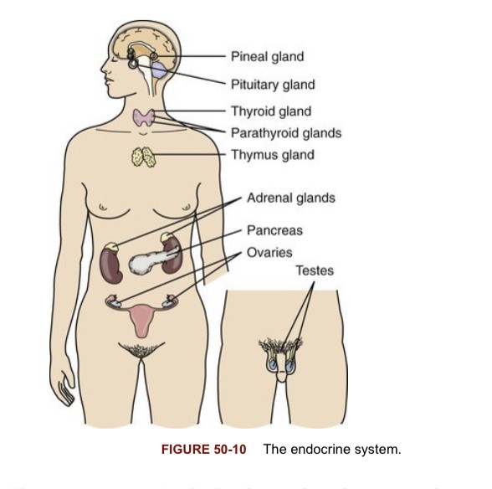
Endocrine Disorders
The endocrine system is made up of glands. The endocrine glands secrete chemical substances called hormones into the bloodstream that can affect other organs and glands in the body. Diabetes, the most common endocrine disorder, involves the pancreas.
The pancreas secretes insulin.

Slide 37
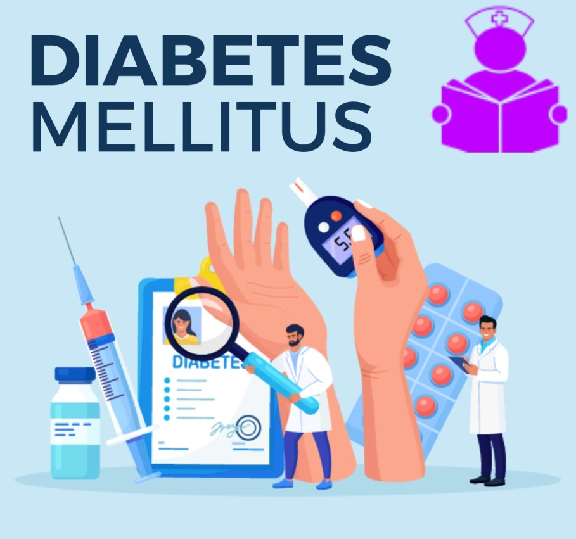
Diabetes
In diabetes, the body cannot produce or use insulin properly. Without any or enough insulin, sugar builds up in the blood. Blood glucose (sugar) is high. Cells do not have enough sugar for energy and cannot function.

Slide 38
Types of Diabetes
• Type 1 diabetes. Occurs most often in children and young adults but can develop in adults. The pancreas makes no insulin. Too much glucose stays in the blood. Onset is rapid.
• Type 2 diabetes. The body does not make enough insulin or use insulin well. The most common type of diabetes, it can occur at any age including childhood. Risk factors include being age 45 or older, having a family history of diabetes, being overweight or obese, and being physically inactive.
• Gestational diabetes. Develops during pregnancy. (Gestation comes from gestare. It means to bear.) This type usually goes away after the baby is born. However, the mother is at risk for type 2 diabetes later in life.

Slide 39
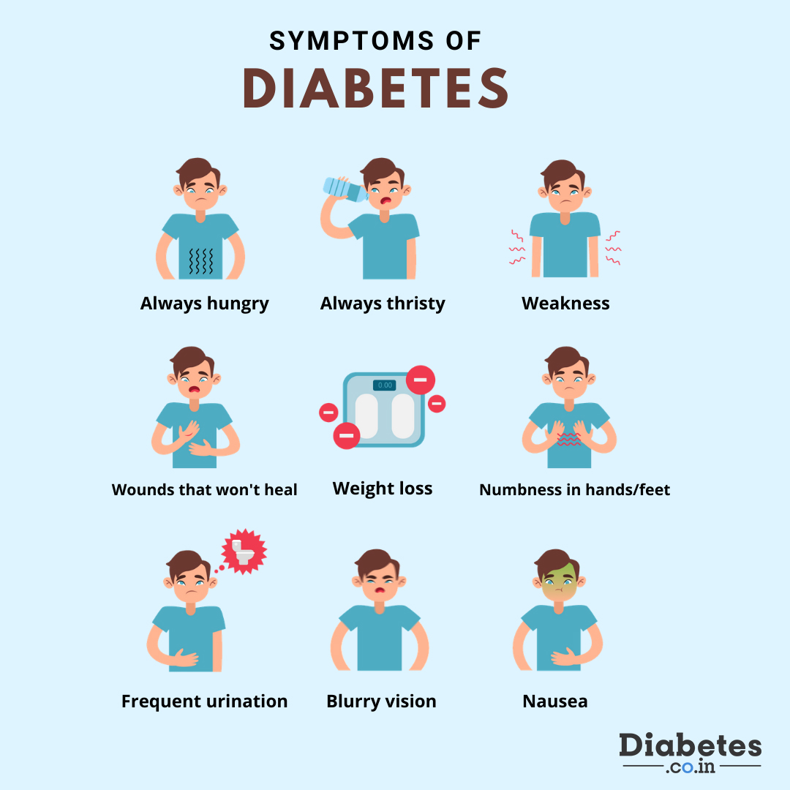
Signs and Symptoms
• Being very thirsty
• Frequent urination
• Feeling very hungry or tired
• Weight loss without trying
• Sores that heal slowly
• Dry, itchy skin
• Tingling or loss of feeling in the feet
• Blurred vision

Slide 40
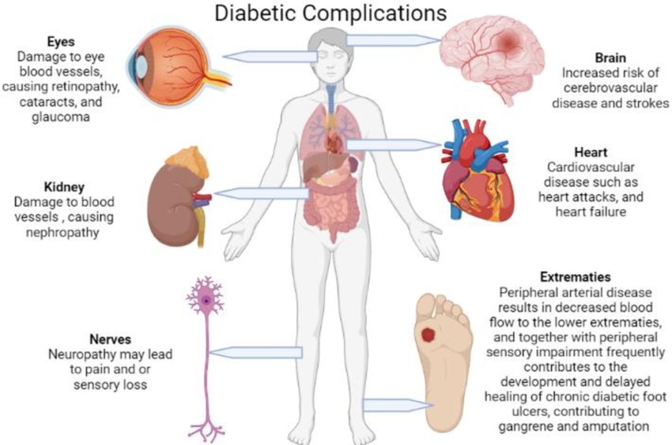
Complications
Diabetes must be controlled to prevent complications.
High blood glucose levels can cause serious health problems.
Heart disease,
stroke,
kidney disease,
eye problems, and nerve damage are examples.
So are dental disease and foot problems.

Slide 41
Treatment
Type 1 diabetes is treated with daily insulin therapy, healthy eating and exercise.
Type 2 diabetes is treated with healthy eating, exercise, and weight loss if needed. The person with type 2 may take oral drugs or need insulin.
Types 1 and 2 involve controlling blood pressure, cholesterol, and the risk factors for coronary artery disease.
Good foot care is needed. Corns, blisters, calluses, and other foot problems can lead to an infection and amputation.

Slide 42
The person's blood sugar level can fall too low or go too high.
Hyper-glycemia high (hyper) sugar (glyc) in the blood (emia) ↑
Hypo-glycemia low (hypo) sugar (glyc) in the blood (emia) ↓

Slide 44
Health Education

Slide 45
Any Q ?

Slide 46
References :
1. Sorrentino, S. A., Remmert, L., & Wilk, L. S. (2020). Mosby's Textbook for Nursing Assistants (10th ed.). St. Louis, MO: Elsevier.)

Slide 47
Thank you ..

