Slide 1
C H A P T E R 5 1 Urinary Disorders
Mada alsedrah

Slide 2
OBJECTIVES
• Define the key terms and key abbreviations
• Describe the care required for urinary tract infections.
• Describe the care required for prostate enlargement.
• Describe the care required for renal calculi.
• Describe the care required for acute and chronic kidney failure.

Slide 3
KEY TERMS
dialysis The process of removing waste products from the blood
dysuria Difficult or painful (dys) urination (uria)
hematuria Blood (hemat) in the urine (uria)
oliguria Scant (olig) urine (uria)
pyuria Pus (py) in the urine (uria)

Slide 5
Body Structure and Function Review The Urinary System

Slide 6
Urinary System Disorders
Disorders can occur in urinary system structures— kidneys, ureters,
bladder, and urethra. Men can develop prostate problems.

Slide 7
Urinary Tract Infections
Urinary tract infections (UTIs) are common. Infection in 1 area can spread through the urinary tract. Microbes can enter the system through the urethra.
Urological exams, intercourse, poor perineal hygiene, immobility, and poor fluid intake are common causes.
Persons with urinary catheters are at high risk UTI is a common healthcare-associated infection .
Women are at high risk. Microbes can easily enter the female urethra and travel a short distance to the bladder.
Prostate gland secretions help protect men from UTIs. However, an enlarged prostate increases the risk of UTI.

Slide 8
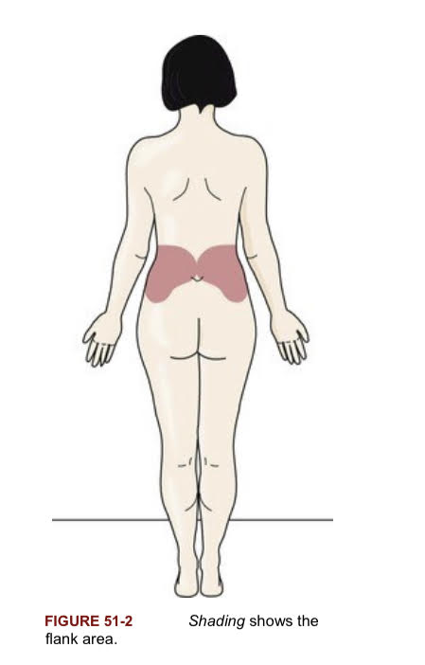
Common Signs and Symptoms
• Urinary frequency • Urgency
• Burning on urination • Oliguria—scant (olig) urine (uria)
• Dysuria—difficult or painful (dys) urination (uria) • Hematuria—blood (hemat) in the urine (uria)
• Pyuria—pus (py) in the urine (uria) • Cloudy urine
• Urine that appears red, pink, or dark from blood in the urine
• Fever • Fatigue
• Weakness • Pressure in the lower abdomen
• Urine odor • Pelvic pain—women
• Rectal pain—men • Flank pain

Slide 9
treatment
UTIs are treated with antibiotics. Fluids, especially water, are encouraged to
flush bacteria from the urinary tract. Normal elimination is promoted.
The person should urinate when the urge is felt.
For prevention and treatment, proper perineal care and catheter care are needed

Slide 10
Prostate Enlargement
The prostate is a walnut-shaped gland in men. It lies in front of the rectum and just below the bladder .The prostate surrounds the urethra. The prostate grows larger (enlarges) as the man grows older.
This is called benign prostatic hyperplasia (BPH). Benign means nonmalignant. Hyper means excessive. Plasia means formation or development.
Common in older men, BPH symptoms often start after age 50. The enlarged prostate presses against the urethra, obstructing urine flow.

Slide 11
Signs and Symptoms
• Urinary frequency—voiding 8 or more times a day
• Urgency—cannot delay voiding
• Trouble starting a stream
• Weak or “stop and start” urine stream
• Dribbling after voiding
• Frequent voiding during sleep (nocturia)
• Urinary retention—the bladder does not empty; urine remains in the bladder
• Urinary incontinence
• Pain during urination (dysuria)
• Urine has an unusual color or smell
• Blood in the urine

Slide 12
management
For mild BPH, drugs can shrink the prostate or stop its growth. Some microwave and laser treatments destroy excess prostate tissue and widen the urethra.
Transurethral resection of the prostate (TURP) is a common surgical procedure for severe BPH.

Slide 13
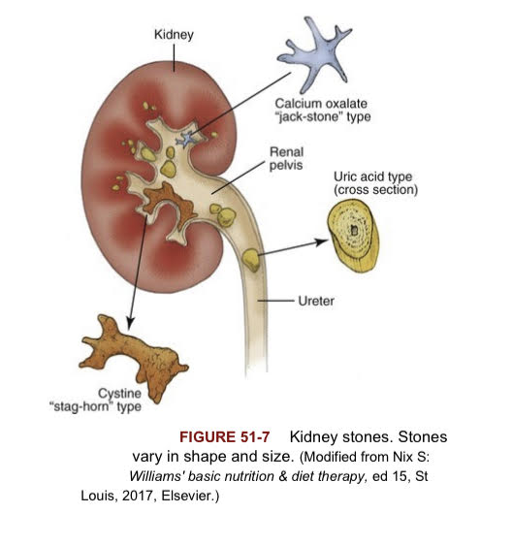
Kidney Stones
Kidney stones (calculi) are hard, pebble-like materials that develop in 1 or both kidneys .They vary in size—from a grain of sand to pea-sized.
Men are at higher risk than women. A family history of kidney stones increases the risk. So does having kidney stones before. Not drinking enough liquids is another risk factor.

Slide 14
Signs and symptoms
• Severe, cramping pain in the back and side just below the ribs
• Pain in the lower abdomen, thigh, and rethra
• Nausea and vomiting
• Fever and chills
• Dysuria—difficult or painful (dys) urination (uria)
• Urinary frequency and urgency
• Pain or burning on urination
• Hematuria—blood (hemat) in the urine (uria)
• Cloudy urine
• Foul-smelling urine

Slide 15
management
Drugs are given for pain relief.
The person needs to drink 2000 to 3000 mL (milliliters) a day. Fluids help flush stones out through the urine. All urine is strained.
Medical or surgical removal of the stone may be necessary.
Diet changes may prevent stones.

Slide 16
Kidney Failure
In kidney failure (renal failure), the kidneys do not function or are severely impaired. Waste products are not removed from the blood. Fluid is retained. Heart failure and hypertension easily result. The person is very ill.

Slide 17
types
•Acute kidney failure. Onset is rapid in a few days or less. Blood flow to the kidneys is severely decreased, the kidneys are damaged, or the urinary tract is blocked. The causes are many. Usually the person is already critically ill.
•Chronic kidney disease (CKD). Kidney function is slowly lost over several months or years. Diabetes and hypertension are the most common causes. Other causes include kidney stones, infection, and a blocked urinary tract. Signs and symptoms may not appear until the disease is advanced .

Slide 18
Chronic Kidney Disease—Signs and Symptoms
•Appetite—loss of
•Blood in the stools
•Breath odor
•Bruising
• Concentration: problems with
•Drowsiness
•Fatigue
•Feeling ill
• Headaches
• Hiccups
•Muscle cramps or twitching
• Nausea and vomiting
• Numbness in the hands and feet
•Shortness of breath

Slide 19
Cont…
•Skin—dry, itching; dark or light color
•Sleep problems
•Swelling in the hands and feet
•Thirst: excessive
•Urinary output: decreased
•Weight loss

Slide 20
Treatment
Treatment for acute kidney failure and CKD involves drugs and fluid and diet restrictions.
The person's care plan may include the measures

Slide 21
Kidney Failure—Care Measures
•A diet low in protein, potassium, and sodium
•Fluid restriction
•Measuring blood pressure in the supine, sitting, and standing positions
•Measuring daily weight
•Measuring and recording intake and output
•Turning and re-positioning at least every 2 hours
•Measures to prevent pressure injuries

Slide 22
Cont…
•Range-of-motion exercises
•Measures to prevent itching (bath oils, lotions, creams)
•Measures to prevent injury and bleeding
•Frequent oral hygiene
•Measures to prevent infection
•Deep-breathing and coughing exercises
•Measures to prevent diarrhea or constipation
•Measures to meet emotional needs
•Measures to promote rest

Slide 23
Acute kidney failure may be reversed. CKD has no cure. Kidney failure, also called end-stage renal disease (ESRD), is the last stage of CKD. The person will need a kidney transplant or dialysis.
Dialysis is the process of removing waste products from the blood.
Hemodialysis filters blood (hemo) through an artificial kidney
Peritoneal dialysis uses the lining of the abdominal cavity (peritoneal membrane) to remove waste and fluid from the blood

Slide 24
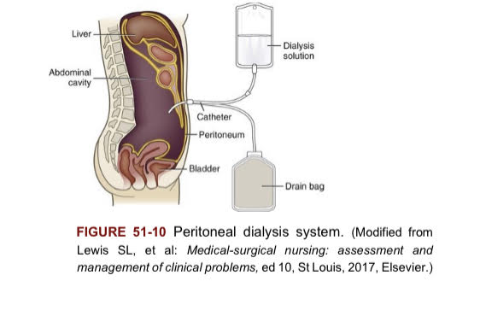

Slide 25
Health Education

Slide 26
Q?

Slide 27
Thank you ..

