Slide 1
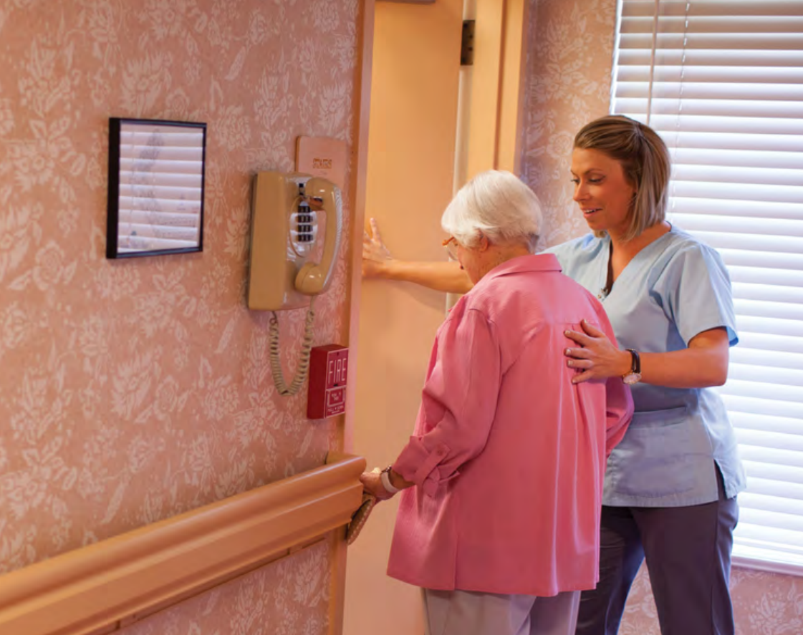
Common Medical Emergencies
Prepared by:
Ms.Jamilah Allehaib
BSN, RN

Slide 2
Learning Objectives:
Define the Term of Emergency.
Describe the Emergency.
Identify the Medical Emergency and Responding to Medical Emergency.
List the Common Medical Emergencies.

Slide 3
Learning Outcomes:
■ Recognize and respond to common medical emergencies, including stroke, myocardial infarction, choking, bleeding, shock, seizure, fainting and burns.
■ Understand the Scenario for respond to medical emergency.

Slide 4
Emergency:
An emergency is a situation that arises suddenly and requires immediate action to keep a person safe.
As a nurse assistant, you must know how to respond in the event of an emergency to keep the people in your care safe.
To expand your knowledge of how to respond to emergencies, it is strongly recommended that you take American Red Cross First Aid/CPR/ Automated External Defibrillator (AED) training in addition to the nurse assistant training course.

Slide 5
Emergency can be
Medical in nature.
Acute illness or injury that required immediate attention.
To prevent the person from dying or experiencing permanent long term effects
Environmental
Change to a person environment that affect the person health and safety
Example: Fire, Weather emergency (such as snow storm, tornadoes and hurricanes)
And Disaster (sever events that cause widespread damage and destruction, affecting many people and disrupting normal function of the community).

Slide 6
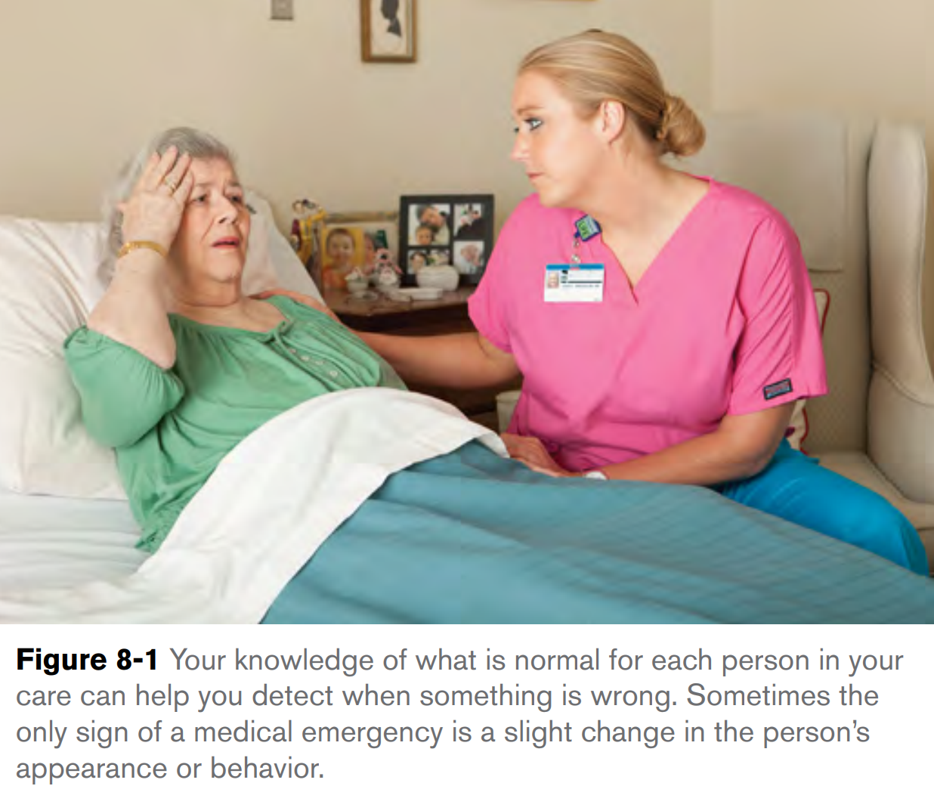
Medical Emergencies
Recognizing and Responding to Medical Emergencies:
The following steps guide your actions in an emergency and ensure your safety and the safety of others.
Recognize the emergency: Sometimes it will be obvious that a person is in distress. Other times, however, a medical emergency may only be signaled by a slight change in the person’s behavior or appearance.
As a nurse assistant, you will have in-depth knowledge of what is normal for each person in your care. A change from normal could signal an emergency and should be reported immediately (Figure 8-1).

Slide 7
Responding to Medical Emergency:
Check: Stay calm, and check the scene and the person.
First, make sure there is nothing that could hurt you or cause further injury to the person, such as a downed wire in the area.
Next, look for clues that may help you understand what happened.
Finally, check the person: tap her shoulder or hand and shout to see if he or she is conscious.

Slide 8
Responding to Medical Emergency:
Call: Next, call for help. In a hospital, there is usually a code you can dial to call for help from within the facility. In other health care settings, you may be required to dial 9-1-1 or another emergency number. Know your employer’s policies and procedures related to calling for help in an emergency.
FYI: In King Fahd Specialist Hospital in Buraydah Code 2222
4. Care: Provide appropriate care (according to the situation and your level of training) until help arrives.
Help the person rest comfortably, and provide reassurance because the person is likely to be frightened and upset.

Slide 9
Responding to Medical Emergency:
Report and record: Your observations about what happened before, during and after the emergency are important to share with other members of the health care team.
These observations should be reported to the nurse and documented on the appropriate forms, per your employer’s policy.
Note whether the person complained of any symptoms before the event, the time the symptoms started and how long the symptoms lasted, because some of the medications used to treat stroke are only effective within a certain time frame after the onset of symptoms.
Be specific; For example, “She was breathing at a rate of 25 breaths per minute” is more specific than “She was having trouble breathing.” If you arrived on the scene to find the person in distress and unconscious or otherwise unable to tell you what happened.
Note anything unusual that you observed while you were checking the scene and the person. Also report and record exactly what you did to help the person (for example, “I helped her to sit up and held her there.”)

Slide 11
Common Medical Emergencies:
Stroke:
A Stroke, or Cerebrovascular Accident(CVA), occurs when blood flow to a part of the brain is interrupted, resulting in the death of brain cells.
Usually only part of the brain is affected. A stroke may be caused by a thrombus, an embolus, or hemorrhage if a blood vessel in the brain ruptures.
A Stroke can also be caused by bleeding into the brain tissue.
Strokes can cause permanent brain damage, but with quick action, sometimes the damage can be stopped or reversed.

Slide 12
Stroke:
Signs of stroke vary, they depend on the size and location of brain injury.
Loss of consciousness or semi-consciousness, rapid pulse, labored respirations, high blood pressure, facial drooping, and hemiplegia (paralysis on 1 side of the body) are signs of a stroke.
The person may have sudden confusion, numbness on 1 side of the body or in a body part, slurred speech, and aphasia (the inability to have normal speech). Loss of vision in 1 or both eyes, sudden and severe headache, dizziness, unsteadiness, and falling also are signs and symptoms.
Seizures may occur.

Slide 13
Signs and Symptoms of Stroke:
The signs and symptoms of a stroke can vary from person to person.
A person who is having a stroke may show any of the following signs and symptoms:
■ Slurring of words.
■ Drooping of the features on one side of the face (for example, the eyelid and the corner of the mouth).
■ Trouble seeing in one or both eyes.
■ Weakness or numbness in an arm or leg.
■ A sudden, severe headache.
■ Dizziness or loss of balance.
■ Confusion, or a loss of consciousness.
■ A generally ill appearance, or abnormal behavior.

Slide 14
CONT…
The “FAST” check (Figure 8-2) is a quick way of checking for signs of a stroke:
Face: Ask the person to smile. Is there weakness or drooping on one side of the face?
Arm: Ask the person to raise both arms. Is there weakness or drooping of one of the arms?
Speech. Ask the person to say a simple sentence or phrase. Does the person have trouble speaking, or is her speech slurred?
Time. If the person has difficulty performing any of these actions or shows other signs of stroke, call for help immediately. Prompt medical attention may reduce the amount of disability the person experiences as a result of the stroke.

Slide 17
Common Medical Emergencies:
B. Myocardial Infarction (MI):
A Myocardial Infarction (MI), or Heart Attack, occurs when blood flow to part of the heart muscle (the myocardium) is blocked, causing the cells in that area to die. As a result, the heart’s ability to pump blood throughout the body can be affected.
If a large area of the heart is damaged, the heart may stop beating (cardiac arrest).
Men most often have the classic signs of a heart attack (for example, chest pain).
Women often have more subtle signs, such as a squeezing sensation in the chest, extreme fatigue, nausea, breaking out in a cold sweat, dizziness or lightheadedness, and shortness of breath.

Slide 18
Signs and Symptoms of Myocardial Infarction:
Signs and symptoms of Myocardial Infarction/ heart attack vary from person to person, and can be different in women than they are in men.
A person who is having a heart attack may show any of the following signs and symptoms:
■ Chest pain, discomfort, pressure, or squeezing that lasts longer than 3 to 5 minutes and is not relieved by resting, changing position, or taking nitroglycerin, or that goes away and then comes back.
■ Discomfort or pain that spreads to one or both arms, the back, the shoulder, the neck, the jaw or the upper part of the stomach.
■ Dizziness, lightheadedness or loss of consciousness.
■ Trouble breathing, including noisy breathing, shortness of breath and breathing that is faster than normal.
■ A heartbeat that is faster or slower than normal, or irregular.
■ Nausea.
■ Pale, ashen or slightly bluish skin ■ A feeling of anxiety or doom.
■ A cold sweat. ■ Extreme fatigue (tiredness).

Slide 19
CONT…
If you think a person in your care is having a heart attack, stay with her and follow your employer’s procedure for calling for help. Encourage the person to remain calm and quiet while you are waiting for help to arrive.
If the person loses consciousness, stops breathing, or has no pulse, the person is in cardiac arrest and will require cardiopulmonary resuscitation (CPR) and possibly defibrillation (delivery of an electric shock to the heart muscle to restore a normal rhythm).

Slide 20
Common Medical Emergencies:
Choking:
Foreign bodies can obstruct the airway. This is called choking or foreign-body airway obstruction (FBAO). Air cannot pass through the airways into the lungs. The body does not get enough oxygen. It can lead to cardiac arrest.
Airway obstruction can be mild or severe. With severe airway obstruction, air does not move in and out of the lungs. If the obstruction is not removed, the person will die.
Abdominal thrusts are used to relieve severe airway obstruction.
Choking occurs when the airway becomes either partially or completely blocked by a foreign object.
Many of the people in your care will have risk factors for choking.
For example, neurological conditions, such as a stroke or multiple sclerosis, can affect a person’s ability to swallow or clear the airway through coughing.
Also Dental problems or poorly fitting dentures can affect a person’s ability to chew food properly, putting him at risk for choking.
As well Eating while talking or laughing, or eating too fast, can also lead to choking.

Slide 21
CONT…
If you are with a person who starts to choke, you will need to take quick action:
First, ask the person to speak to you.
If the person can speak and is coughing forcefully, stay with the person, have her sit up if she is lying down, and encourage her to keep coughing.
If the person is not able to expel the object and clear the airway quickly, call for help.
If the person is not able to expel the object and clear the airway quickly, call for help.
You must call for help immediately and then follow the procedure for giving first aid to a conscious choking adult.

Slide 22
CONT…
If the person is unable to speak, cough or breathe, she will lose consciousness quickly unless the airway is cleared. Call for help immediately.
If the person becomes unconscious, you must follow a different procedure.
The procedure for helping an unconscious person who is choking is not taught as part of this course. This skill is taught as part of the American Red Cross First Aid/CPR/AED course, which you are strongly encouraged to take in addition to your nurse assistant training course.

Slide 23
Common Medical Emergencies:
D.1 Bleeding:
Bleeding can be: Internal or External.
Internal bleeding is not immediately obvious, but external bleeding is obvious.
Severe bleeding, whether it is internal or external, is life-threatening.
To provide care for a person who is bleeding externally;
First: take standard precautions by putting on gloves. If you think the blood might spray or splatter, you may need eye and face protection as well.

Slide 24
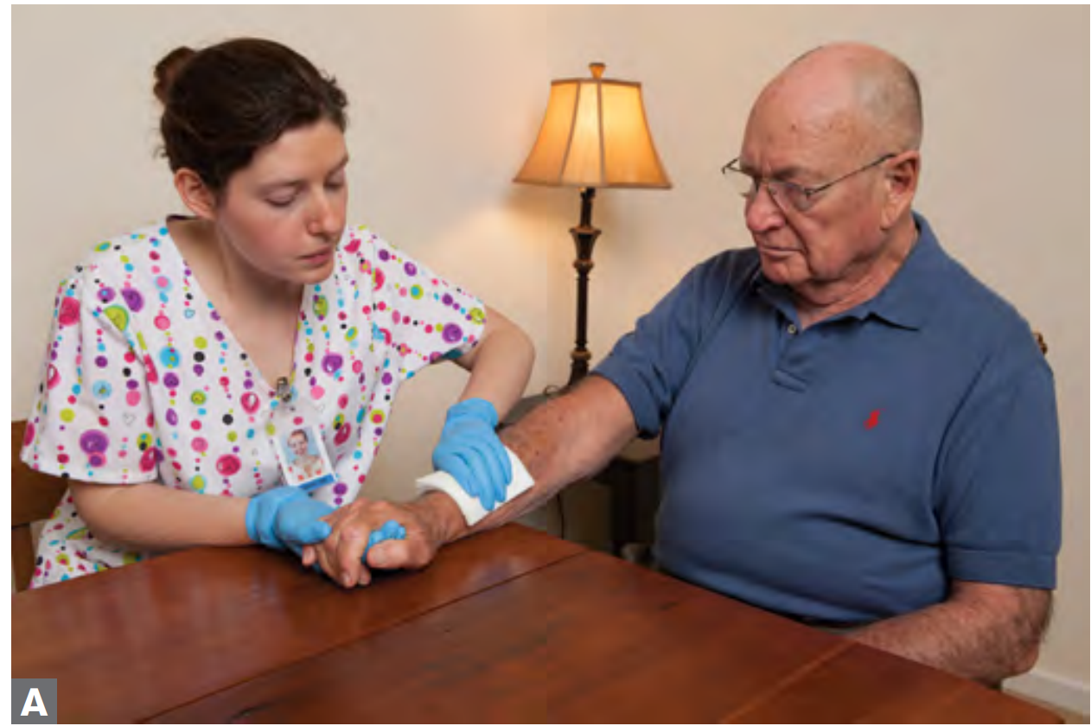
CONT…
Second: Control the bleeding by covering the wound with a sterile dressing and firmly pressing against the wound with your gloved hand until the bleeding stops (Figure 8-4, A).

Slide 25
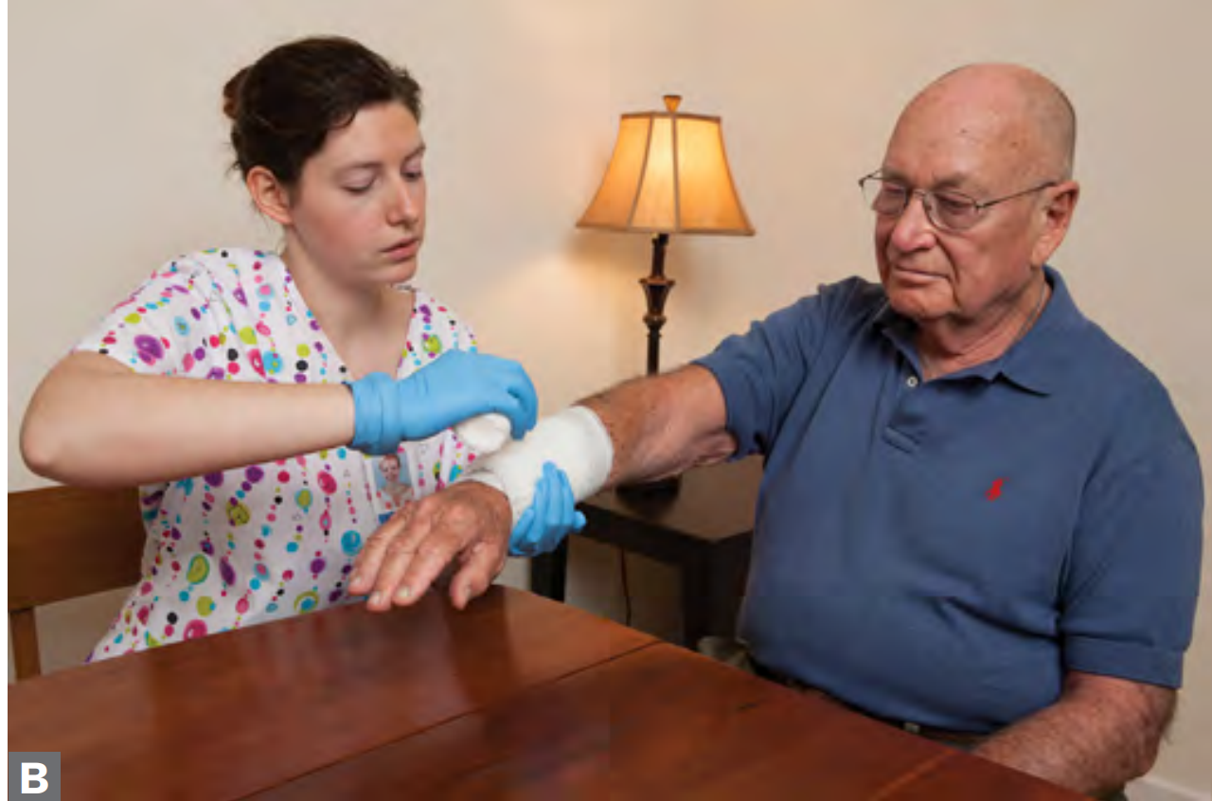
CONT…
Third: Apply a pressure bandage over the dressing to maintain pressure on the wound and to hold the dressing in place (see Figure 8-4, B).
If blood soaks through the first dressing and bandage, continue to apply pressure and add a second dressing and bandage.
If the bleeding does not stop, you must call for help.
Stay with person, and observe the person closely for signs that may indicate that the person’s condition is worsening, such as breathing that is faster or slower than normal, changes in skin color and restlessness. Provide reassurance, and keep the person calm.
Remember to wash your hands immediately after removing your gloves.

Slide 26
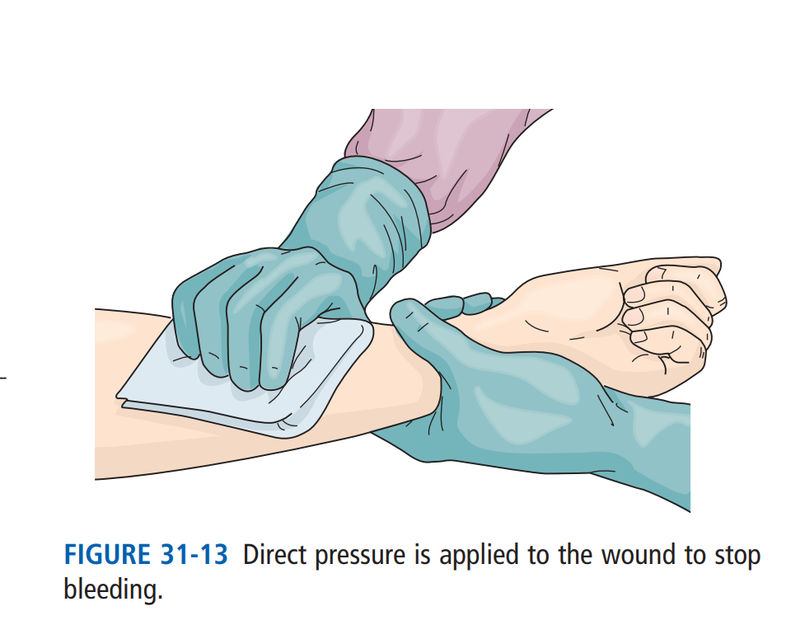
Common Medical Emergencies:
D.2 Hemorrhage ( Same term Bleeding):
Life and body functions require an adequate blood supply.
Hemorrhage: is the excessive loss of blood in a short time.
If a blood vessel is cut or torn, bleeding occurs.
The larger the blood vessel, the greater the bleeding and blood loss.
If bleeding is not stopped, the person will die.
Hemorrhage is internal or external.
You cannot see internal hemorrhage. The bleeding is inside body tissues and body cavities.
Pain, shock, vomiting blood, coughing up blood, and loss of consciousness signal internal hemorrhage.
There is little you can do for internal bleeding.

Slide 28
Common Medical Emergencies:
E. Shock:
Shock is a condition in which the circulatory system fails to deliver enough oxygen-rich blood to the body’s tissues and vital organs.
There are many causes of shock, including massive blood loss, heart failure, severe allergic reactions and severe infections that overwhelm the body.
The treatment for shock depends on the underlying cause.
For example, if the shock is caused by severe blood loss, the bleeding must be stopped.
Shock that is caused by a severe allergic reaction is treated by administering epinephrine.

Slide 30
CONT…
Shock is possible in any person who is acutely ill or severely injured. Follow the rules in Box 31-1.
Keep the person lying down. If the person does not have injuries from trauma, raise the feet 6 to 12 inches. Lower the feet if the position causes pain.
Maintain an open airway and control bleeding. Begin CPR if cardiac arrest occurs.
People who know they are severely allergic to something may carry epinephrine with them in the form of an auto-injector (Figure 8-5).
You can learn how to assist someone with using an auto-injector in the American Red Cross First Aid/CPR/AED course.

Slide 32
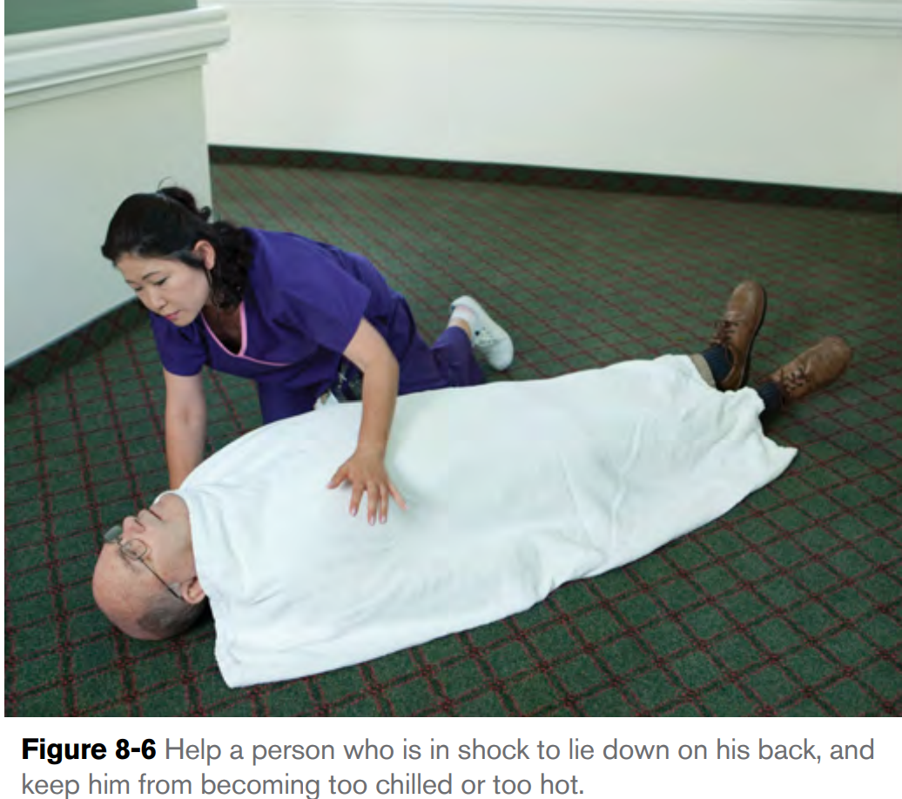
CONT…
To provide first aid for a person who is in shock;
First call for help immediately.
Second Take any measures that you can to address the cause of the shock (for example, control external bleeding or assist the person with using an auto-injector, if you have been trained to do so).
Third Keep the person from becoming chilled or overheated, and help the person to rest comfortably (Figure 8-6).
Even though the person is likely to be thirsty, do not give the person anything to drink or eat. The person may need surgery, which is safest when the stomach is empty.
Finally Comfort and reassure the person until medical help arrives

Slide 36
Common Medical Emergencies:
Seizure:
Seizures (convulsions) are violent and sudden contractions or tremors of muscle groups.
Movements are uncontrolled. The person may lose consciousness.
Seizures are caused by an abnormality in the brain. Causes include head injury during birth or from trauma, high fever, brain tumors, poisoning, and nervous system disorders or infections. Lack of blood flow to the brain can also cause seizures.
A seizure is the result of abnormal electrical activity in the brain, which leads to temporary and involuntary changes in body movement, function, sensation, awareness or behavior.
Seizures can have many different causes.
Some people may have epilepsy, a chronic seizure condition that can often be controlled with medication.
Other causes of seizures include fever, infection and injuries to the brain tissue.

Slide 37
CONT…
Although usually we think of a seizure as involving; convulsions (uncontrolled body movements caused by contraction of the muscles) and loss of consciousness, sometimes a person having a seizure will just become very quiet and have a blank stare.
A person with epilepsy may experience something called an aura (an unusual sensation or feeling) before the onset of a seizure.
Most seizures last only a few minutes.
Your main goal is to protect the person from injury during the seizure;
Remove nearby furniture or other objects that the person could accidentally hit during the seizure.
Do not try to hold or restrain the person, or put anything in the person’s mouth or between the teeth to prevent the person from biting his tongue.

Slide 42
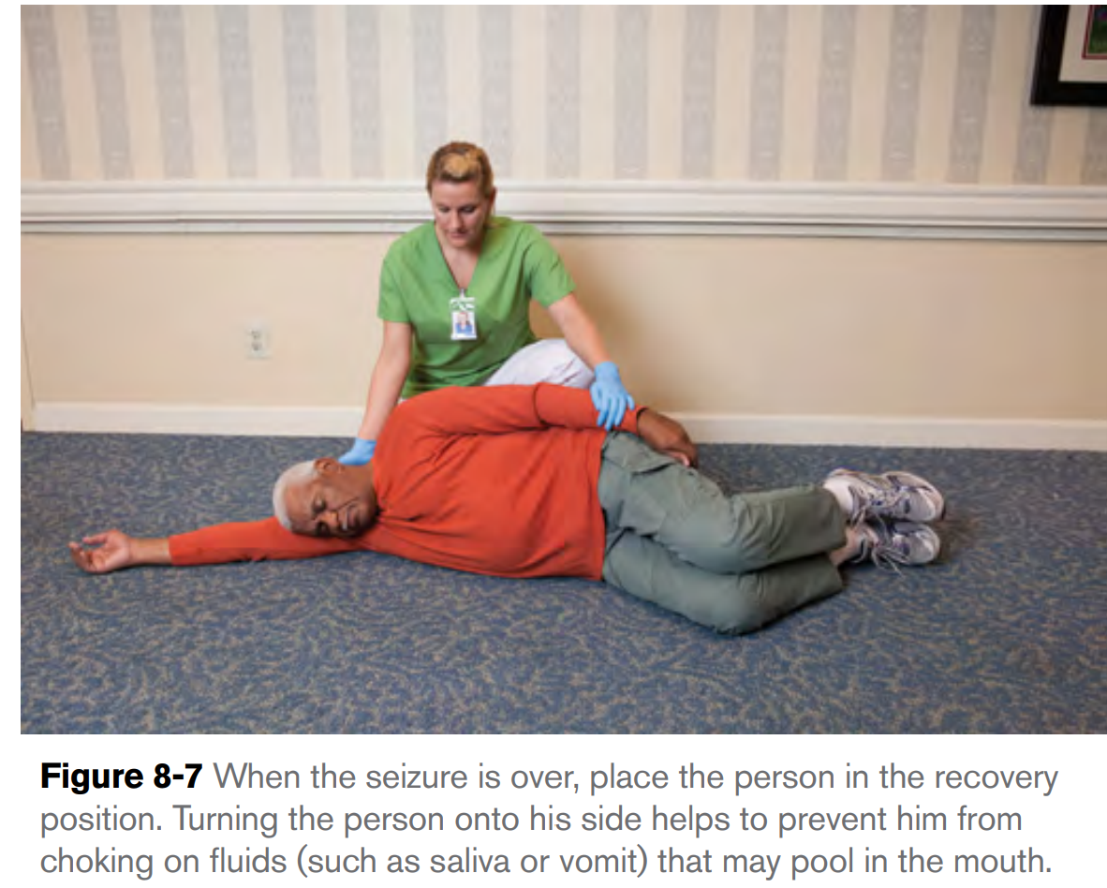
CONT…
When the seizure is over, place the person on one side (Figure 8-7) to prevent him from choking on secretions that may have pooled in the mouth.
The person may be drowsy and disoriented or unresponsive for a period of time. He may be very tired and want to rest.
Stay with the person until he is fully recovered from the seizure and aware of his surroundings.

Slide 44
Common Medical Emergencies:
G. Fainting:
Fainting is a temporary loss of consciousness caused by a sudden decrease in the blood supply to the brain.
Fainting may be a sign of a serious medical issue, such as a heart condition, but it can also be caused by factors such as hunger, being too hot, standing 1 position for long periods of time, medication side effects, fatigue or strong emotions.
A person who is about to faint often becomes pale, begins to perspiration (sweating), blackness before the eyes are warning signals, The pulse is weak, Respirations are shallow and then loses consciousness and collapses.
Some people faint at the sight of blood or injury. The person may feel weak or dizzy.

Slide 45
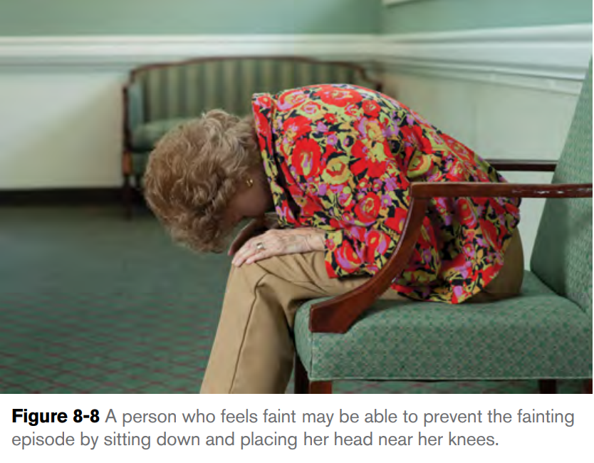
CONT…
A fainting spell might be prevented by having the person lie down or sit with her head level with her knees (Figure 8-8).
If the person does begin to faint, lower the person to the floor using good body mechanics, and position her flat on her back. Loosen tight clothing, such as a tie, collar or scarf. Make sure the person is breathing.
Do not give the person anything to eat or drink. If the person vomits, turn her onto one side to prevent her from choking.
The person will usually recover quickly with no lasting effects; however, she should receive a medical evaluation after the fainting episode.

Slide 46
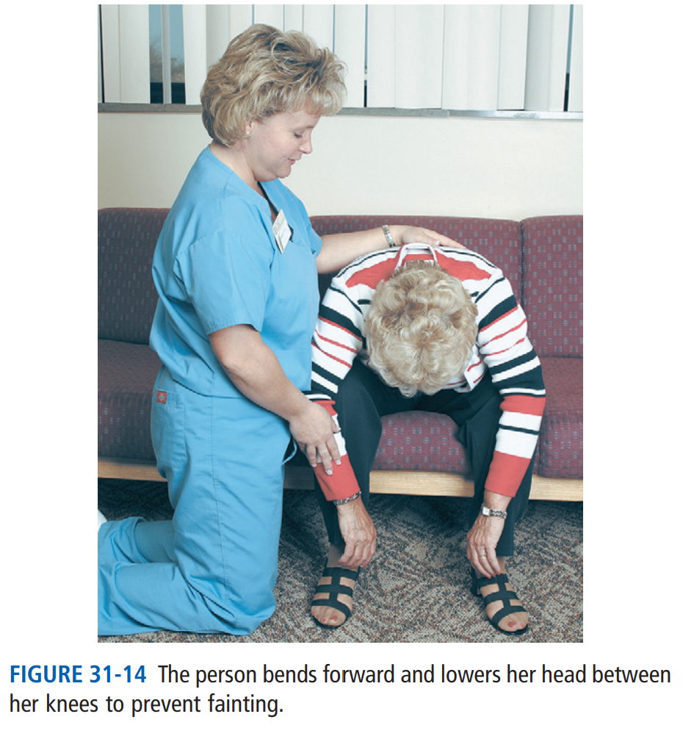

Slide 47
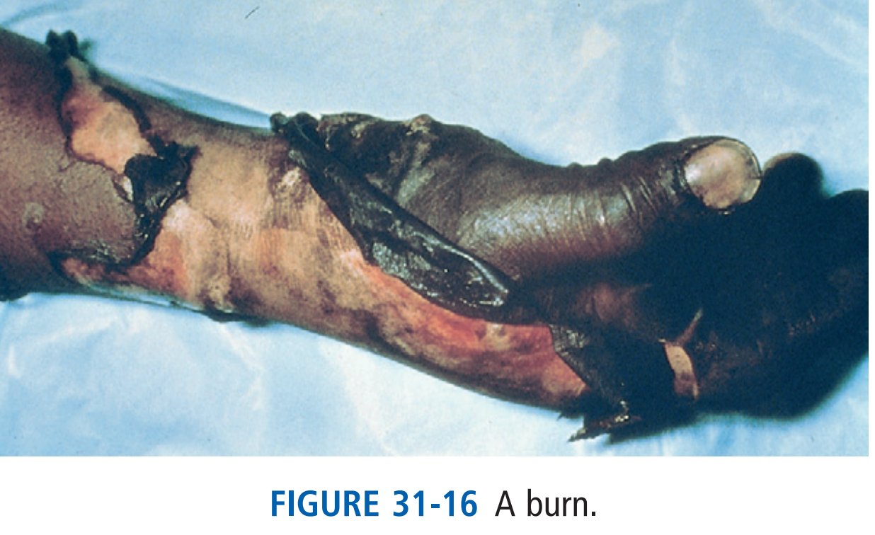
Common Medical Emergencies:
H. Burns:
Burns are injuries to the skin and possibly the underlying structures (for example, bone and muscle) as a result of exposure to heat, radiation, an electric shock or chemicals.
Burns can severely disable a person (Fig. 31-16). They can also cause death.
Burns can range in severity from minor (for example, a sunburn) to life-threatening.
Most burns occur in the home: Infants, children, and older persons are at risk.

Slide 48
Burns:
Common causes of burns and fires are:
Scalds from hot liquids.
Playing with matches and lighters.
Electrical injuries.
Cooking accidents (barbecues, microwave ovens, stoves, ovens)
Falling asleep while smoking.
Fireplaces.
Space heaters .
No smoke detectors or non-functioning smoke detectors.
Chemicals
Some burns are minor; others are severe.
Severity depends on burn size and depth, the body part involved, and the person’s age. Burns to the face, eyes, ears, hands, and feet are more serious than burns to an arm or leg.
Infants, young children, and older persons are at high risk for death.

Slide 49
CONT…
If a person is burned, you should always call 9-1-1 when:
■ The burn is causing the person to have trouble breathing, or there are signs of burns around the mouth and nose.
■ The burn covers more than one body part or a large area of the body.
■ The person’s head, neck, hands, feet or genitals are burned.
■ The burn involves underlying structures (for example, muscles or bone) and the person is younger than 5 years or older than 60 years.
■ The burn was caused by exposure to chemicals, an explosion or electricity.

Slide 50
CONT…
While waiting for help to arrive;
First try to remove the source of the burning.
For a burn caused by heat, cool the burn with large amounts of cold running water.
For a chemical burn, remove the chemical from the skin by flushing the area with large amounts of running water (if the chemical is liquid) or brushing the chemical off using gloved hands and then flushing the area with water. Be careful not to get the chemical on yourself, or on another area of the person’s body.
If the burn was caused by an electrical shock, turn off the power at its source before attempting to assist the person. If you cannot turn the power off at the source, do not touch the electrical wire or the person.
Cover the burned area loosely using a sterile, dry dressing. Provide reassurance, and monitor the person for the development of shock.

Slide 52
Case Scenario

Slide 53
Any Questions ?

Slide 55
Reference:
American Red Cross. First Aid/CPR/AED Participant’s Manual. StayWell Health and Safety Solutions. 2011.
Mosby’s essentials for nursing assistants / Sheila A. Sorrentino, Leighann N. Remmert.—5th edition.

