Slide 1
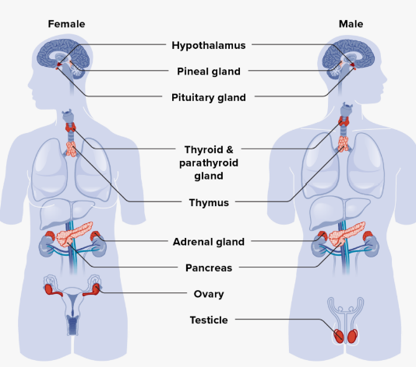
The Endocrine System
Prepared by:
Ms.Jamilah Allehaib
BSN, RN

Slide 2
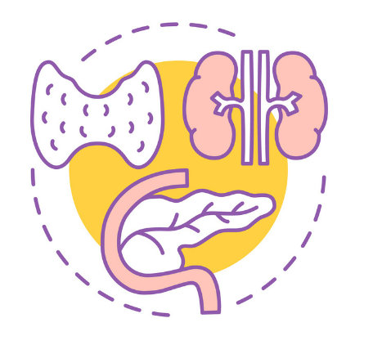
Learning Objectives:
Define The Structure and Function Endocrine System.
Identify Word Parts Related To The Endocrine System.
Describe Disorders Related To The Endocrine System.
Summary of the Endocrine glands, hormones and hormones function.
Identify Diagnostic test, treatments and Surgical Procedure.
Pronounce, spell, and define medical terms related to the endocrine system and its disorders.

Slide 3
Learning Outcomes:
Upon completion, you should be able to:
■ Name the major endocrine glands and the hormones each gland secretes.
■ Pronounce, spell, and define medical terms related to the endocrine system and its disorders.
■ Interpret abbreviations associated with the endocrine system.

Slide 4
Introduction of The Endocrine System:
The Endocrine System: consists of ductless glands and organs that secrete hormones directly into the bloodstream.
Glands are cell groupings that function as a secretory organ.
In the case of the endocrine system, the secretion is called a hormone.
Hormones are transported in the bloodstream to stimulate specific cells or tissues, working together with the nervous system.
The Endocrine system helps to maintain homeostasis (chemical balance) throughout the body.
The Nervous system also contributes to this process by either stimulating or delaying hormone release according to feedback mechanisms.

Slide 5
Word Parts Related To The Endocrine System
Endocrine comes from endo- (within) and the Greek krinein (to separate) and refers to secreting internally.
This can be contrasted to exocrine glands, which secrete hormones through ducts instead of directly into the bloodstream.
Example of an exocrine gland is a sweat gland, which secretes onto the skin surface.
Aden/o is the root for gland and comes from the Greek word for gland, aden.
Be careful not to confuse aden/o with adren/o.
Adren/o refers specifically to the adrenal glands, found by the kidneys and comes from the Latin ad- (near) and ren/o (kidney).
Table 9-1 lists word parts that make up endocrine system terms.

Slide 10
Structure and Function of The Endocrine System
Several glands make up the endocrine system. These include the pineal, pituitary (anterior lobe, intermediate, and posterior lobes), thyroid, parathyroid (two paired glands, superior and inferior), thymus, adrenal (cortex and medulla), pancreas (pancreatic islets), testes (in males), and ovaries (in females).

Slide 12
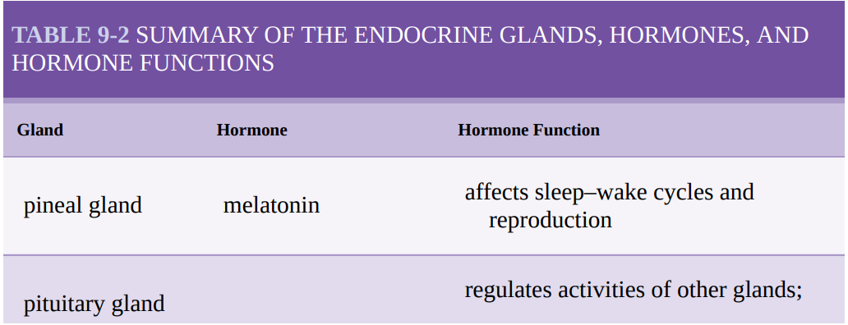
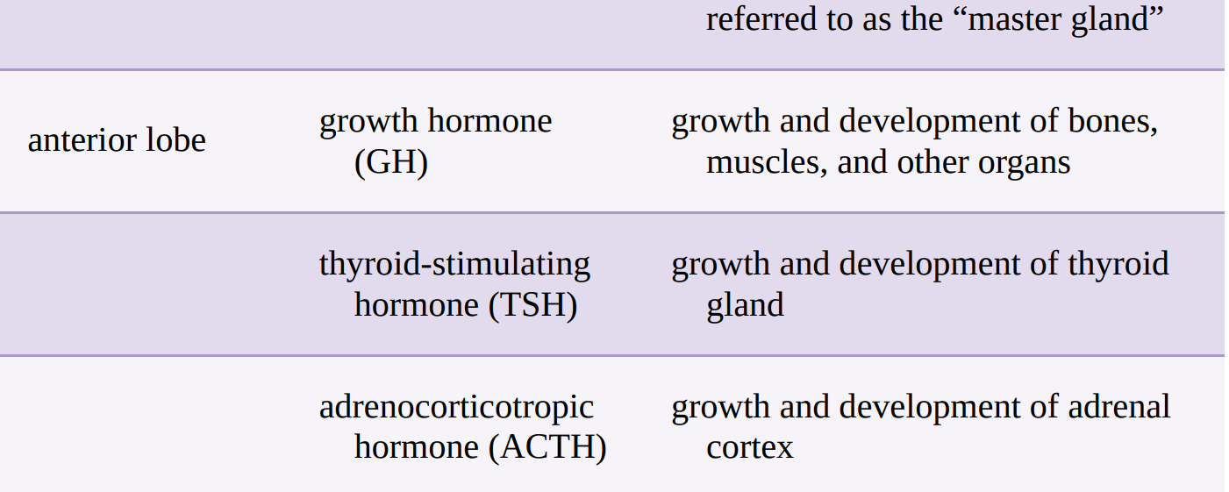

Slide 15
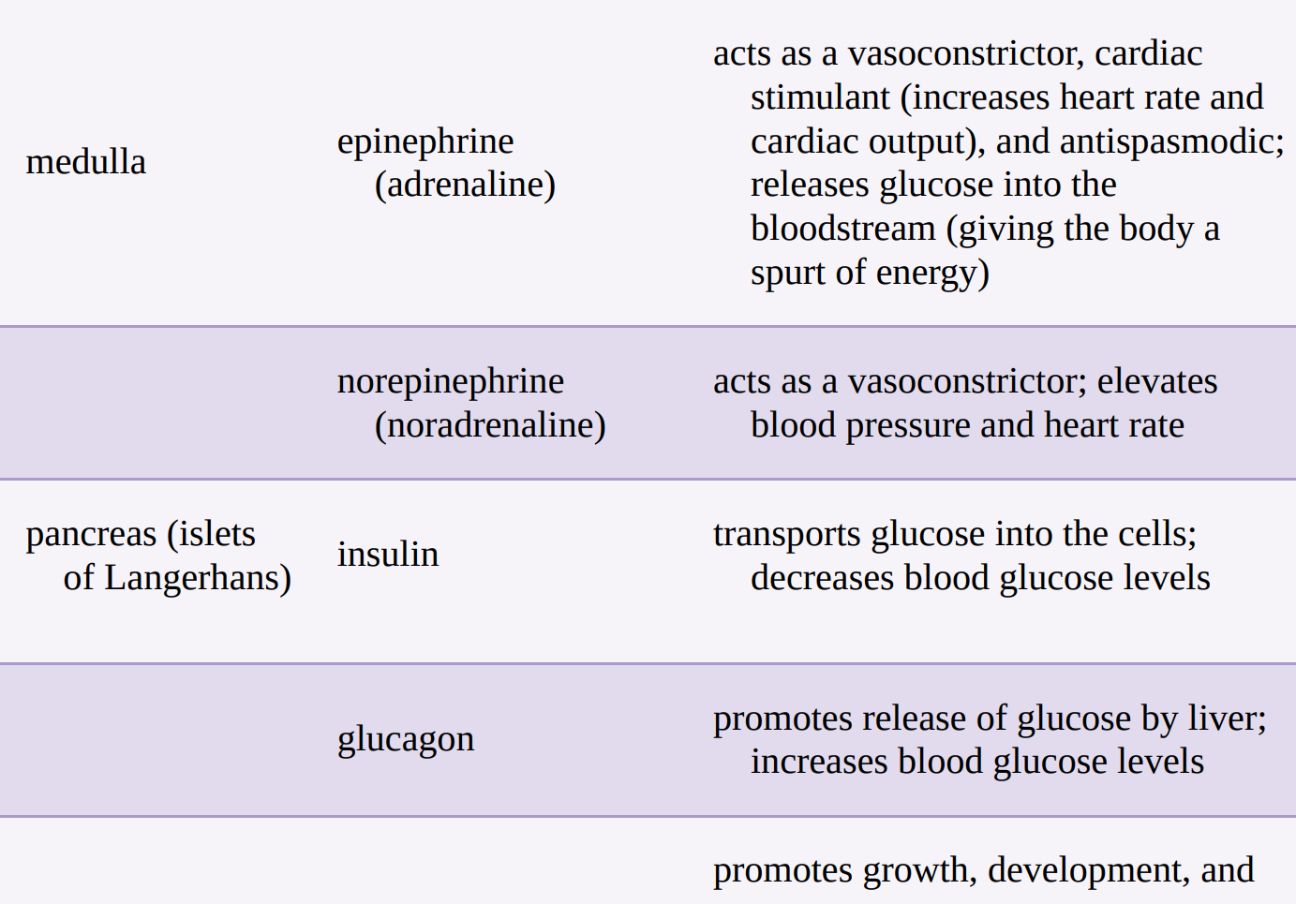

Slide 16
Disorders Related To The Endocrine System:
Disorders of the endocrine system are almost always the result of an excess or a deficit in hormone production.
In other words, either too much or too little of a hormone causes a problem.
If there is too much, surgery or radiation may be needed.
If there is too little, replacement therapy is the usual treatment.
Disorder of the Pituitary Gland:
Adenoma: a benign tumor that causes excessive hormone secretion.
Diabetes insipidus: is a disorder in which the posterior lobe of the pituitary gland no longer releases sufficient amounts of ADH (Anti-Diuretic Hormone) or because the response to ADH is impaired.
-This results in polydipsia (excessive thirst) and polyuria (excessive urination).
Gigantism, or giantism: is a disorder caused by excessive secretion of growth hormone (GH) before puberty, resulting in abnormally long bones. When excessive GH secretion occurs in adulthood, this results in acromegaly, which is characterized by abnormally thick bones in the extremities, especially the hands and feet.

Slide 17
CONT…
Disorder of The Thyroid Gland:
Hypothyroidism: deficient hormone production by the thyroid gland, is characterized by decreased metabolic rate, weight gain, and tiredness.
Excessive thyroid hormone production leads to hyperthyroidism, characterized by increased metabolic rate, weight loss, and rapid heartbeat.
A form of hyperthyroidism is Graves disease, which is an autoimmune disorder (condition in which the body’s antibodies are directed against itself) resulting in goiter (neck swelling) and exophthalmos (eye protrusion).
Disorders of the Adrenal Gland:
Addison disease: is a progressive disorder caused by an insufficient amount of cortisol and aldosterone production in the adrenal gland or a failure of the pituitary gland to produce a stimulating hormone targeting the adrenal gland. It is characterized by skin darkening, weakness, and loss of appetite
Cushing’s syndrome: is caused by an excessive amount of cortisol production by the adrenal glands. It is characterized by fat pads in the chest and abdomen and a “moon face” appearance.

Slide 18
CONT…
Disorders of the Pancreas:
Diabetes mellitus (DM): is a disorder caused by insulin deficiency and/or insulin resistance.
This results in poor carbohydrate metabolism and high blood glucose level.
There are two main types: Type 1 DM is a metabolic disorder caused by insufficient production of insulin and usually develops in childhood. Symptoms in the early stages include glycosuria (excess glucose in the urine) and hyperglycemia (excess glucose in the blood).
Type 2 DM is caused by either a lack of insulin or the body’s inability to use insulin efficiently. It usually develops in middle-aged or older adults.

Slide 19
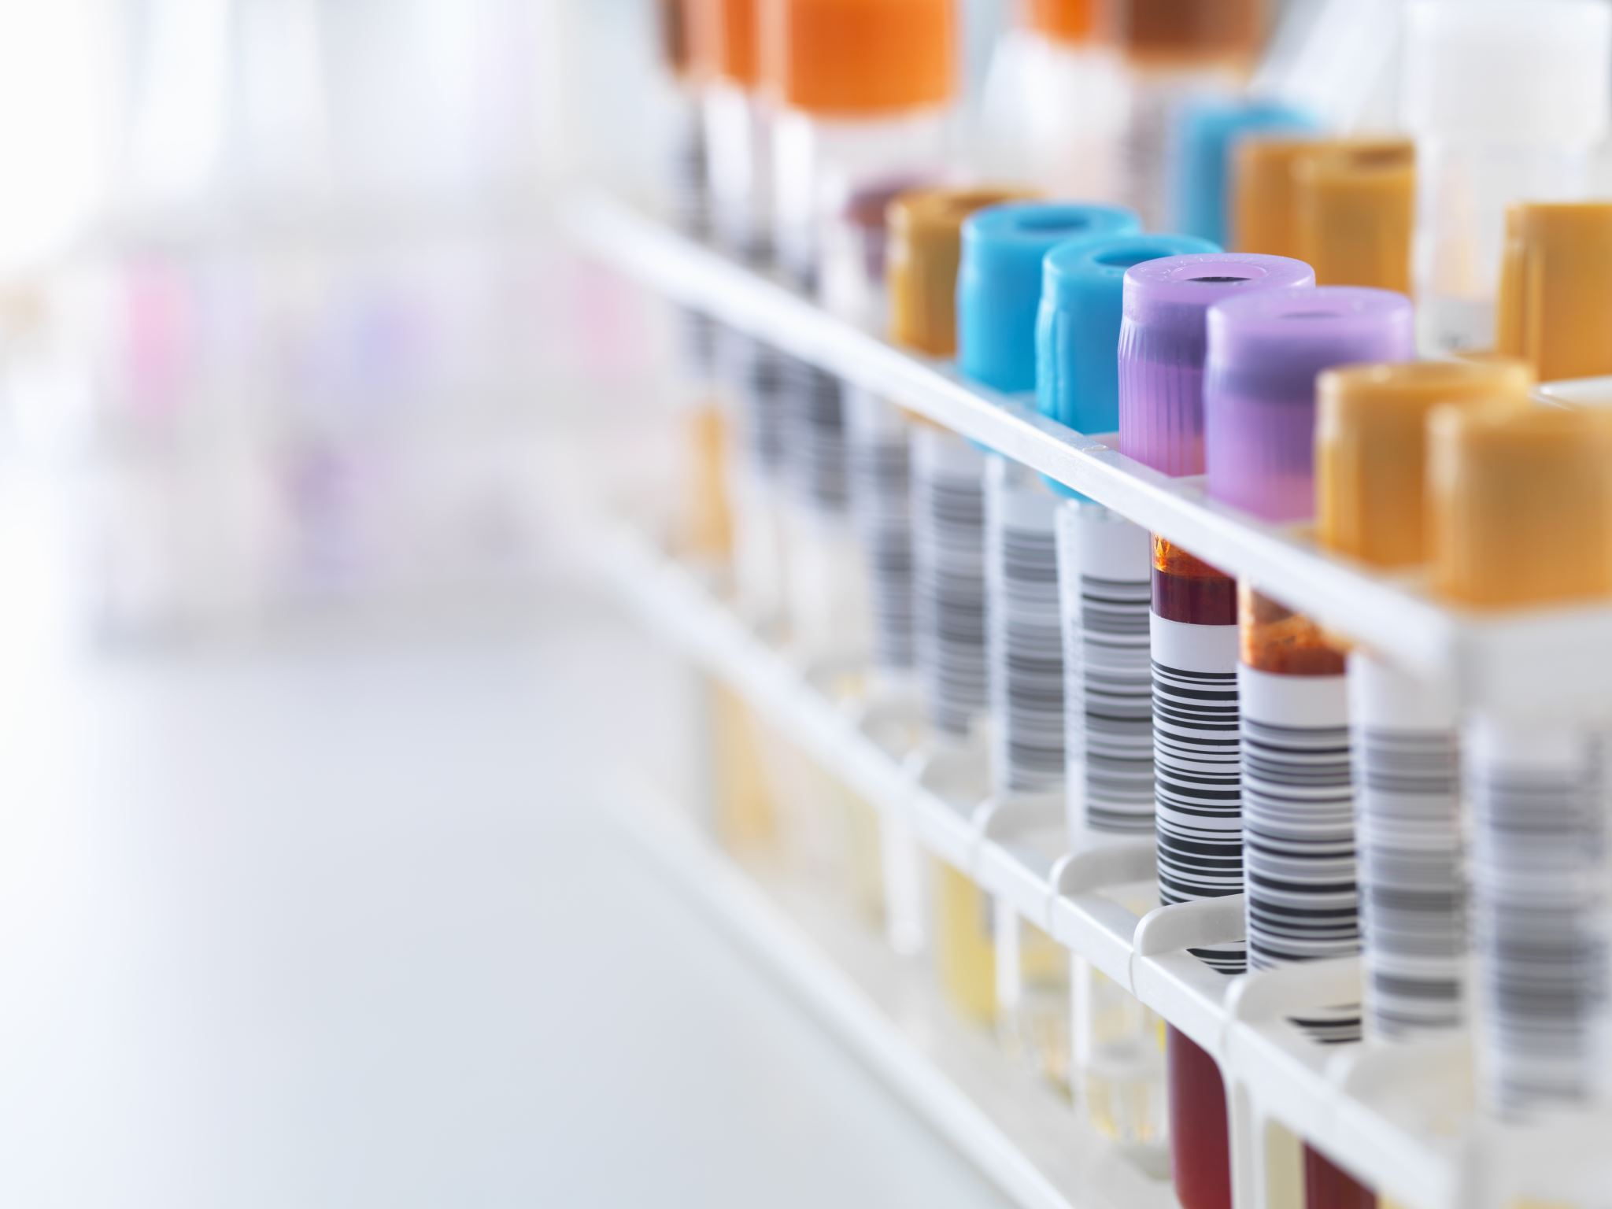
Diagnostic test, treatments and Surgical Procedure.
Hormone replacement therapy: is often used to correct endocrine disorders, where the problem is a low hormone level.
- Examples of disorders treatable by hormone replacement: hypothyroidism and DM.
-In hypothyroidism, patients are given a medication called levothyroxine to replace low thyroxine levels.
-In diabetes (DM), patients are given medications to treat high glucose levels. Most commonly, Type I patients are given insulin. In Type II, diet and exercise may be enough to control glucose levels. If they do need medications, these patients are more likely to receive oral medications to help decrease blood glucose.
In Addison’s disease, where the hormone lacking is cortisol, corticosteroids may also be administered for their immunosuppressant and anti-inflammatory properties.

Slide 20
Practice and Practitoners:
Endocrinology: is the medical practice of treating endocrine and hormonal disorders.
Endocrinologist, specializes in caring for patients with endocrine diseases and hormonal dysfunctions that may involve sexual development, body growth, or other bodily functions.

Slide 25
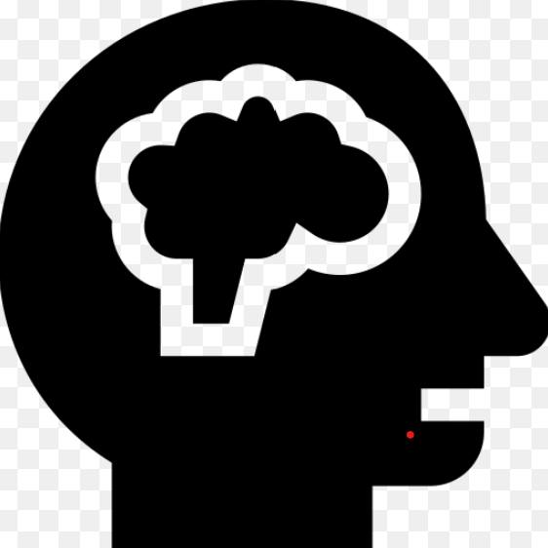
Check your understand

Slide 26
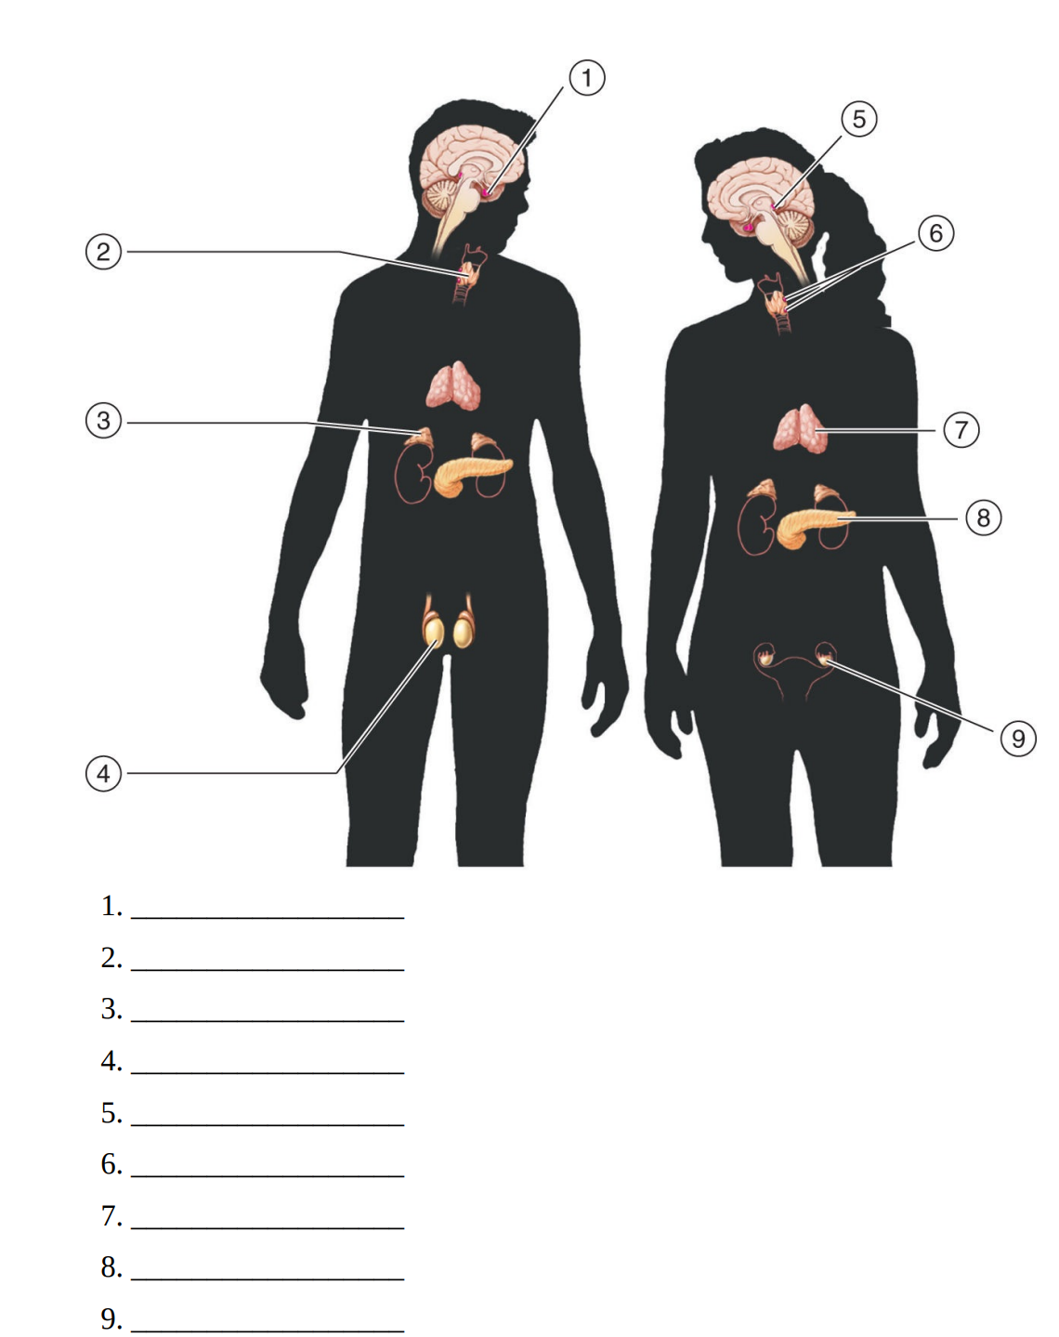

Slide 30
Nath, Judi Lindsley, A short course in medical terminology,Fourth edition [2019].
Reference:

Slide 31
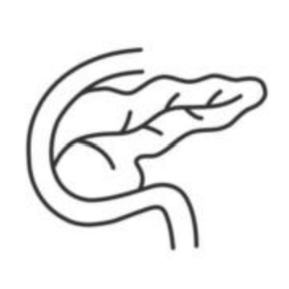
Any Questions?

Slide 32
Thank you !

