Slide 1
C H A P T E R 5 3 Confusion and Dementia
MADA ALSEDRAH

Slide 2
OBJECTIVES
• Define the key terms and key abbreviations in this chapter.
• Describe confusion and its causes.
• List the measures that help confused persons.
• Explain the difference between delirium and dementia.
• Describe the signs, symptoms, and behaviors of Alzheimer's disease (AD).
• Explain the care required by persons with AD and other dementias.

Slide 3
KEY TERMS
Cognitive function involves memory, thinking, reasoning, ability to understand, judgment, and behavior
Confusion A state of being disoriented to person, time, place, situation, or identity
Delirium A state of sudden, severe confusion and rapid changes in brain function
Delusion A false belief dementia the loss of cognitive function that interferes with daily life and activities

Slide 4
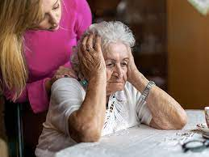
INTRODUCTION
Changes in the brain and nervous system occur with certain diseases and with age.. Cognitive function may be affected. (Cognitive relates to knowledge.) Cognitive function involves memory, thinking, reasoning, ability to understand, judgment, and behavior. Changes in function affect quality of life.

Slide 5
Confusion
Confusion is a state of being disoriented to person, time, place, situation, or identity. Disoriented means to be apart from (dis) one's awareness (oriented). Memory and the ability to make good judgments are often lost.
A person may not know people, the time, or the place. Daily activities may be affected.
Behavior changes are common—anger, restlessness, depression, irritability.
Disease, brain injury, infections, fever, alcohol or drug use, and drug side effects are some causes of confusion.
Hypoxia , hypoglycemia, sleep problems, and seizures are other causes. Poor nutrition and fluid and electrolyte imbalances can cause confusion. Depending on the cause, onset may be fast or slow. Confusion may be temporary or permanent. Treatment is aimed at the cause.

Slide 8
Delirium
Delirium is a state of sudden, severe confusion and rapid changes in brain function. Usually temporary and reversible, it occurs with physical or mental illness. Other causes include surgery, drug or alcohol abuse, drug side effects, severe lack of sleep, and electrolyte imbalances. Infections such as urinary tract infections and pneumonia can cause delirium.
Onset is usually fast—within hours or a few days.

Slide 9
Signs and symptoms :
• Alertness: changes in (usually more alert in the morning and less alert at night)• Sensation: changes in• Awareness: changes in • Movement: very active or slow moving • Drowsiness • Confusion about time or place • Memory: decreased short-term memory and recall (cannot remember events since the delirium began) • Thinking: changes in • Concentration: problems with • Speech: does not make sense • Incontinence • Emotional changes: agitation, anger, depression, euphoria, irritability
May come and go during the day and worsen at night. Delirium often lasts for about 1 week. However, it may take several weeks for normal mental function to return.

Slide 10
Dementia
Dementia is the loss of cognitive function that interferes with daily life and activities. (De means from. Mentia means mind.) Changes in personality, mood, behavior, and communication are common. Dementia is a group of symptoms, not a specific disease.
Dementia is caused by damage to brain cells. Some conditions cause thinking and memory problems that can be reversed when the cause is treated.
Depression, drug side effects, excess alcohol use, thyroid problems, and vitamin deficiencies are examples. Head injury and blood clots, tumors, or infections in the brain are other treatable causes. Permanent dementias result from changes in the brain. There is no cure. Function declines over time.

Slide 12
CONT…
Dementia is not a normal part of aging. The risk increases with age. Persons over 65 and those with a family history of dementia are at higher risk.
Early warning signs include: • Memory loss (losing things, forgetting names) • Problems with common tasks (for example, dressing, cooking, driving) • Problems with language and communication; forgetting simple words • Getting lost in familiar places • Misplacing things and putting things in odd places (for example, putting a watch in the oven) • Personality, mood, and behavior changes • Poor or decreased judgment (for example, going out in the snow without shoes)

Slide 13
Mild Cognitive Impairment
Mild cognitive impairment (MCI) causes slight changes in memory or thinking. For example, the person loses things often, forgets important events or appointments, or forgets which words to use. Changes are greater than those with normal aging. The person can do normal activities and care for himself or herself. The person is at risk for dementia.

Slide 14
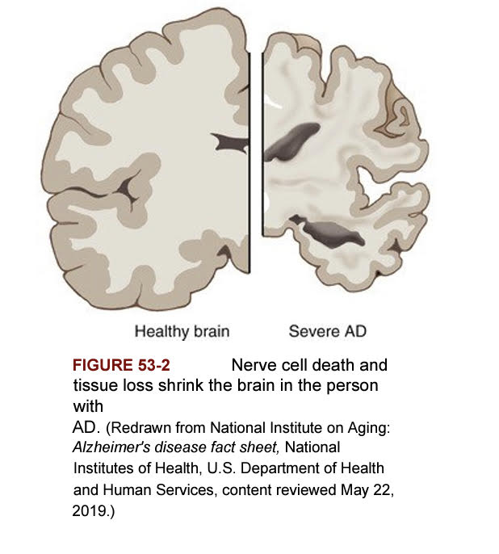
Alzheimer's Disease
Alzheimer's disease (AD) is the most common type of permanent dementia. Many brain cells are destroyed and die. Connections between nerve cells are lost. Over time, the brain shrinks from nerve cell death and tissue loss .Two abnormal structures are thought to cause damage.

Slide 15
CONT…
AD onset is gradual. Usually symptoms appear after age 60. Persons with AD can live for 4 to 8 years or longer. A family history of AD increases the person's risk. More persons with AD are women because women live longer than men.
The National Institute on Aging (NIA) recommends the following to maintain cognitive health.
• Get regular exercise. • Eat a healthy diet. • Spend time with family and friends. • Keep the mind active. • Control type 2 diabetes • Maintain healthy blood pressure) and cholesterol levels). • Maintain a healthy weight. • Do not smoke. • Get help for depression). • Avoid excess alcohol intake. • Get enough sleep.

Slide 16
CONT…
Signs of AD According to the Alzheimer's Association, one of the most common early symptoms of AD is forgetting newly learned information. There is a slow decline in memory, thinking, and reasoning.

Slide 18
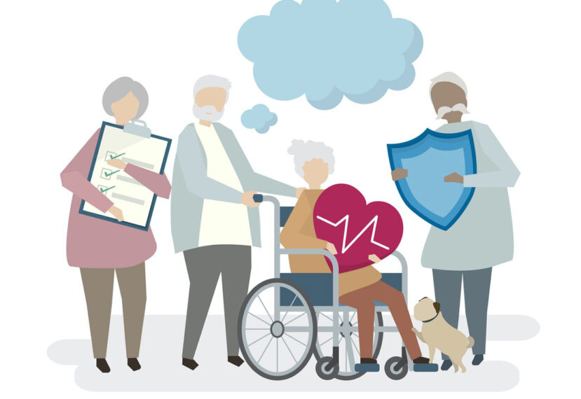
The care required by persons with AD and other dementias

Slide 19
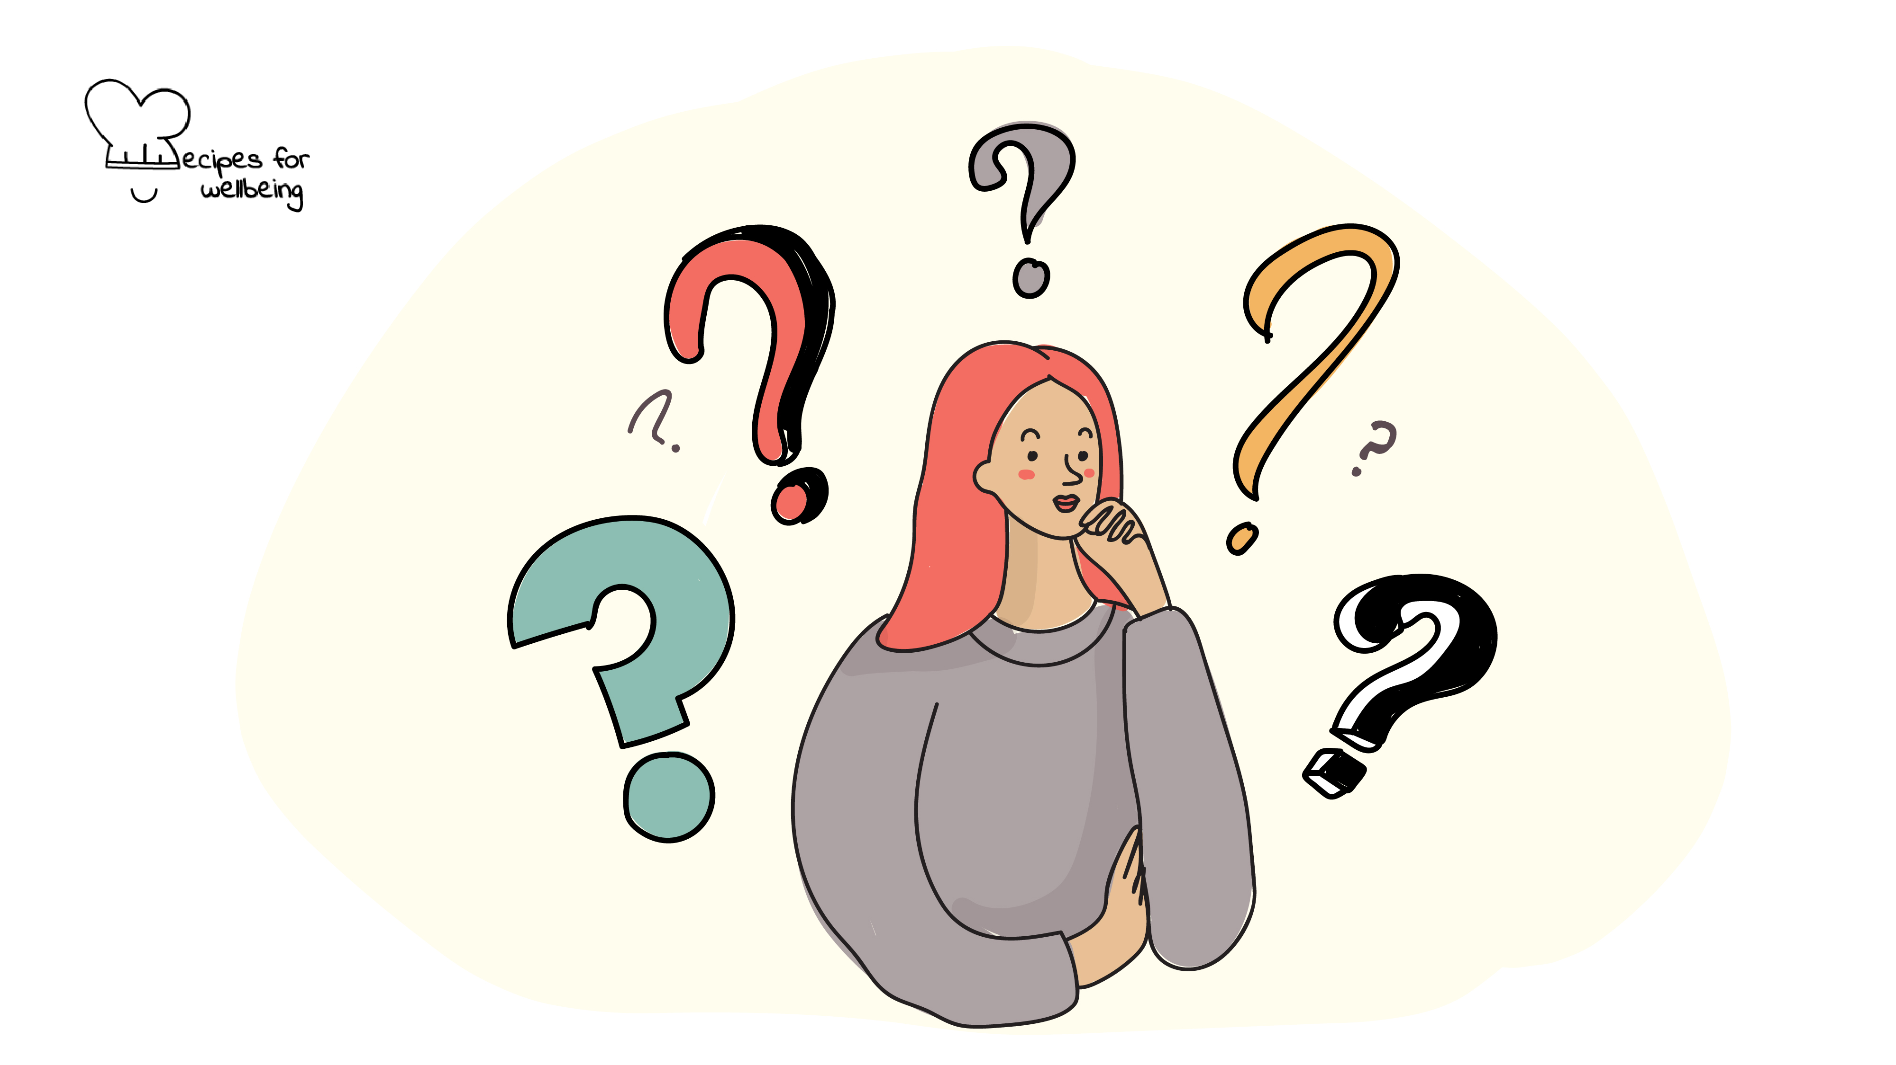

Slide 20
REFERENCE:
1. Sorrentino, S. A., Remmert, L., & Wilk, L. S. (2020). Mosby's Textbook for Nursing Assistants (10th ed.). St. Louis, MO: Elsevier.)

