Slide 1
Fall Prevention
MADA ALSEDRAH
BSN.MSN.RN

Slide 2
OBJECTIVES
DEFINE OF FALL
IDENTIFI THE RISK FACTORS OF FALL INJURY
EXPLAIN THE FALL RISK PREVENTION SRTRATEGIES
DISCUSE THE FALL RISK ASSESSMENT TOOLS

Slide 3
INTRODUCTION
The risk of falling increases with age. Persons older than 65 years are at risk. Falls are a leading cause of injuries and deaths among older persons. A history of falls increases the risk of falling again. Falls are the most common accidents in nursing centers.
The Centers for Medicare & Medicaid Services defines A Fall as:
Unintentionally coming to rest on the ground, floor, or other lower level. Force, such as being pushed, was not involved.
When a person loses his or her balance and would have Fallen if staff did not act to prevent the fall.
When a person is found on the floor unless matters suggest otherwise.

Slide 4
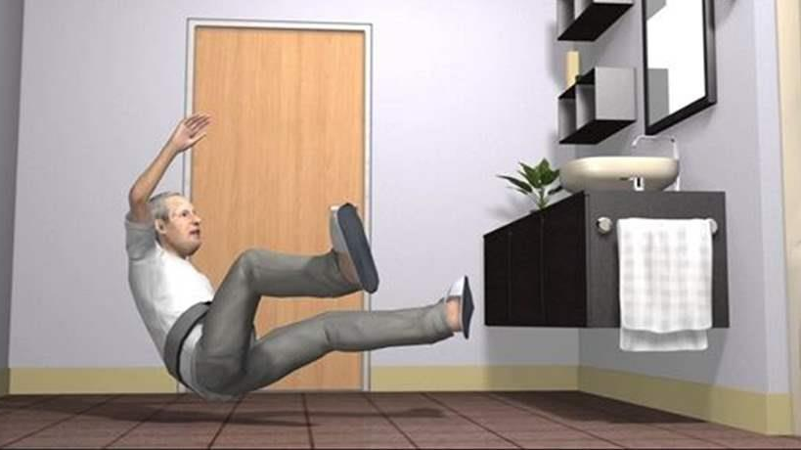
CAUSES AND RISK FACTORS FOR FALLS
Most falls occur:
• In patient and resident rooms and in bathrooms.
• Within the first 72 hours of admission to a hospital or nursing center.
• During the night and after meals.
• During shift changes. Staff are busy going off and coming on duty. Confusion can occur about who gives care and answers call lights.
The accident risk factor of the population at risk for safety hazards can lead to falls .

Slide 5
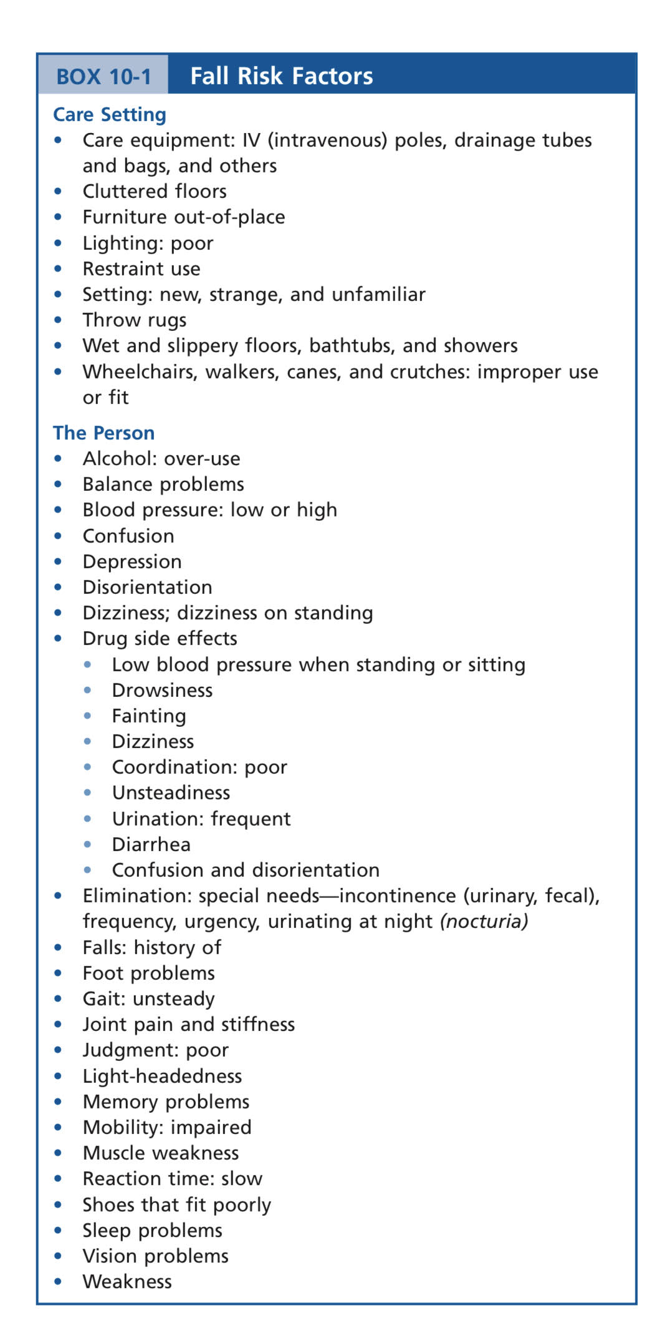

Slide 6
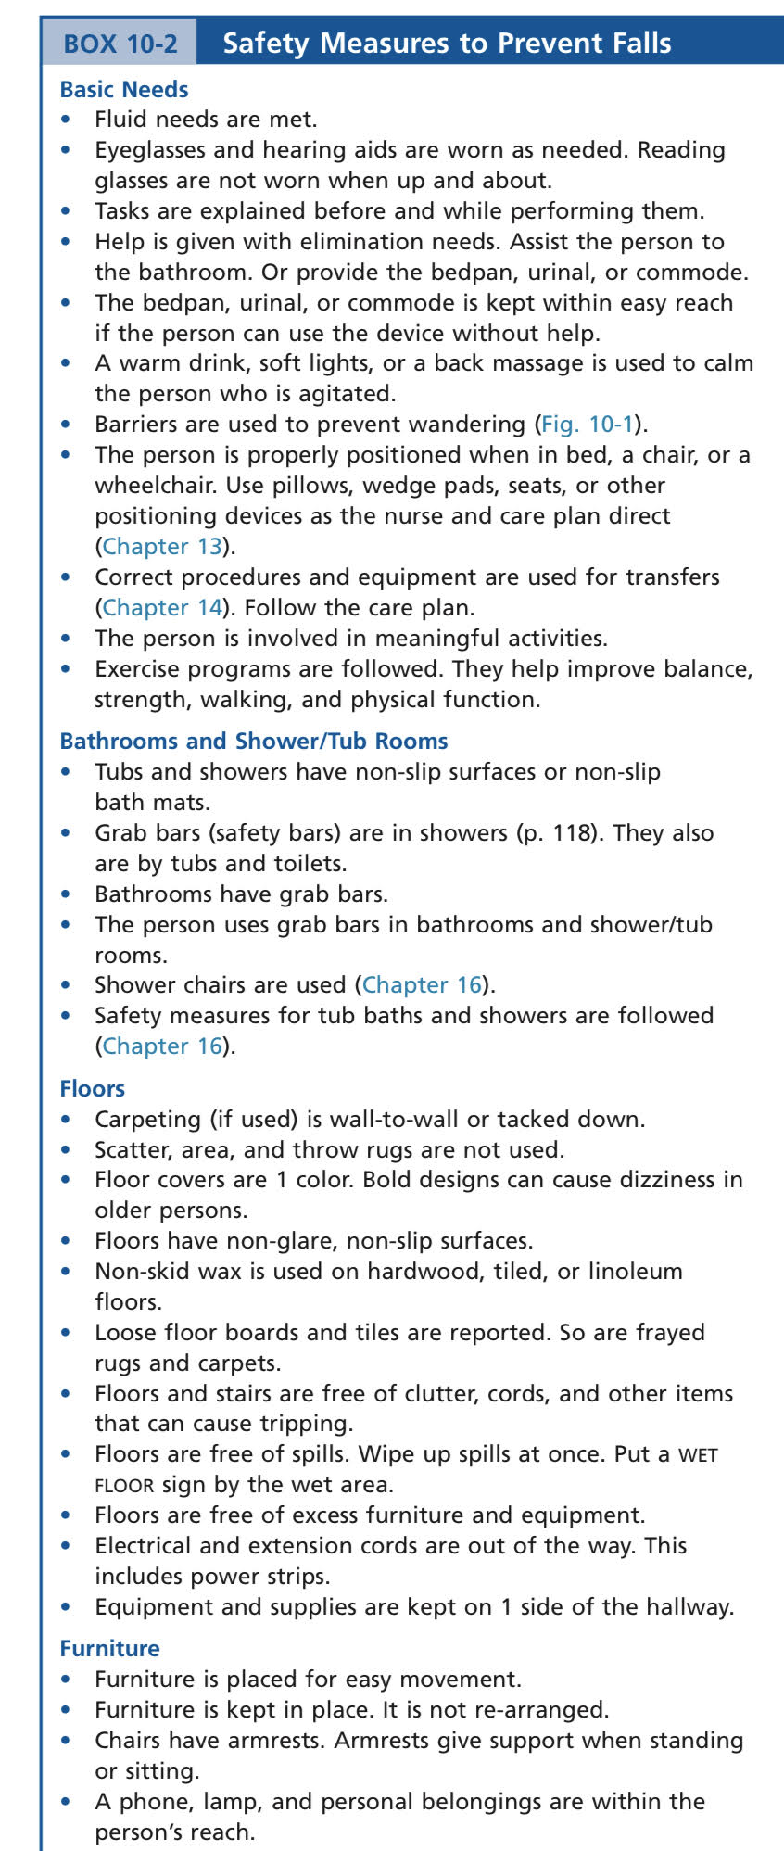
STRATEGIES

Slide 7
Cont…

Slide 8
CONT…

Slide 9
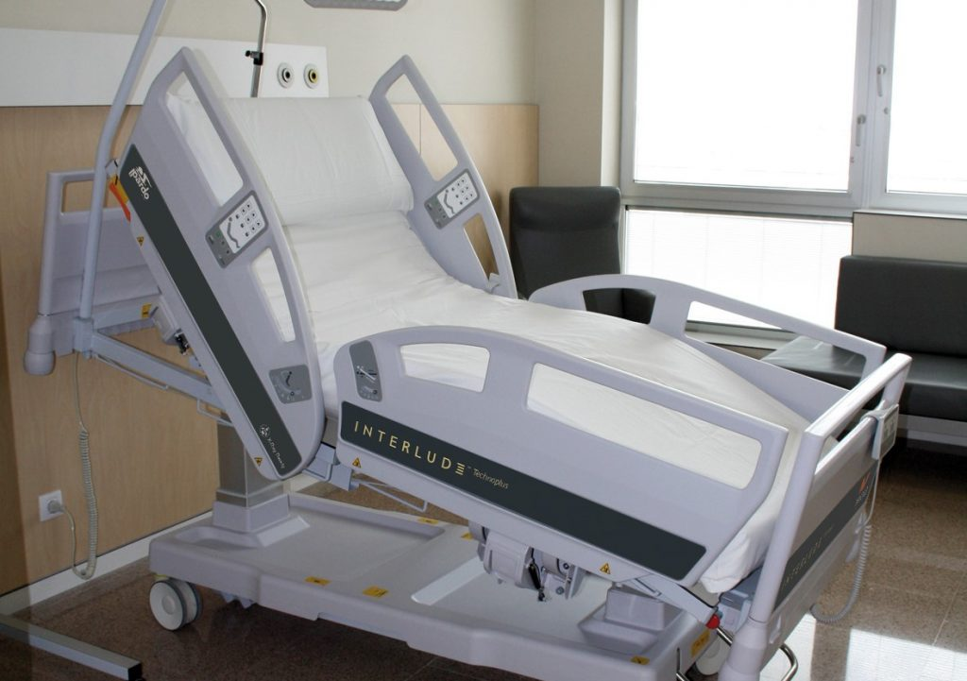

Slide 10
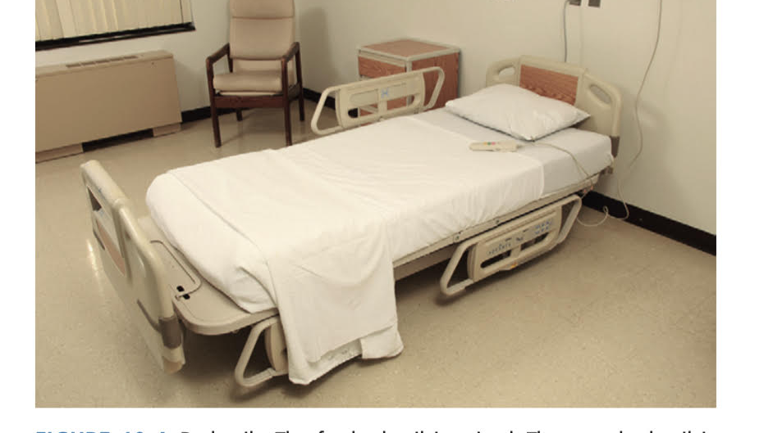
Bed Rails
A bed rail (side rail) is a device that serves as a guard or barrier along the side of the bed.
They are needed by persons who are unconscious or sedated with drugs. Some confused or disoriented people need them. If a person needs bed rails, always keep them up except when giving bedside nursing care.
Bed rails are considered restraints if:
• The person cannot get out of bed.
• The person cannot lower them without help.
Some people feel safer with bed rails up. Others use them to change positions in bed.

Slide 11
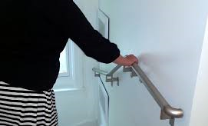
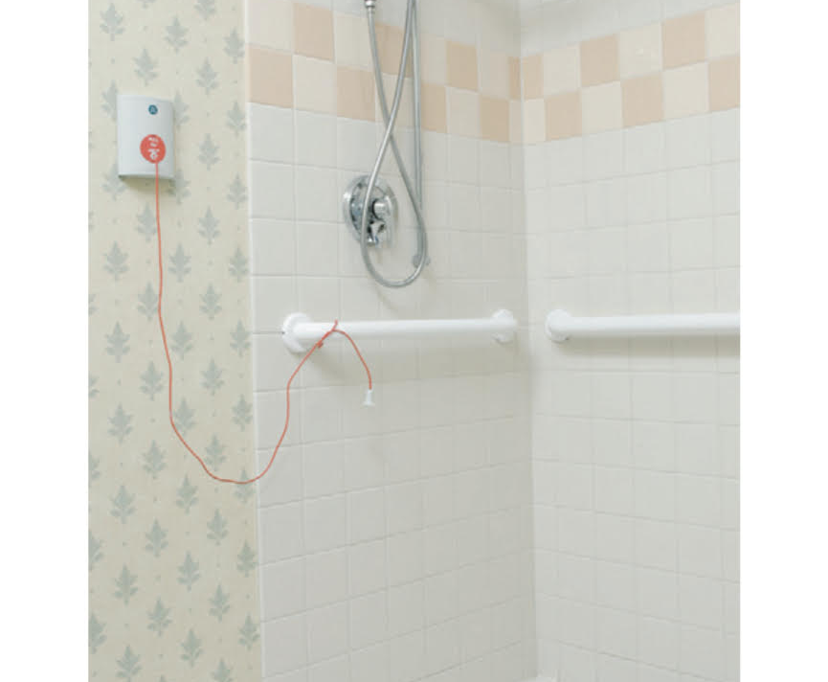
Handrails and Grab Bars
Handrails are in hallways and stairways .They give support to persons who are weak or unsteady when walking.
Grab bars are in bathrooms and in shower/tub rooms .They provide support for sitting down or getting up from a toilet. They also are used for getting in and out of the shower or tub.

Slide 12
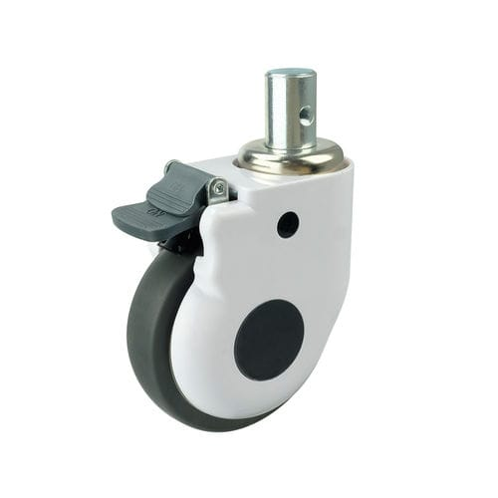
Wheel Locks
Bed legs have wheels. They let the bed move easily. Wheels have locks to prevent the bed from moving.
Wheels are locked at all times except when moving the bed.
Make sure bed wheels are locked:
• When giving bedside care
• When you transfer a person to and from the bed
Wheelchair and stretcher wheels also are locked during transfers

Slide 13
FALL RISK ASSESSMENT TOOLS

Slide 14
CONT…
HIGH RISK SCORE : 12 AND ABOVE , MINIMUM SCORE 7 AND MAXIMUM SCORE IS 23

Slide 20
REFERANCES:
1. Sorrentino, S. A., Remmert, L., & Wilk, L. S. (2020). Mosby's Textbook for Nursing Assistants (10th ed.). St. Louis, MO: Elsevier.)
KFSH-B POLICY & PROCEDURE

Slide 21
ANY q ?

Slide 22
THANK YOU

