Slide 1
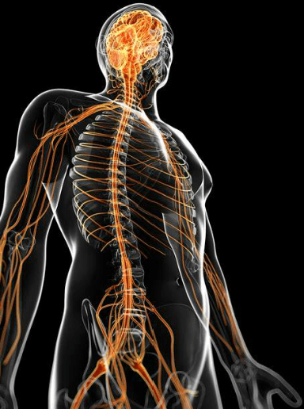
Nervous system and common health problems
Module 5, Specific care stuatons
Prepared by:
Ms.Jamilah Allehaib
BSN, RN

Slide 2
Learning objectives:
Describe structure and function of Nervous system.
Explain the central nervous system (CNS).
Describe Stroke, signs and symptoms and care measures.
Explain Parkinson disease, signs and symptoms and care measures.
Explain Multiple Sclerosis disease, signs and symptoms and care measures.
List the common injury, causes and care measures

Slide 3
Nervous system body structure and function:
The nervous system controls, directs, and coordinates body functions.
Neurologic condition: chronic conditions of the nervous system include Parkinson’s disease, multiple sclerosis (MS), stroke and spinal cord injury.
Nerves connect to the spinal cord.
Nerves carry messages or impulses to and from the brain.
A stimulus causes a nerve impulse.
A stimulus is anything that excites or causes a body part to function, become active, or respond.
A reflex is the body’s response (functioning or movement) to a stimulus.
Reflexes are involuntary, unconscious, and immediate.
The person cannot control reflexes.
Nerves are easily damaged and take a long time to heal.
Some nerve fibers have a protective covering called a myelin sheath.
The myelin sheath also insulates the nerve fiber.
Nerve fibers covered with myelin conduct impulses faster than those fibers without it.

Slide 4
Nervous system body structure and function:
Nervous system
Its 2 main divisions are
The central nervous system (CNS)
The peripheral nervous system
It consists of the brain and spinal cord
It involves the nerves throughout the body

Slide 7
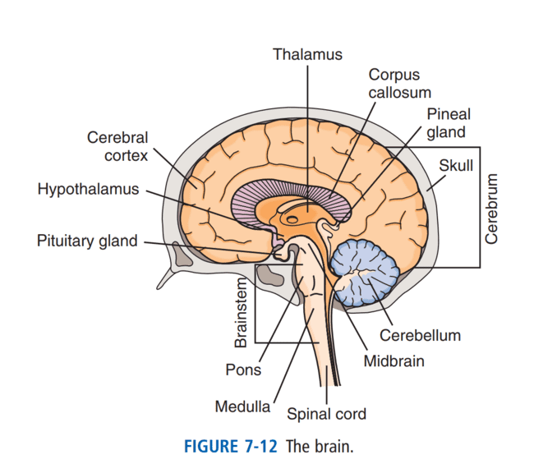
Central Nervous System (CNS):
The brain and spinal cord make up the central nervous system.
The brain is covered by the skull.
The 3 main parts of the brain are the cerebrum, the cerebellum, and the brainstem (Fig. 7-12).

Slide 8
Cerebrum:
The cerebrum is the largest part of the brain.
It is the center of thought and intelligence.
The cerebrum is divided into 2 halves called right and left hemispheres.
The right hemisphere controls movement and activities on the body’s left side.
The left hemisphere controls the right side.
The outside of the cerebrum is called the cerebral cortex.
Cerebral cortex controls the highest functions of the brain.
These include reasoning, memory, consciousness, speech, voluntary muscle movement, vision, hearing, sensation, and other activities

Slide 9
Cerebellum:
The cerebellum: regulates and coordinates body movements.
It controls balance and the smooth movements of voluntary muscles.
Injury to the cerebellum results in jerky movements, loss of coordination, and muscle weakness.

Slide 10
Brainstem:
The brainstem connects the cerebrum to the spinal cord.
The brainstem contains the midbrain, pons, and medulla.
The midbrain and pons relay messages between the medulla and the cerebrum.
The medulla is below the pons.
The medulla controls heart rate, breathing, blood vessel size, swallowing, coughing, and vomiting.
The brain connects to the spinal cord at the lower end of the medulla

Slide 11
Spinal Cord:
The spinal cord lies within the spinal column.
The cord is 17 to 18 inches long.
It contains pathways that conduct messages to and from the brain.
The brain and spinal cord are covered and protected by 3 layers of connective tissue called meninges.
The outer layer lies next to the skull. It is a tough covering called the dura mater.
The middle layer is the arachnoid.
The inner layer is the pia mater

Slide 12
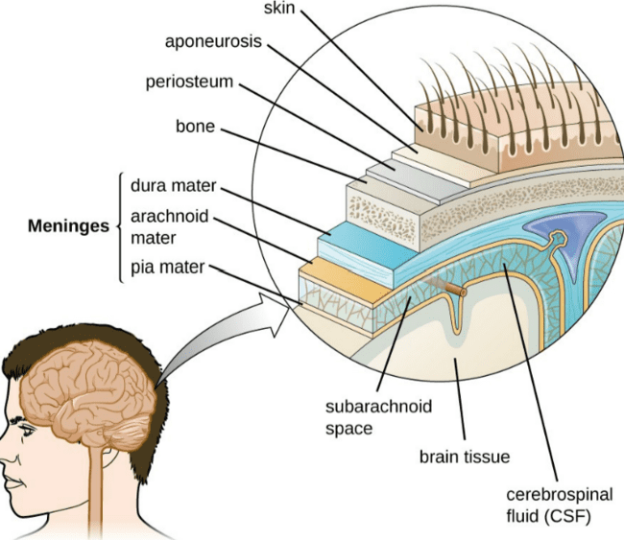
CONT…
The space between the middle layer (arachnoid) and inner layer (pia mater) is the arachnoid space.
The space is filled with cerebrospinal fluid.
It circulates around the brain and spinal cord.
Cerebrospinal fluid protects the central nervous system.
It cushions shocks that could easily injure brain and spinal cord structures.

Slide 13
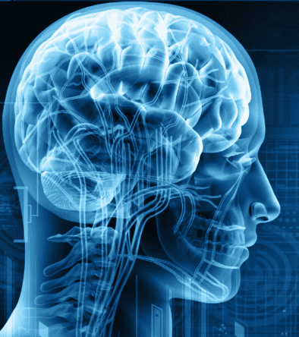
Nervous System Disorders:
Nervous system disorders can affect mental and physical function.
They can affect the ability to speak, understand, feel, see, hear, touch, think, control bowels and bladder, and move.

Slide 14
Stroke :
Stroke is a disease that affects the arteries that supply blood to the brain. It also is called a brain attack or cerebrovascular accident (CVA).
A stroke (cerebrovascular accident [CVA]) occurs when blood flow to a part of the brain is interrupted, which results in death of brain cells.
A stroke can also be caused by bleeding into brain tissue.
It occurs when 1 of these happens:
A blood vessel in the brain bursts. Bleeding occurs in the brain (cerebral hemorrhage).
A blood clot blocks blood flow to the brain. Brain cells in the affected area do not get enough oxygen and nutrients. Brain damage occurs. Functions controlled by that part of the. brain are lost (Fig. 28-13).
A stroke can cause hemiplegia (paralysis on one side) or hemiparesis (weakness on one side).
So can hemiplegia—paralysis (plegia) on 1 side (hemi) of the body. The person may lose bowel and bladder control and the ability to speak.
(See “Aphasia.”) All stroke-like symptoms signal the need for emergency care. aphasia The total or partial loss (a) of the ability to use or understand language (phasia)
The person may have a decreased sense of pain, touch and temperature on the affected side. In addition, the person may have difficulty swallowing (Figure 18-5).
Other effects of stroke may include aphasia (language disorder, difficulty speaking, reading or writing), vision impairments, and bowel or bladder incontinence (or both).

Slide 15
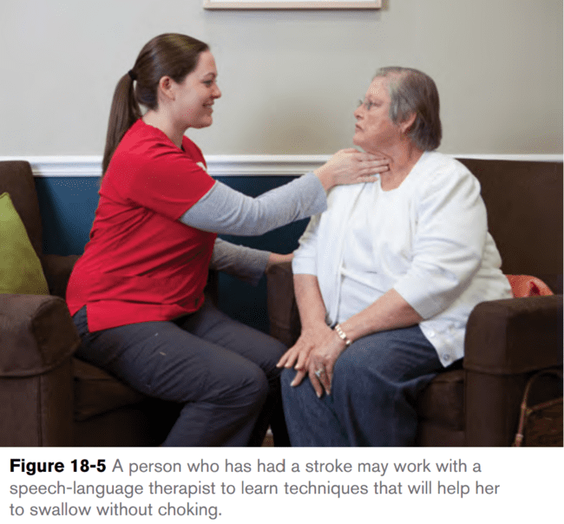

Slide 16
Transient Ischemic Attack (TIA):
Warning signs may last a few minutes. This is called a transient ischemic attack (TIA).
(Transient means temporary or short term. Ischemic means to hold back [ischein] blood [hemic]).
Blood supply to the brain is interrupted for a short time.
A TIA may occur before a stroke.
The person also may have nausea, vomiting, and memory loss, unconsciousness, noisy breathing, high blood pressure, slow pulse, redness of the face, and seizures may occur.

Slide 17
STROKE:
Stroke is a leading cause of death and disability among adults in the United States.
See Box 28-6 for warning signs. The person needs emergency care.
Blood flow to the brain must be restored as soon as possible.
Depending on the area of the brain damaged by the stroke, the person may have trouble forming words or understanding the meaning of words.
If the person has trouble forming words, allow the person extra time to express her thoughts. The person may rely heavily on nonverbal forms of expression (such as body language or gestures) or pointing to pictures to communicate with others. As appropriate, ask “yes” or “no” questions to make it easier for the person to respond.
. If the person has trouble understanding the meaning of words, speak slowly and clearly in a normal tone of voice.
Choose simple words rather than complex ones, and speak in simple, direct sentences (for example, “Mr. Lewis, please sit here” instead of “Mr. Lewis, could you please sit down?”).
Use hand gestures (such as patting the seat of the chair), pictures or written messages to help the person understand your meaning.

Slide 19
Stroke:
The effects of stroke include:
• Loss of face, hand, arm, leg, or body control.
• Hemiplegia.
• Changing emotions (crying easily or mood swings, sometimes for no reason).
• Difficulty swallowing (dysphagia).
• Aphasia or slowed or slurred speech.
• Changes in sight, touch, movement, and thought.
• Impaired memory.
• Urinary frequency, urgency, or incontinence.
• Loss of bowel control or constipation.
• Depression and frustration Rehabilitation starts at once.
The person may depend in part or totally on others for care. The health team helps the person regain the highest possible level of function (Box 28-7).

Slide 20
Stroke Care Measures:
When you provide care for a person who has had a stroke;
Encourage her to do as much as possible for herself.
If the dominant side of her body is affected, she may have to relearn how to do activities using her other side.
Encourage the person to use assistive devices for eating, mouth care and other activities to maintain her independence.
In addition:
Encourage the person to do active-assistive range-of-motion exercises or assist the person with passive range-of-motion exercises, according to the person’s care plan.
Be aware that the person’s sense of touch may be affected. He may be unable to recognize pain and temperature and will be unaware of how his affected body parts are positioned. Take measures to keep the person safe.

Slide 21
CONT…
Follow measures on the person’s care plan designed to prevent pressure ulcers, such as following a repositioning schedule and using positioning aids to support weak or paralyzed limbs and ensure good body alignment.
Supervise the person while she eats. If the person cannot eat independently, always put food on the side of the mouth that is not affected by paralysis. Make sure that no food is left in the person’s mouth after the meal is fi nished to lower the person’s risk of choking. Make sure that the person sits up to eat so that she can swallow food more easily.
Because the person may drool on the paralyzed side and her skin may become irritated, keep her face clean and dry. If ordered, apply a protective skin cream.
Supervise the person while he shaves. The person may miss spots that he cannot feel, or he may cut himself and not feel it.
Help the person walk, according to the physical therapist’s directions. The person may need a walker or cane to steady herself.
Put articles that the person needs, such as the person’s method for calling for help, eyeglasses, hearing aid, telephone and a glass of water, within reach on his unaffected side.

Slide 24
Parkinson’s Disease:
Parkinson’s disease is one of the most common nervous system disorders affecting older adults.
Persons over the age of 50 are at risk.
In Parkinson’s disease, a brain chemical called dopamine is not produced in adequate amounts.
Dopamine is needed for proper functioning of the nerves that control movement. As a result, communication between the brain and the nerves that control muscle movement is disrupted.
Parkinson’s disease is a slow, progressive disorder with no cure. Movement is affected.

Slide 25
Signs and symptoms of Parkinson’s disease:
Signs and symptoms become worse over time (Fig. 28-14).
They include:
• Tremors—often start in the hand.
• Pill-rolling movements—rubbing the thumb and index finger— may occur.
• The person may have trembling in the hands, arms, legs, jaw, and face.
• Rigid, stiff muscles—in the arms, legs, neck, and trunk.
• Slow movements—the person has a slow, shuffling gait.
• Stooped posture and impaired balance—it is hard to walk.
• Falls are a risk.
• Mask-like expression—the person cannot blink and smile. A fixed stare is common.

Slide 27
CONT…
A person with Parkinson’s disease has muscle tremors (shaking or repetitive motions of the muscles), especially in the hands.
The tremors are worse when the person is resting and decrease when the person attempts movement.
As the disorder gets worse over time, muscles become weak and stiff.
The person may shuffle and lean forward during walking, and it can be difficult for the person to stop suddenly once he is walking.
These factors put the person at risk for falling.
As the muscles of the face are affected, the person may have trouble chewing and swallowing, and he may drool.
Speech may also be affected; the person may speak in a low tone without much variation.
The person may lose the ability to smile, frown or show other facial expressions.

Slide 28
CONT…
Other signs and symptoms develop over time. They include:
swallowing and chewing problems, constipation, and bladder problems.
Sleep problems, depression, and emotional changes (fear, insecurity) can occur.
So can memory loss and slow thinking.
The person may have slurred, monotone, and soft speech.
Some people talk too fast or repeat what they say.

Slide 29
Parkinson’s disease care measures:
When you provide care for a person who has Parkinson’s disease: focus your care on promoting safety, independence, good nutrition and mobility.
Care strategies for a person with Parkinson’s disease include the following:
Avoid rushing the person.
Muscle tremors increase when the person becomes anxious.
Encourage the person to use assistive devices as needed.
Be patient and allow the person to take the time that she needs.
Encourage the person to exercise within his capabilities and according to his care plan.
Activity can help prevent worsening of stiffness and balance problems.
Frequent rest periods can help the person avoid becoming too tired or frustrated.

Slide 30
CONT…
When the person is walking, remind her to take big steps.
A person with Parkinson’s disease has to make a conscious effort to do what comes naturally to people who can control their movements.
Use a high toilet or elevated toilet seat set on top of a regular toilet seat.
This can make it easier for the person to sit down on, and get up from, the toilet.
Many people with Parkinson’s disease work with a speech therapist to learn safe techniques for eating and swallowing.
Remind the person to use these techniques and check to make sure that he uses them properly.
Offer small, frequent meals and snacks.
People with Parkinson’s disease usually lose weight because they become tired before they finish a meal.
They may also be embarrassed by spilling food or by how slowly they eat, and they may lose interest in eating.

Slide 31
CONT…
Be aware that Parkinson’s disease can affect the muscles used for speech, which makes it difficult for the person to express herself.
Be patient and give the person time to respond to a question or request. When appropriate, asking questions that can be answered with a simple “yes” or “no” may make it easier for the person to express herself.
Provide emotional support.
Drugs are ordered to treat and control the disease.
Exercise and physical therapy help improve strength, posture, balance, and mobility.
Therapy is needed for speech and swallowing problems.
The person may need help with eating and self-care.
Normal elimination is a goal.
Safety measures are needed to prevent falls and injuries.

Slide 32
Multiple Sclerosis:
Multiple sclerosis (MS): is a chronic disease.
Multiple sclerosis (MS): is a chronic disease that gradually destroys the protective coating on the nerves in the brain and spinal cord.
This condition creates a situation similar to a short circuit or crossed wire.
Multiple means many, Sclerosis means hardening or scarring.
The myelin (which covers nerve fibers) in the brain and spinal cord is destroyed.
Nerve impulses are not sent to and from the brain in a normal way.
Functions are impaired or lost.
Nerves cannot communicate with each other or with the brain.

Slide 33
Multiple Sclerosis:
Late in the disease, the person may become paralyzed.
There is no cure for MS.
Symptoms usually start between the ages of 20 and 40.
The risk increases if a family member has MS.
MS can present in many ways.
For example: The symptoms last for a few weeks or a few months.
The symptoms gradually disappear with partial or complete recovery.
The person is in remission. At some point, symptoms flare up again (relapse).
The person may experience periods of remission, with no symptoms, but then the symptoms return and are much worse.
The person’s condition gradually declines with more and more symptoms. There are no remissions.
Symptoms become worse. More symptoms occur with each flare-up. The person’s condition declines.

Slide 34
Signs and Symptoms of Multiple Sclerosis:
A person with MS may have difficulty walking; loss of balance; muscle tremors and muscle weakness; feelings of numbness, tingling and burning; vision problems; speech problems (such as slurred speech); bowel and bladder problems; pain; and overwhelming fatigue
Signs and symptoms may include:
• Blurred or double vision; blindness in 1 eye.
• Muscle weakness in the arms and legs.
• Balance and coordination problems.
• Tingling, prickling, or numb sensations.
• Partial or complete paralysis. • Pain.
• Speech problems. • Tremors. • Dizziness.
• Concentration, attention, memory, and judgment problems.
• Depression. • Bowel and bladder problems.
• Problems with sexual function. • Hearing loss. • Fatigue

Slide 35
Multiple Sclerosis Care Measures:
When you care for a person with MS;
Persons with MS are kept as active as long as possible and as independent as possible.
The care plan reflects the person’s changing needs.
Skin care, hygiene, and ROM exercises are important.
So are turning, positioning, and deep breathing and coughing.
Bowel and bladder elimination is promoted.
Injuries and complications from bedrest are prevented.
Encourage the person to do as much for herself as possible to maintain independence.
As always, focus on what the person can do rather than what she cannot do.
Encourage the person to do active range-of-motion (ROM) exercises when possible, or help her with range-of-motion exercises according to her care plan.
to prevent contractures and maintain joint mobility.

Slide 36
Head Injury:
Head injuries result from trauma to the scalp, skull, or brain.
Some minor injuries do not need health care.
Or the person needs some emergency treatment.
Traumatic brain injury (TBI): occurs when a sudden trauma damages the brain.
Brain tissue is bruised or torn.
Bleeding can be in the brain or in nearby tissues.
Spinal cord injuries are likely. Motor vehicle crashes, falls, assaults, and firearms are common causes. So are sports and recreation injuries.

Slide 37
Head Injury:
If the person survives, some permanent damage is likely.
Disabilities depend on the severity and site of injury.
They include:
Cognitive problems: thinking, memory, and reasoning.
Sensory problems: sight, hearing, touch, taste, and smell.
Communication problems: expressing or understanding language.
Behavior or mental health problems: depression, anxiety, personality changes, aggressive behavior, socially inappropriate behavior.
Stupor: an unresponsive state; the person can be briefly aroused.
Coma: the person is unconscious, does not respond, is unaware, and cannot be aroused.
Vegetative state: the person is unconscious and unaware of surroundings. He or she has sleep-wake cycles and periods of being alert.
Persistent vegetative state (PVS): the person is in a vegetative state for more than 1 month.
Rehabilitation is required.
Nursing care depends on the person’s needs and abilities

Slide 38
Spinal Cord njury:
Messages to and from the brain travel through the spinal cord.
Spinal cord injuries often occur suddenly, as a result of trauma (for example, a motor vehicle crash or diving accident).
Spinal cord injuries can seriously damage the nervous system.
Paralysis (loss of muscle function, sensation, or both) can result.
Common causes are stab or gunshot wounds, motor vehicle crashes, falls, and sports injuries.
Problems depend on the amount of damage to the spinal cord and the level of injury.
The higher the level of injury, the more functions lost (Fig. 28-15).

Slide 39
Spinal Cord njury:
Spinal cord injuries can cause paralysis (the loss of movement and sensation) below the level of the injury.
Paraplegia is paralysis that affects both legs and the lower trunk and can result from injury to the lower spinal cord (for example, at waist level or below).
Paralysis in the arms, legs, and trunk is called quadriplegia or tetraplegia. (Quad and tetra mean four. Plegia means paralysis.)
Quadriplegia is paralysis that affects both arms, the trunk and both legs.
An injury in the neck or upper spinal cord can result in quadriplegia.
Lumbar injuries: sensory and muscle function in the legs is lost.
The person has Paraplegia: paraplegia is paralysis in the legs and lower trunk. (Para means beyond; plegia means paralysis).
Thoracic injuries: sensory and muscle function below the chest is lost. The person has paraplegia.
Cervical injuries: sensory and muscle function of the arms, legs, and trunk is lost.

Slide 41
Severity of Spinal Cord njury:
Depending on the location of the damage to the spinal cord, as well as the severity of the injury.
The person may experience:
■ Loss of sensation in the affected body parts.
■ Loss of movement in the affected body parts.
■ Loss of bladder control, bowel control or both.
■ Loss of the ability to breathe without mechanical assistance.
Loss of sensation puts the person at risk for injuring the affected body parts, and loss of movement can affect the person’s ability to manage some tasks.

Slide 42
Spinal Cord Injury Care Measures:
When you provide care for someone with a spinal cord injury:
focus on promoting safety and independence.
Follow the person’s care plan concerning care measures such as:
schedules for repositioning and toileting.
Remember the principles that you learned about providing restorative care.
Physical rehabilitation from a spinal cord injury can be long and difficult, so providing emotional support and encouragement is important.
Cervical traction with a special bed may be needed.
The spine is kept straight at all times.
See Box 28-8 for care measures.
Emotional needs are great.
Reactions to paralysis and loss of function are often severe.
If the person lives, rehabilitation is needed.

Slide 44
Fok, P.; Farrell, M.; McMeeken, J.; and Kuo, Y. “The Effects of Verbal Instructions on Gait in People with Parkinson’s Disease: A Systematic Review of Randomized and Non-Randomized Trials.” Clinical Rehabilitation (May 2011); 25(5): 396-407.
Miller, N.; Noble, E.; Jones, D.; and Burn, D. “Hard to Swallow: Dysphagia in Parkinson’s Disease.” Age Ageing (November 2006); 35(6): 614-618.
Parkinson’s Disease Foundation. Understanding Parkinson’s. http://www.pdf.org/en/ understanding_pd. Accessed June 20, 2012.
Parkinson’s Disease Foundation. Understanding Parkinson’s: Falls Prevention. http://www. pdf.org/pdf/fs_falls_prevention_10.pdf. Accessed June 20, 2012.
Sorrentino, S. A., Remmert, L., & Wilk, L. S. (2014). Mosby's Textbook for Nursing Assistants (5th ed.). St. Louis, MO: Elsevier.)

