Slide 1
Module 3:Facility management & safety (FMS)
Mada Alsedrah
BSN.MSN,RN

Slide 2
OUTLINE :
Medical wastes disposable
Ensuring safety in the patient \ clinical environment
Common hazards in clinical settings
Fire safety in workplace

Slide 3
Medical wastes disposable

Slide 4
Bagging Items.
Contaminated items are bagged for removal from the person’s room.
Leak-proof plastic bags are used.
Bag and transport linens following agency policy.
Do not over-fill the bag.

Slide 5
Biohazardous waste
Is items contaminated with blood, body fluids, secretions, or excretions. (Bio means life. Hazardous means dangerous or harmful.)

Slide 6
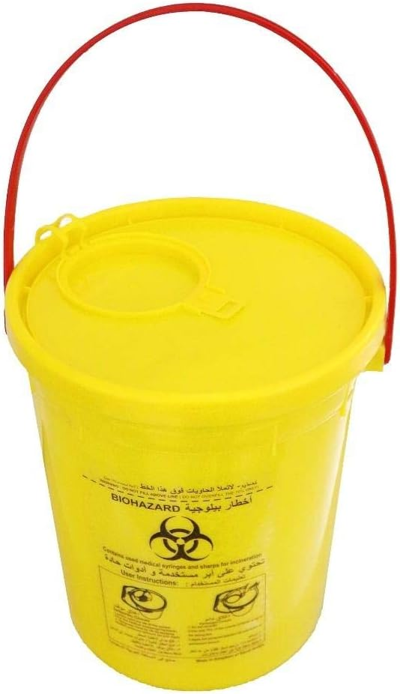

Slide 7
Collecting Specimens.
Blood, body fluids, secretions, and excretions often require laboratory testing Specimens are transported to the laboratory in bio-hazard specimen bags.
Follow agency procedures to collect and transport a specimen when a person is on Transmission-Based Precautions.

Slide 9
Ensuring safety in the patient \ clinical environment

Slide 10
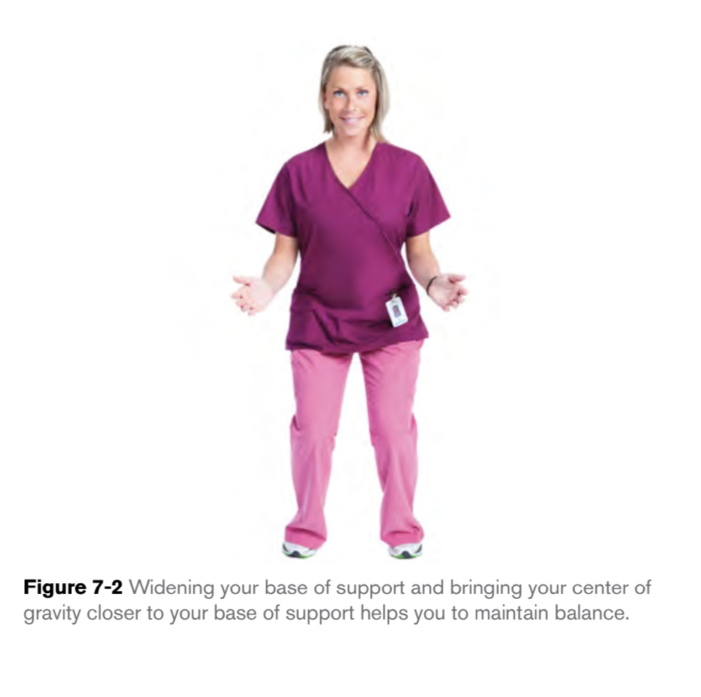
Body Mechanics
Body mechanics, you use your body in a safe and efficient way to accomplish tasks such as lifting, pushing and pulling. Good body mechanics are all about alignment, balance and coordination.
Balance is stability achieved through the even distribution of weight. spreading your legs apart and bending your knees to bring your torso lower helps you to remain stable on your feet.
Coordination is the use of direction and force for purposeful action.

Slide 11
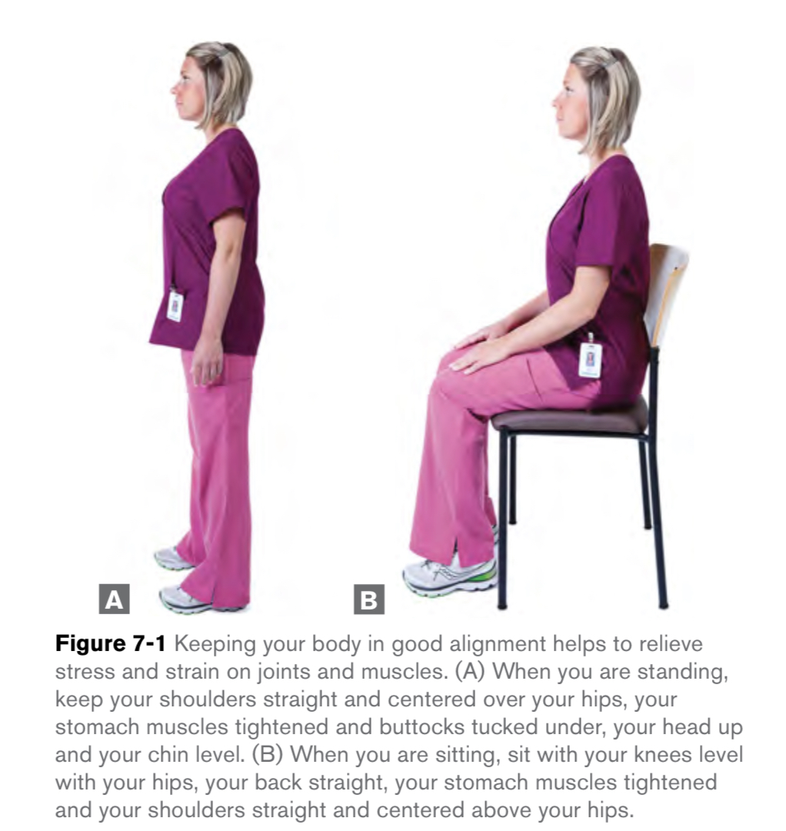
Cont…
Alignment is good posture.
Standing. To practice good alignment while standing, keep your knees slightly bent and stand with your feet shoulder-width apart. Put your weight evenly on both legs. Keep your shoulders straight and centered over your hips, your stomach muscles tightened, and buttocks tucked under, your head up and your chin level
Sitting. To practice good alignment while sitting, sit with your knees level with your hips, your back straight, your stomach muscles tightened, and your shoulders straight and centered above your hips.

Slide 12
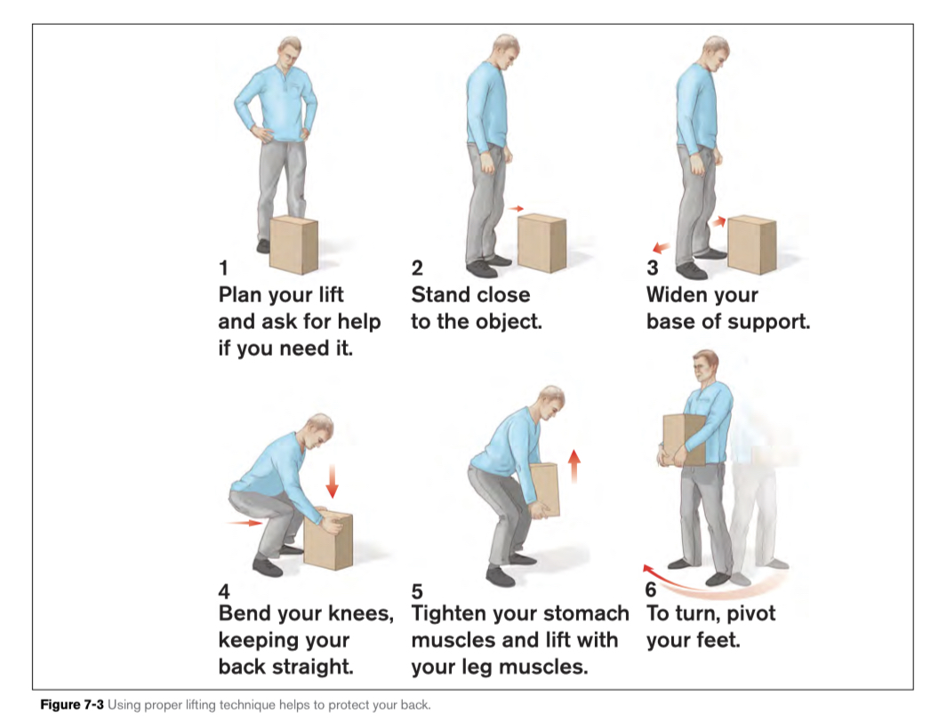
Lifting Safely
Proper lifting technique involves using the powerful muscles of your legs and buttocks to drive yourself, and whatever you are lifting, upward. To practice proper lifting technique:
1. Plan your lift and get help if you need it.
2. Stand close to the person or object you are lifting. Avoid leaning over or reaching.
3. Place your feet about 12 inches apart, with one foot slightly in front of the other.

Slide 13
Cont…
4. Avoid bending over at the waist. Instead, bend your knees and keep your back straight. Keeping the person or object close to your body, tighten your stomach muscles and drive yourself upward, using the muscles of your legs and buttocks.
5. To turn, pivot with your feet. Avoid twisting your body at the waist when your arms are loaded.

Slide 14
USING EQUIPMENT SAFELY
Before using any piece of equipment, be sure you understand how it works. Read the user’s manual and follow instructions exactly.
If you are not completely confident about using the equipment, ask the nurse for help rather than risk injuring yourself or the person in your care.

Slide 15
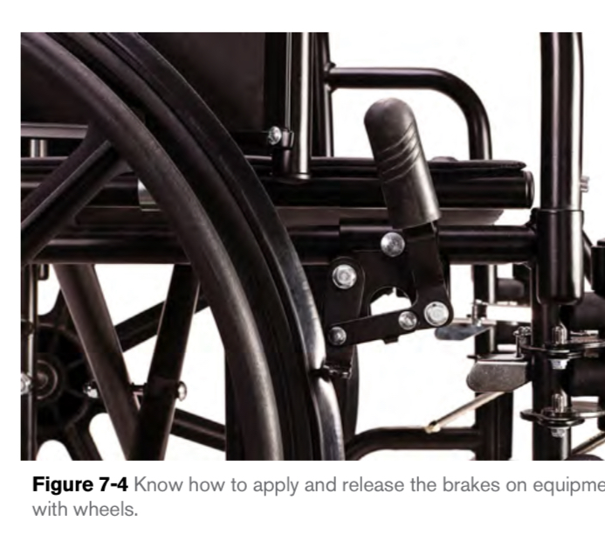
Equipment with Wheels
Many pieces of equipment that you will use in the health care setting, such as beds, shower chairs and wheelchairs, have wheels. The brakes provided on equipment with wheels prevent the equipment from rolling.

Slide 16
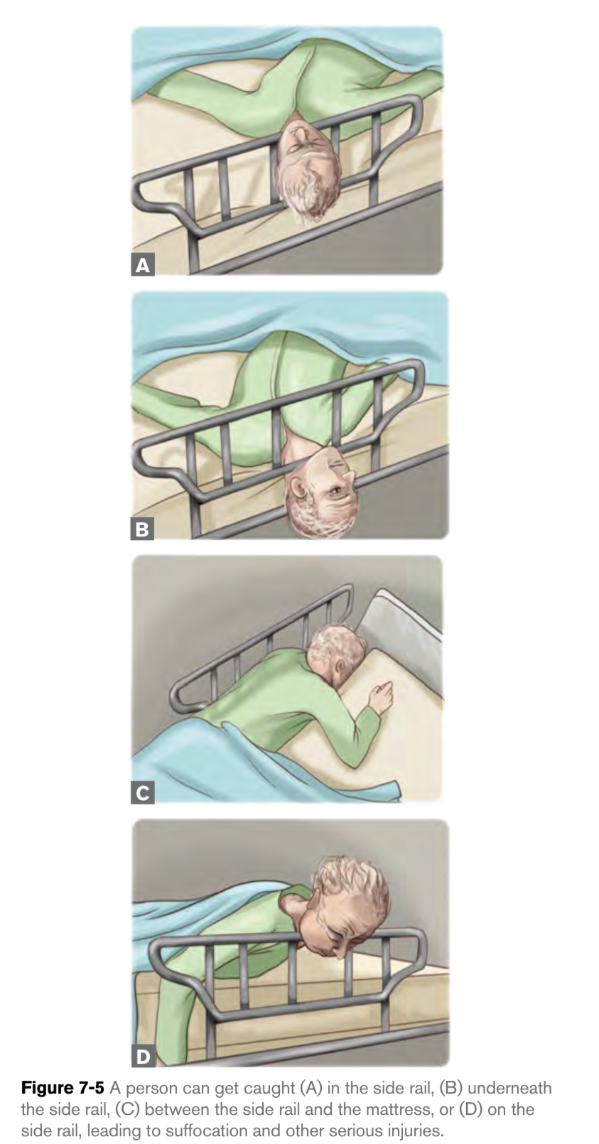
Side Rails
Entrapment is also a concern when side rails are in use, especially with older people who are confused or disoriented. In entrapment, the person’s head or another body part gets trapped between, under, or on side rails , or between the mattress and the side rails.
The person’s care plan will state whether the side rails are to be lowered or raised when the person is in bed.

Slide 17
KEEPING THE PEOPLE IN YOUR CARE SAFE

Slide 18
Common hazards in clinical settings

Slide 19
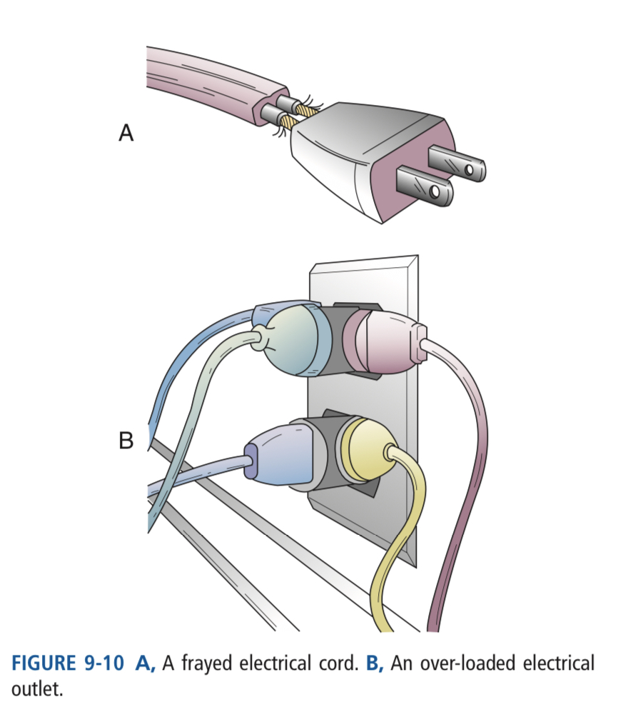
Falls
Electrical shocks : Always inspect electrical devices before you use them to make sure that they are in good working order and that cords are intact.
Burns: Smoking, spilled hot liquids, electrical items, and very hot water (sinks, tubs, showers) are common causes of burns.
-Turn hot water on last and off first and check the temperature of the water coming out of the faucets.

Slide 20
4. Poisoning : A poison is any substance that causes injury, illness or death if it enters the body. Cleaning supplies, fluids used for car and home maintenance, and certain plants can all cause poisoning if a person swallows them. Poisoning can also occur if a person takes the wrong medication, or too much of it.

Slide 21
Reporting Incidents
An incident is something unusual that happens to a person receiving care, a staff member or a visitor to the facility and has the potential to cause harm. You must verbally report all incidents, even those that do not result in injury, to the nurse. In addition, you must complete a written incident report, per your employer’s policy. When reporting an incident and completing an incident report, it is important to provide facts, not opinions.

Slide 22
A complete incident report contains answers to the following questions:
■ Who was the person involved in the incident?
■ Was the person confused before or afterthe incident?
■ Was the person alone?
■ What happened to the person? Was the person injured? If so, describe the injury.
■ What caused the incident? (For example, was water on the fl oor?) Remember to state only facts, not opinions.
■ Where did the incident happen?
■ When did the incident happen (time, date)?
■ Who gave assistance or first aid?
■ What kind of assistance or fi rst aid was given?
■ Were there witnesses to the incident? If so, who?
■ Did the person receive medical treatment?

Slide 23
RESTRAINTS

Slide 24
A restraint is any device that inhibits a person’s freedom of movement. Restraints can be physical or chemical. A physical restraint is attached on or near a person’s body to limit the person’s freedom of movement or ability to reach part of her body. Examples of physical restraints include wrist restraints, mitt restraints, jacket restraints and vest restraints.
Chemical restraints are medications used to subdue a person, so that the person is unable to function normally.

Slide 25
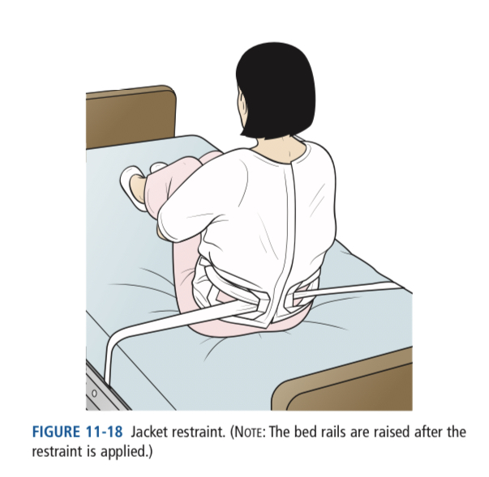
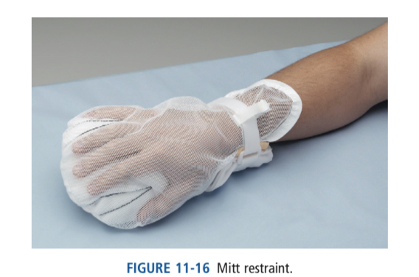
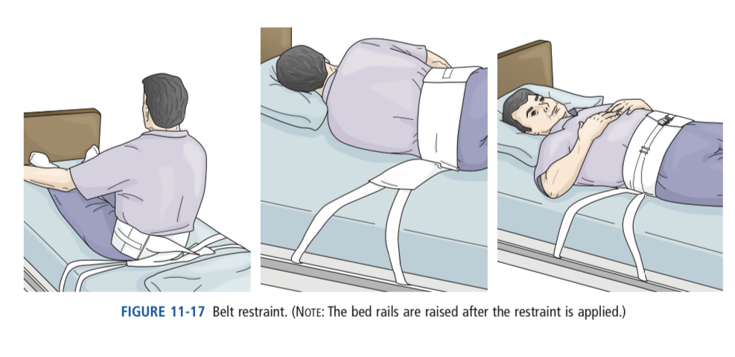

Slide 26
Complications Associated with Restraints
Strangulation
Entrapment and other serious injuries.
Mental effects. A person who is restrained may become more agitated and confused.
Complications of immobility.
Complications of immobility.
Bladder and bowel elimination problems.

Slide 27
Care for a Person Who is Restrained
Check on the person very frequently.
Release the restraints every 2 hours and help the person go to the bathroom, stretch, change positions and do range-of-motion exercises. Inspect the person’s skin for reddened areas and report any concerns to the nurse.
Observe the person carefully and report any changes in behavior (such as increased agitation, drowsiness or decreased appetite) immediately to the nurse.
Report and record

Slide 28
PERFORMING SKILLS SAFELY
There are certain steps that you should always take
before starting a skill and after completing the skill.
“Preparation Steps” and “Completion Steps.”
Performing these steps routinely promotes safety and efficiency and helps to protect the person’s rights.

Slide 29
Preparation Steps
Wash your hands. This is essential to prevent the spread of infection.
Gather your supplies. Having everything you need before you start promotes efficiency.
Knock, greet the person and ensure privacy.
Explain the procedure.
Adjust equipment for body mechanics and safety.

Slide 30
Completion Steps
Ensure the person’s comfort and good body alignment.
Adjust equipment for safety.
Clean up your work area.
Wash your hands.
Report and record.

Slide 32
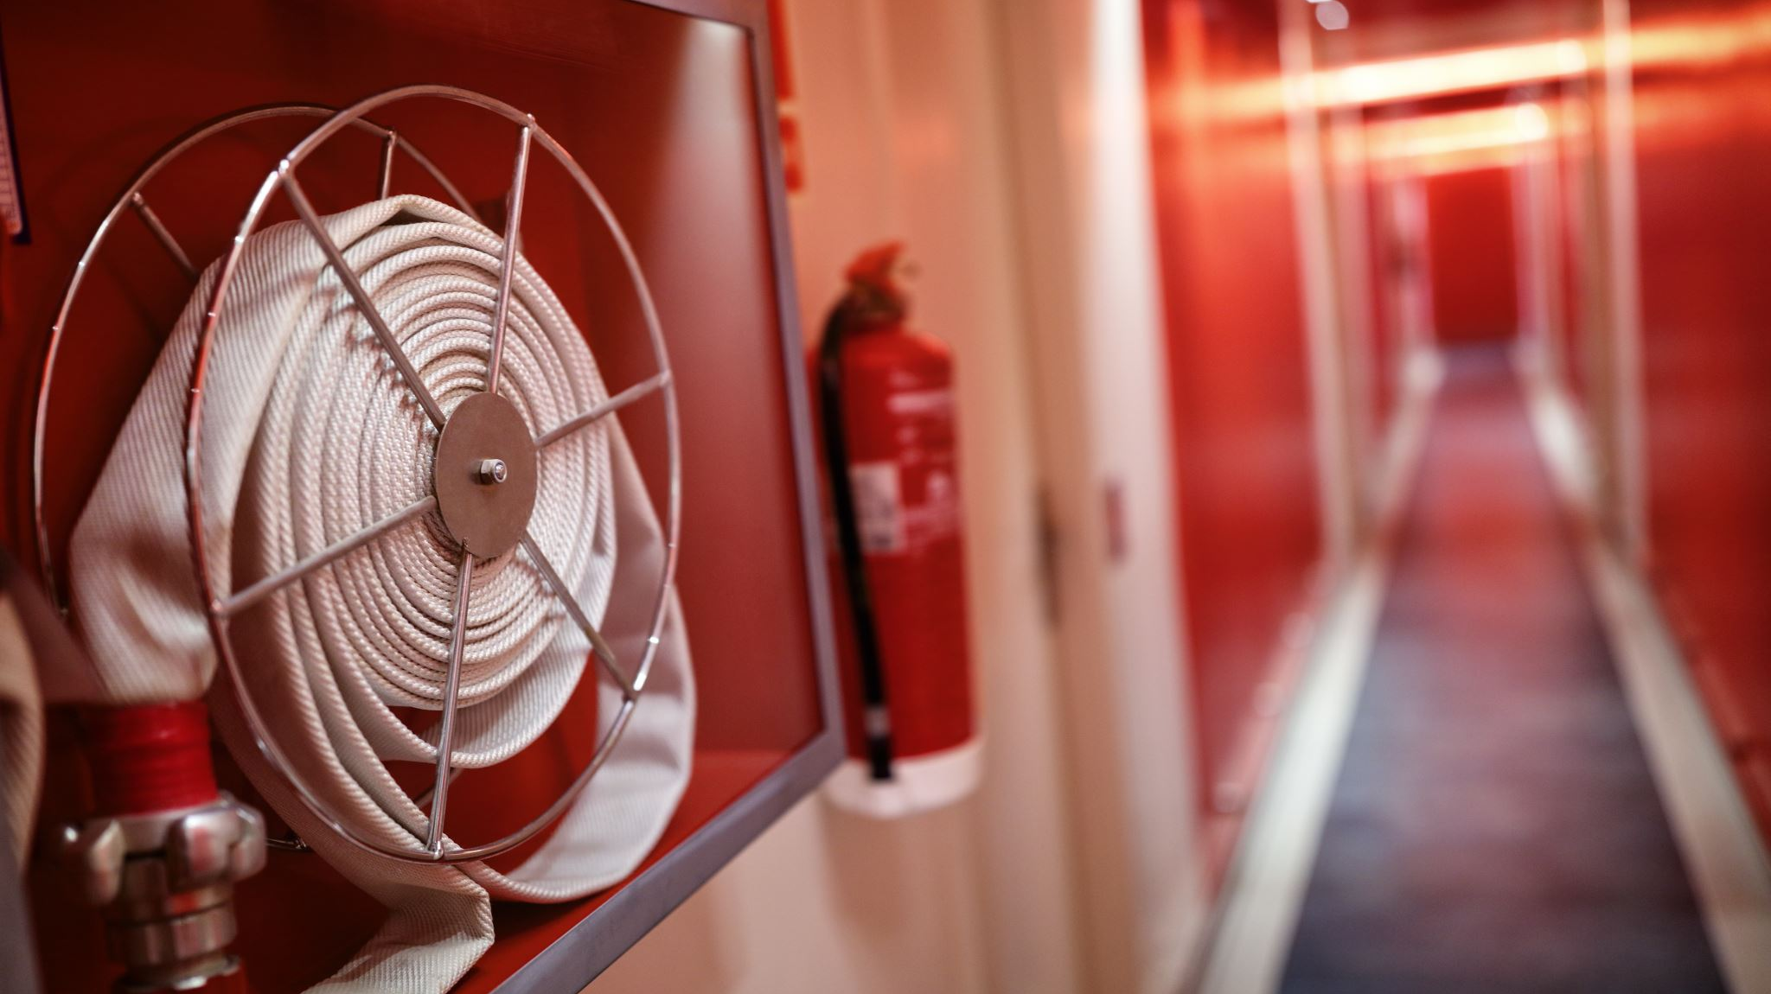
Fire safety in workplace

Slide 33
Fire Safety: Faulty electrical equipment and wiring, over-loaded electrical circuits, and smoking are major causes of fires. The health team must prevent fires and act quickly during a fire.

Slide 34
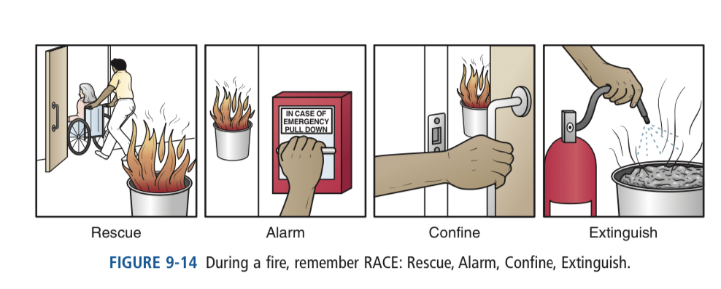
RACE
R—for rescue. Rescue persons in immediate danger.
Move them to a safe place.
A—for alarm. Sound the nearest fire alarm. Notify the operator.
C—for confine. Close doors and windows to confine the fire. Turn off oxygen or electrical items used in the general area of the fire.
E—for extinguish. Use a fire extinguisher on a small fire that has not spread to a larger area.

Slide 35
Fire Extinguisher
Different extinguishers are used for different kinds of fires.
• Oil and grease fires
• Electrical fires
• Paper and wood fires

Slide 37
References :
1. Sorrentino, S. A., Remmert, L., & Wilk, L. S. (2020). Mosby's Textbook for Nursing Assistants (10th ed.). St. Louis, MO: Elsevier.)
2. American Red Cross (2013). American Red Cross Nurse Assistant Training Textbook: Third Edition.United States of America: Krames Stay Well Strategic Partnerships Division. ISBN: 978-1584805823,

Slide 38
Any questions ?

Slide 39
Thank you

