Slide 1
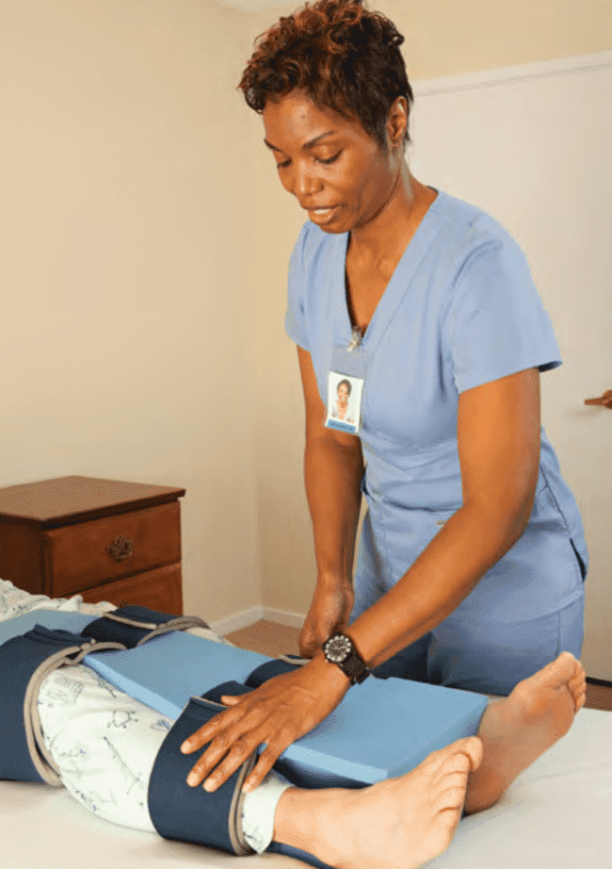
Musculo-Skeletal System and common disorders
Module 5, Specific care stuatons
Prepared by:
Ms.Jamilah Allehaib
BSN, RN

Slide 2
Learning Objectives:
Review of the musculo-skeletal system structure and function.
Describe the common causes of musculo-skeletal disorders and plan of care measures.
Explain the Fractures and care measures.
Mention person care after joint replacement hip and knee.
Describe care of person in cast, traction and with hip fracture.

Slide 3
The Musculo-skeletal system
The musculo-skeletal system provides the framework for the body, it lets the body move.
This system also protects internal organs and gives the body shape.
Common conditions that affect the musculoskeletal system include arthritis, osteoporosis and hip fractures.
Musculo-skeletal disorders affect movement. Activities of daily living, social activities, and quality of life are affected. Injury and aging are common causes of musculo-skeletal disorders.

Slide 4
Bones:
The human body has 206 bones (Fig. 7-5).
Bones are hard, rigid structures. They are made up of living cells.
Calcium and phosphorus are needed for bone formation and strength.
Bones store these minerals for use by the body.
Bones are covered by a membrane called periosteum. Periosteum contains blood vessels that supply bone cells with oxygen and food. Inside the hollow centers of the bones is a substance called bone marrow. Blood cells are formed in the bone marrow.
There are 4 types of bones include:
Long bones bear the body’s weight, Leg bones are long bones.
Short bones allow skill and ease in movement, bones in the wrists, fingers, ankles, and toes are short bones.
Flat bones protect the organs, they include the ribs, skull, pelvic bones, and shoulder blades.
Irregular bones are the vertebrae in the spinal column, they allow various degrees of movement and flexibility.

Slide 6
Joints :
A joint is the point at which 2 or more bones meet.
Joints allow movement (Chapter 23).
Cartilage is connective tissue at the end of the long bones. It cushions the joint so that the bone ends do not rub together.
The synovial membrane lines the joints. It secretes synovial fluid. Synovial fluid acts as a lubricant so the joint can move smoothly.
Bones are held together at the joint by strong bands of connective tissue called ligaments.

Slide 7
Types of Joints :
There are 3 major types of joints (Fig. 7-6):
A ball-and-socket joint: allows movement in all directions. It is made of the rounded end of 1 bone and the hollow end of another bone. The rounded end of 1 fits into the hollow end of the other. The joints of the hips and shoulders are ball-and-socket joints.
A hinge joint: allows movement in 1 direction. The elbow is a hinge joint.
A pivot joint allows turning from side to side. A pivot joint connects the skull to the spine. Some joints are immovable. They connect the bones of the skull.

Slide 9
Muscles:
The human body has more than 500 muscles (Figs. 7-7 and 7-8).
Some are voluntary. Others are involuntary.
• Voluntary muscles: can be consciously controlled.
Muscles attached to bones (skeletal muscles) are voluntary.
Arm muscles do not work unless you move your arm; likewise for leg muscles.
Skeletal muscles are striated. That is, they look striped or streaked.
• Involuntary muscles: work automatically.
You cannot control them.
They control the action of the stomach, intestines, blood vessels, and other body organs.
Involuntary muscles also are called smooth muscles. They look smooth, not streaked or striped.
Cardiac muscle: is in the heart.
It is an involuntary muscle.
However, it appears striated like skeletal muscle.

Slide 11
Function of the Muscles:
Muscles have 3 functions:
Movement of body parts.
Maintenance of posture or muscle tone.
Production of body heat.
Strong, tough connective tissues called tendons connect muscles to bones.
When muscles contract (shorten), tendons at each end of the muscle cause the bone to move.
The body has many tendons. See the Achilles tendon in Figure 7-8.
Some muscles constantly contract to maintain the body’s posture.
When muscles contract, they burn food for energy.
Heat is produced. The more muscle activity, the greater the amount of heat produced.
Shivering is how the body produces heat when exposed to cold.
Shivering is from rapid, general muscle contractions.

Slide 12
CONT…
Sphincters are circular bands of muscle fibers.
They constrict (narrow) a passage.
Or they close a natural body opening.
For example:
• The pyloric sphincter (Fig. 7-9) is an opening from the stomach into the small intestine. Closed, it holds food in the stomach for partial digestion. It opens to allow partially digested food to enter the small intestine.
• The anal sphincter: keeps the anus closed. It opens for a bowel movement.
• Urethral sphincters: seal off the bladder. This allows urine to collect in the bladder. The sphincters open for urination.

Slide 14
Arthritis:
Arthritis means joint (arthr) inflammation (itis).
Pain, swelling, and stiffness occur in the affected joints.
The joints are hard to move.
Arthritis is a condition that causes joints to become inflamed, swollen, stiff and painful (Figure 18-1).
A few or many joints may be affected.
The smooth tissue that covers the ends of bones becomes rough or wears away, causing painful friction between bones when the person moves.
The remaining tissues around the joints swell, which leads to stiffness.
This stiffness makes normal movement difficult. Even an activity like unscrewing the lid of a jar or walking up stairs can be difficult and cause pain.

Slide 16
Arthritis Care Measures:
Imagine what it might be like being in constant pain or not being able to move without pain.
When you provide care for a person with arthritis:
focus on relieving pain.
Assisting with mobility and promoting independence.
Let the person know that you understand that movement is painful and that you are there to help.
Ask the person about ways to make movement easier and less painful.
If the person takes pain medication, plan her morning care so that it is scheduled to occur after she takes her morning dose of pain medication.
When the person has less pain, she may be able to participate more in her own care.
Because warm water and heat soothe joints and help reduce stiffness and pain, assist the person with tub baths, warm soaks or heat therapy, according to the person’s care plan.
To reduce stiffness and pain, encourage the person to wear warm clothing that covers the affected joints.
Encourage the person to exercise the affected joints, or assist her with range-of-motion exercises according to the care plan. Activity promotes independence and keeps the joints more flexible. However, never move a joint that is painful, red or swollen.
Encourage the person to use assistive devices as needed. For example, toothbrushes, hair brushes and combs with built-up handles may be easier for a person with arthritis in the hands to hold, allowing more independence.

Slide 17
Osteoporosis:
Osteoporosis: a disease in which loss of bone tissue causes the bones to become very fragile and prone to breaking).
occurs mainly in older women but may also occur in men.
Aging, being overweight, and joint injury are common causes.
The fingers, spine (neck and lower back), and weight-bearing joints (hips, knees, and feet) are often affected.
Joint stiffness occurs with rest and lack of motion.
Pain occurs with weight-bearing and motion.
Or pain is constant or occurs from lack of motion.
Pain can affect rest, sleep, and mobility.
Cold weather and dampness seem to increase symptoms.
There is no cure.

Slide 18
Osteoporosis:
The disease is caused by a gradual loss of minerals, especially calcium, in the bones.
Calcium helps make bones hard and strong.
When calcium is lacking, bones become soft and weak, and they break more easily.
Fractures in the spine can cause the person to develop a stooped posture and a rounded upper back (Figure 18-2).
This posture is very painful for the person.
As the disease progresses, the person may have severe pain in the parts of the body that support her weight.
The person often tires easily and may be fearful of falling while walking.
If a person with osteoporosis breaks a bone, it can take a very long time for the bone to heal.

Slide 20
Osteoporosis:
With osteoporosis, the bone (osteo) becomes porous and brittle (porosis).
Bones are fragile and break easily.
Spine, hip, wrist, and rib fractures are common.
Older people are at risk.
The risk for women increases after menopause because the ovaries do not produce estrogen. The lack of estrogen and low levels of dietary calcium cause bone changes.
All ethnic groups are at risk.
Other risk factors include a family history of the disease, being thin or having a small frame, eating disorders (Chapter 29), tobacco use, alcoholism, lack of exercise, bedrest, and immobility.
Exercise and activity are needed for bone strength.
Bone must bear weight to form properly. If not, calcium is lost from the bone. The bone becomes porous and brittle. Back pain, gradual loss of height, and stooped posture occur. Fractures are a major threat. Even slight activity can cause fractures. They can occur from turning in bed, getting up from a chair, or coughing. Fractures are great risks from falls and accidents.

Slide 21
Treatments of Osteoporosis:
Treatment involves:
Pain relief: drugs decrease swelling and inflammation and relieve pain.
Heat and cold: Heat relieves pain, increases blood flow, and reduces swelling. Cold applications may be used after joint use.
Exercise: Exercise decreases pain, increases flexibility, and improves blood flow. It helps with weight control and promotes fitness. Mental well-being improves. The person is taught what exercises to do.
Rest and joint care: Good body mechanics, posture, and regular rest protect the joints. Relaxation methods are helpful. Canes and walkers provide support. Splints support weak joints and keep them in alignment.
Weight control: If over-weight, weight loss reduces stress on weight-bearing joints. And it helps prevent further joint injury.
Healthy life-style: The focus is on fitness, exercise, rest, managing stress, and good nutrition. Falls are prevented. Help is given with activities of daily living (ADL) as needed. Toilet seat risers are helpful when hips and knees are affected. So are chairs with higher seats and armrests.
Some people need joint replacement surgery

Slide 22
Osteoporosis Care Measures:
When you provide care for a person who has osteoporosis:
it is important to focus on safety. In addition, do the following things:
Help the person exercise as much as he can do comfortably, gentle exercise may help slow down bone loss.
Use a transfer belt when assisting the person to walk or move, according to the person’s care plan. Use the belt very carefully. Remember, the person’s bones are very fragile.
Keep areas where the person walks clear and free of tripping hazards, such as throw rugs.
Make sure that chairs are the proper height and that grab bars are fastened in appropriate places. These precautions help reduce the risk of injury.

Slide 23
CONT…
Follow care measures that may be necessary because of medications the person is taking to treat the osteoporosis.
For example, the person may have to remain upright and may not be allowed to have food or fluids for a period of time after the medication is administered. These measures, if applicable, will be detailed on the person’s care plan.
Be aware that the person’s visual range may be limited due to postural changes, which cause her to lean forward and down and make it difficult for her to look up.
Place objects the person needs where she can see them easily, and ensure the person’s safety while walking.
Report any new pain, loss of function or swelling. These could be signs of a broken bone.

Slide 24
CONT…
Prevention is important.
Doctors often order calcium and vitamin supplements.
Estrogen is ordered for some women.
Other preventive measures include:
Exercising weight-bearing joints: walking, jogging, stair climbing.
No smoking. • Limiting alcohol and caffeine.
Back supports or corsets for good posture.
Walking aids if needed.
Safety measures to prevent falls and accidents.
Good body mechanics.
Safe moving, transferring, turning, and positioning procedure

Slide 25
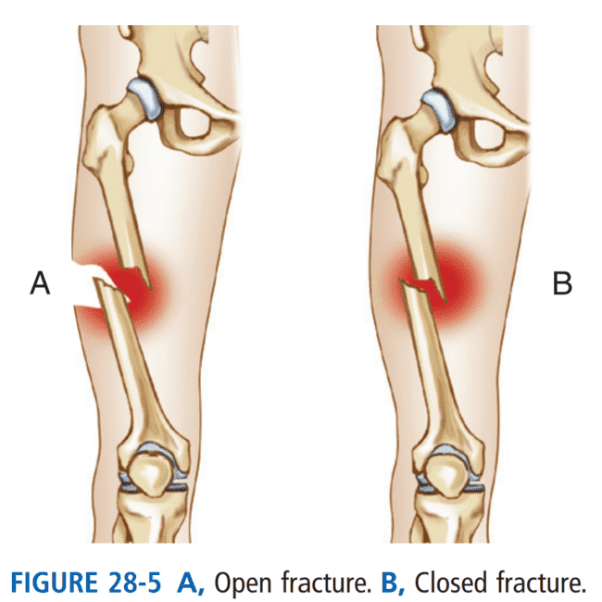
Fracture:
A fracture is a broken bone.
Fractures are open or closed (Fig. 28-5).
Open fracture (compound fracture): The broken bone has come through the skin.
Closed fracture (simple fracture): The bone is broken but the skin is intact.
Falls, accidents, bone tumors, and osteoporosis are some causes.

Slide 26
Signs and symptoms of fracture:
Signs and symptoms of a fracture are:
Pain.
Swelling.
Loss of function or movement.
Movement where motion should not occur.
Deformity (the part is in an abnormal position).
Bruising and skin color changes at the fracture site.
Bleeding (internal or external).

Slide 27
Treatments of Fractures:
For healing, bone ends are brought into and held in normal position. This is called reduction and fixation.
Closed reduction and external fixation: The bone is moved back into place. The bone is not exposed.
Open reduction and internal fixation: This requires surgery. The bone is exposed and moved into alignment. Nails, rods, pins, screws, plates, or wires keep the bone in place.
After reduction, the bone ends must not move.
The person has a cast or traction. Splints, walking boots, and external fixators also are used.

Slide 28
Care after joint replacement (hip and knee):
Joint Replacement Surgery: Arthroplasty is the surgical replacement (plasty) of a joint (arthro).
The damaged joint is removed and replaced with an artificial joint (prosthesis).
Hip and knee replacements are common.
See Box 28-2. Ankle, foot, shoulder, elbow, and finger joints also can be replaced.

Slide 33
CAST and TRACTION:
Casts: Casts are made of plaster of Paris, plastic, or fiberglass.
Plastic and fiberglass casts dry quickly.
A plaster of Paris cast dries in 24 to 48 hours.
It is odorless, white, and shiny when dry.
When wet, it is gray and cool and has a musty smell.
The nurse may ask you to assist with care (Box 28-3).
Traction: A steady pull from 2 directions keeps the bone in place.
Weights, ropes, and pulleys are used (Fig. 28-8).
Traction is applied to the neck, arms, legs, or pelvis.
To assist with the person’s care, see Box 28-4, p. 432.

Slide 39
Hip fracture:
A hip fracture is a break in the bone of the upper thigh, just below the hip joint.
Hip Fractures: Fractured hips are common in older persons (Fig. 28-9). who experience a fall and can have serious consequences.
The fracture requires internal fixation (p. 431) or partial or total hip replacement.
Adduction, internal rotation, external rotation, and severe hip flexion are avoided after surgery.
Rehabilitation is usually needed.
Post-operative problems present life-threatening risks, they include:
Respiratory complications, urinary tract infections, and thrombi (blood clots) in the leg veins.
Pressure ulcers, constipation, and confusion are other risks.
Box 28-5 describes the required care.

Slide 40
Hip fracture:
Hip fractures are usually treated with surgery.
Sometimes the bone can be repaired, but other times it is necessary to replace the entire hip joint with an artificial joint.
Following the surgery, the person will require weeks to months of physical therapy.
Sometimes, other conditions that the person has will make surgical repair impossible. In this case, the person will be put on non-weight-bearing status and physical therapy may possibly not be permitted.

Slide 42
Hip fracture care measures:
While the person recovers from a hip fracture, he will have difficulty changing position on his own.
You will need to assist the person with repositioning according to the person’s care plan, to lower the person’s risk for pressure ulcers.
Encourage the person to help as much as he can by using assistive devices such as a trapeze suspended above the bed.
Use positioning aids, such an abduction pillow as ordered, to keep the hip joint aligned properly (Figure 18-3).
It is also important to make sure that the person maintains good alignment when seated.
The person’s feet should be flat on the floor, and his hips should be flexed no more than 90 degrees.
The person may also have weight-bearing restrictions. During this period, the person will need assistance with transfers by using a mechanical lift, or assistance with pivoting to the chair using only the unaffected leg. As the person continues to heal, these weight-bearing restrictions may be changed.

Slide 44
Hip fracture care measures:
For example, at first the person may not be allowed to bear any weight on the affected leg, but as healing progresses, the person may be allowed to increase weight bearing to 25%, then 50%, and so on.
The physical therapist will teach the person how to use appropriate assistive devices for walking.
You should encourage the person to practice the skills she has learned in physical therapy, and you should monitor her technique to make sure that she uses assistive devices properly.
Always follow the person’s care plan exactly, regarding how much, if any, weight the person is allowed to bear.
Bearing too much weight too soon could result in increased pain, swelling and possible re-fracture of the hip, which would delay the person’s recovery.
A person recovering from a hip fracture may require a great deal of emotional support.
The person may be frustrated by needing so much assistance and by the length of the recovery period. In addition, the person may be very worried about whether she will fully recover from the fracture, and what this could mean for the future.
Listen to the person’s concerns, practice empathy and provide encouragement by acknowledging the person’s progress toward recovery

Slide 48
American Red Cross (2013). American Red Cross Nurse Assistant Training Textbook: Third Edition.United States of America: Krames Stay Well Strategic Partnerships Division. ISBN: 978-1584805823.
Sorrentino, S. A., Remmert, L., & Wilk, L. S. (2014). Mosby's Textbook for Nursing Assistants (5th ed.). St. Louis, MO: Elsevier.)

Slide 49
Any Question ?

Slide 50
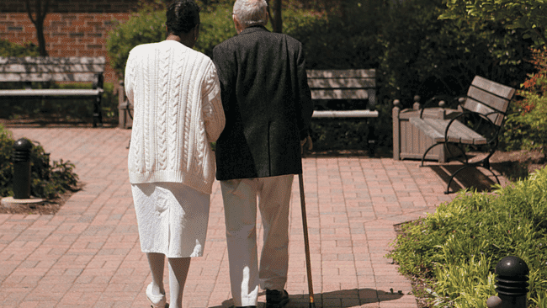
Thank you !

