Slide 1
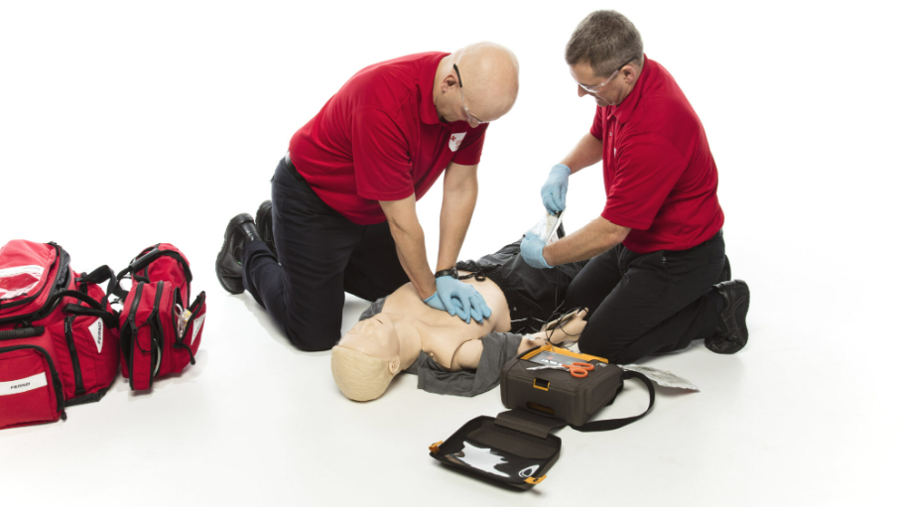
Basic Life Support (BLS)
Prepared by:
Ms.Jamilah Allehaib
BSN, RN

Slide 2
Learning objectives:
Define Emergency Care, First aid,Emergency Medical Service and Rapid Response Teams .
List the Rule of Emergency Care.
Demonstrate Choking and Management of Choking.
Describe Basic Life Support (BLS).
Define Respiratory arrest and Rescue Breathing.
Explain Cardiopulmonary Resuscitation (CPR)for Adults.
Describe Automated External Defibrillator (AED)

Slide 3
Emergency Care:
Emergencies can occur anywhere.
Sometimes you can save a life if you know what to do.
You are encouraged to take a first aid course and a Basic Life Support (BLS) course. These courses prepare you to give emergency care.
First aid is the emergency care given to an ill or injured person before medical help arrives.
.The goals of first aid are to:
• Prevent death.
• Prevent injuries from becoming worse.

Slide 4
Emergency Care:
In an emergency, the Emergency Medical Services (EMS) system is activated.
Emergency personnel (paramedics, emergency medical technicians) rush to the scene.
They treat, stabilize, and transport persons with life-threatening problems.
Their ambulances have emergency drugs, equipment, and supplies. They have guidelines for care and communicate with doctors in hospital emergency departments.
The doctors can tell them what to do. To activate the EMS system, do 1 of the following;
• Dial 911.
• Call the local fire or police department.
• Call the phone operator.

Slide 5
Emergency Care:
Each emergency is different.
The Rules in Box 31-1 apply to any emergency.
Hospitals and other agencies have procedures for emergencies.
Rapid Response Teams (RRTs) are called when a person shows warning signs of a life-threatening condition.
An (RRT) may include a doctor, a nurse, and a respiratory therapist.
The (RRT’s) goal is: to prevent death.

Slide 10
Chocking:
Choking: Foreign bodies can obstruct the airway. This is called choking or foreign-body airway obstruction (FBAO).
Air cannot pass through the airways into the lungs.
The body does not get enough oxygen. Death can result.
Choking often occurs during eating. A large, poorly chewed piece of meat is the most common cause.
Laughing and talking while eating also are common causes. So is excessive alcohol intake.
Unconscious persons can choke. Common causes are aspiration of vomitus and the tongue falling back into the airway.

Slide 11
CONT…
Foreign bodies can cause mild or severe airway obstruction.
With mild airway obstruction, some air moves in and out of the lungs. The person is conscious and usually can speak. Often forceful coughing can remove the object. Breathing may sound like wheezing between coughs.
For mild airway obstruction:
Stay with the person.
Encourage the person to keep coughing to expel the object.
Do not interrupt the person’s efforts to clear the airway.
If the person is breathing and coughing, abdominal thrusts are not needed.
If the obstruction persists, call for help.

Slide 12
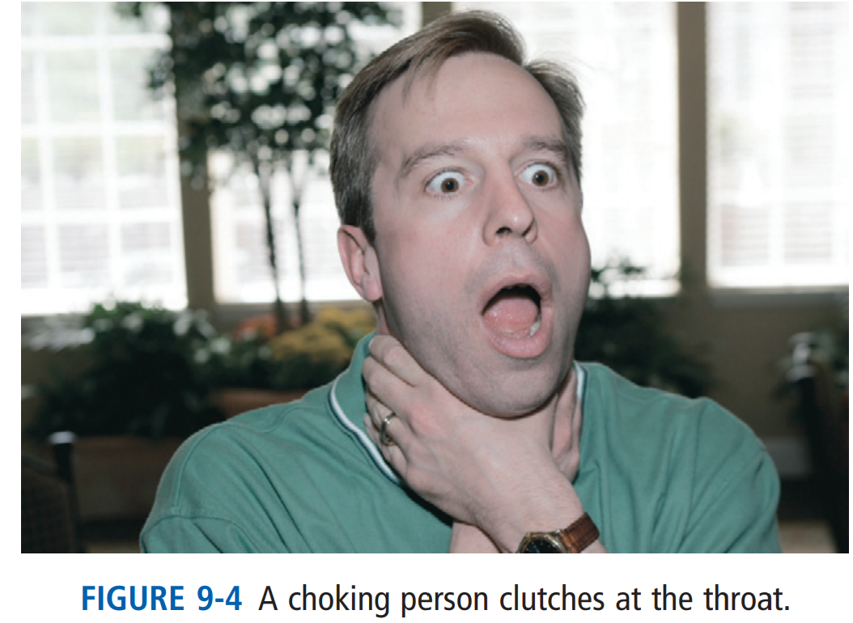
Sever airway Obstruction:
A person with severe airway obstruction has difficulty breathing.
Air does not move in and out of the lungs.
The person may not be able to breathe, speak, or cough. If able to cough, the cough is of poor quality.
When the person tries to inhale, there is no noise or a high-pitched noise. The person may appear pale and cyanotic (bluish color).
The conscious person clutches at the throat (Fig. 9-4).
Clutching at the throat is often called the “universal sign of choking.”
The conscious person is very frightened. If the obstruction is not removed, the person will die.
Severe airway obstruction is an emergency.

Slide 13
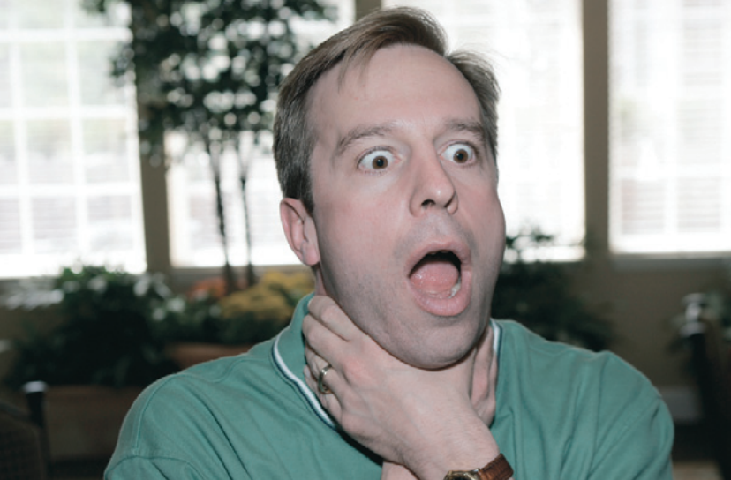
Chocking Management

Slide 14
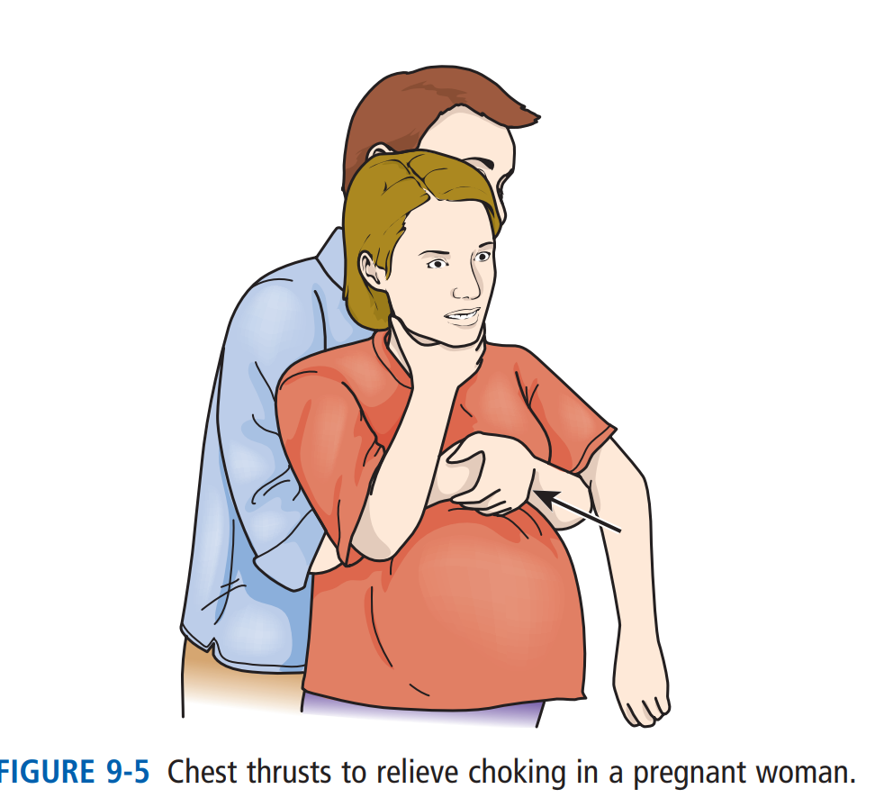
Chocking management:
Relieving Choking:
Abdominal thrusts are used to relieve severe airway obstruction.
Abdominal thrusts are quick, upward thrusts to the abdomen.
They force air out of the lungs and create an artificial cough. They are done to try to expel the foreign body from the airway.
Abdominal thrusts are not used for very obese persons or pregnant women. Chest thrusts are used (Box 9-2 and Fig. 9-5).

Slide 15
CONT…
You may observe a person choking. And you may perform emergency measures to relieve choking.
Relief of choking occurs when the foreign body is removed. Or it occurs when you feel air move and see the chest rise and fall when giving rescue breaths. The person may still be unresponsive.
If you assist a choking person, report and record what happened. Include what you did and the person’s response.

Slide 21
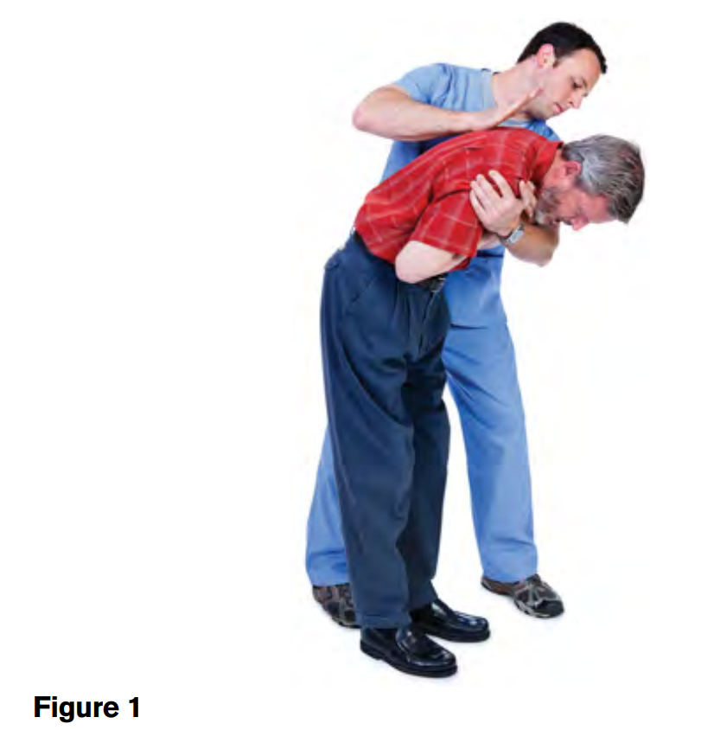
First Aid for a Conscious Choking Adult

Slide 26
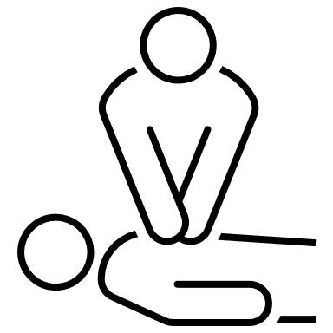
Basic Life Support (BLS) for Adults:

Slide 27
Basic Life Support (BLS) for Adults:
When the heart and breathing stop, the person is clinically dead.
Blood is not circulated through the body. Heart, brain, and other organ damage occurs within minutes.
The American Heart Association’s (AHA) BLS procedures support circulation and breathing.

Slide 28
Chain of Survival for Adults:
Chain of Survival actions for adults are:
• Recognizing cardiac arrest and activating the EMS system at once.
• Early cardiopulmonary resuscitation (CPR).
• Early defibrillation. See p. 487.
• Early advanced care. This is given by EMS staff, doctors, and nurses. They give drugs and perform life-saving measures.
• Organized post–cardiac arrest care. This is care given to improve survival following cardiac arrest.

Slide 29
Sudden Cardiac Arrest (SCA):
Sudden Cardiac Arrest (SCA) or cardiac arrest: is when the heart stops suddenly and without warning. Within moments, breathing stops as well. Permanent brain and other organ damage occurs unless circulation and breathing are restored.
There are 3 major signs of SCA;
No response.
No breathing or no normal breathing.
- The person may have agonal gasps or agonal respirations early during SCA. (Agonal comes from the Greek word that means to struggle. Agonal is used in relation to death and dying.) Agonal gasps do not bring enough oxygen into the lungs. Gasps are not normal breathing.
No pulse.
- The person’s skin is cool, pale, and gray. The person is not coughing or moving.

Slide 30
Sudden Cardiac Arrest (SCA):
SCA is a sudden, unexpected, and dramatic event.
It can occur anywhere and at any time—while driving, shoveling snow, playing golf or tennis, watching TV, eating, or sleeping.
Common causes include heart disease, drowning, electric shock, severe injury, choking (Chapter 9), and drug over-dose.
These causes lead to an abnormal heart rhythm called ventricular fibrillation (p. 487).
The heart cannot pump blood. A normal rhythm must be restored. Otherwise the person will die.

Slide 31
Respiratory Arrest:
Respiratory arrest: is when breathing stops but heart action continues for several minutes.
If breathing is not restored, cardiac arrest occurs.
Causes of respiratory arrest include: • Drowning • Stroke • Choking • Drug over-dose • Electric shock (including lightning strikes) • Smoke inhalation • Suffocation • Heart attack • Coma • Other injuries.

Slide 32
Rescue Breathing:
Rescue breaths are given when there is a pulse but no breathing or only gasping.
To give rescue breaths:
• Open the airway.
• Give 1 breath every 5 to 6 seconds for adults.
• Give each breath over 1 second.
The chest should rise when breaths are given.
• Check the pulse every 2 minutes. If there is no pulse, begin CPR

Slide 33
Cardiopulmonary Resuscitation (CPR)for Adults
When the heart and breathing stop, blood and oxygen are not supplied to the body.
Brain and other organ damage occurs within minutes.
CPR must be started at once when a person has SCA.
CPR supports circulation and breathing. It provides blood and oxygen to the heart, brain, and other organs until advanced emergency care is given.
CPR involves: • Chest compressions.• Airway.• Breathing and Defibrillation.
CPR procedures require speed, skill, and efficiency. Chest compressions and airway and breathing procedures are done until a defibrillator arrives. The defibrillator is used as soon as possible.

Slide 34
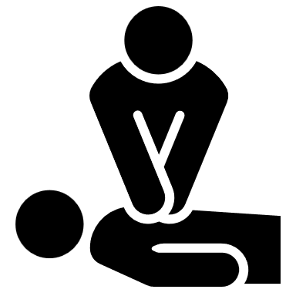
Chest Compressions:
Chest Compressions: The heart, brain, and other organs must receive blood. Otherwise, permanent damage results.
In cardiac arrest, the heart has stopped beating.
Blood must be pumped through the body in some other way.
Chest compressions force blood through the circulatory system.

Slide 35
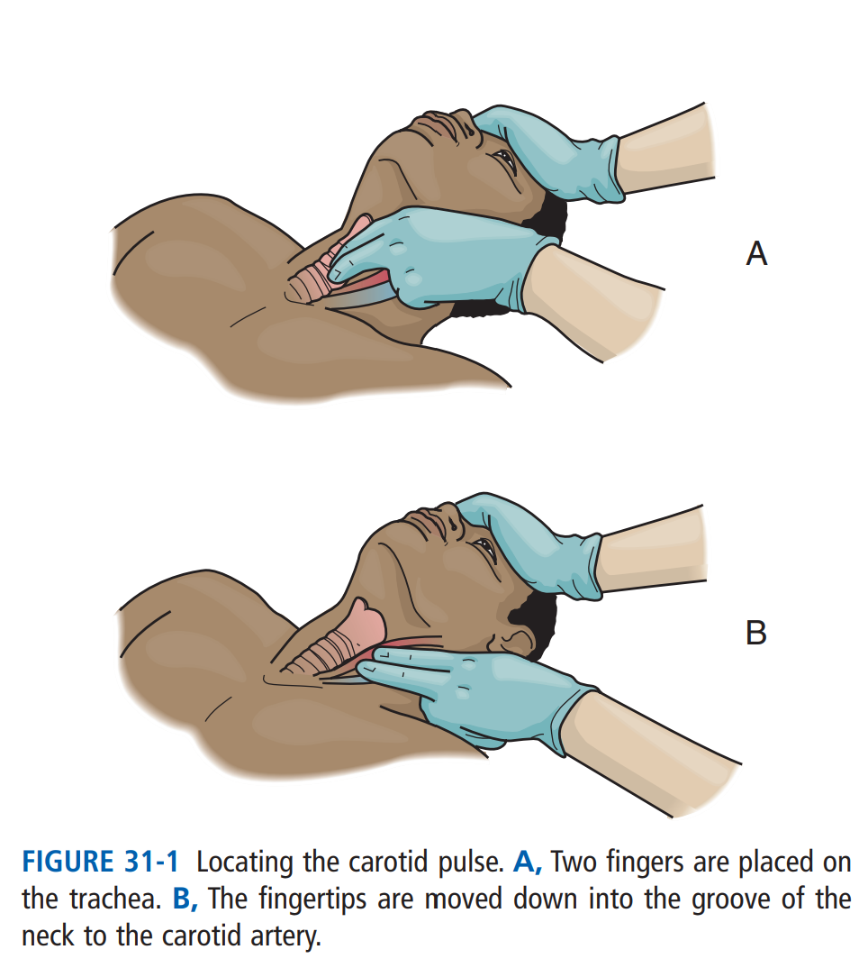
Chest Compressions:
Before starting chest compressions:
check for a pulse.
Use the carotid artery on the side near you.
To find the carotid pulse, place 2 or 3 fingertips on the trachea (windpipe).
Then slide your fingers down off the trachea to the groove of the neck (Fig. 31-1).
Check for a pulse for at least 5 seconds but no more than 10 seconds.
While checking for a pulse, look for signs of circulation.
See if the person has started breathing or is coughing or moving.
The heart lies between the sternum (breastbone) and the spinal column.
When pressure is applied to the sternum, the sternum is depressed. This compresses the heart between the sternum and spinal column (Fig. 31-2).
For effective chest compressions, the person must be supine on a hard, flat surface—floor or back-board. You are positioned at the person’s side.

Slide 36
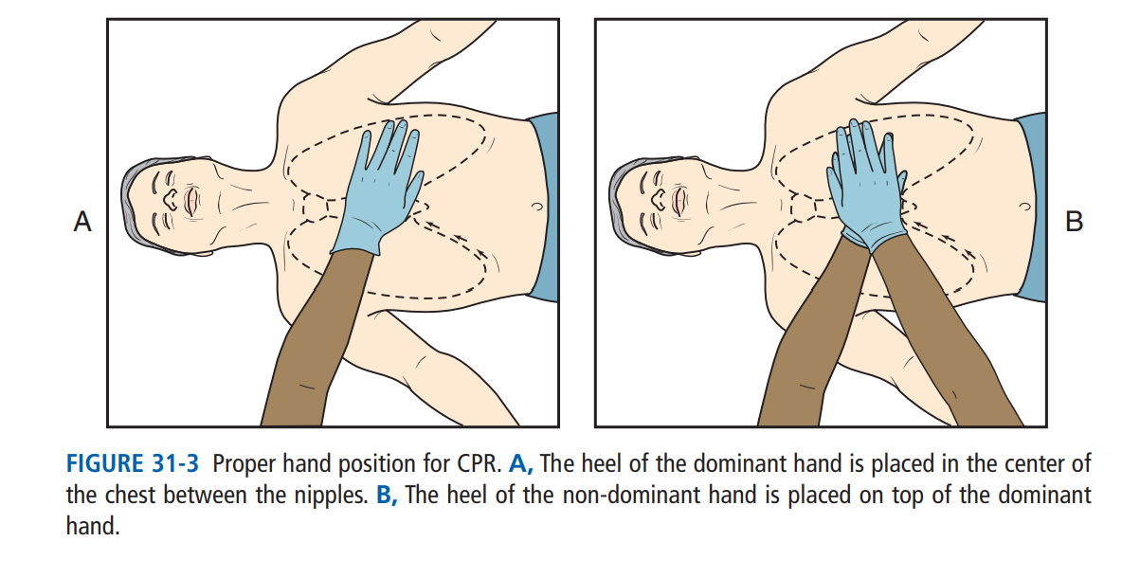
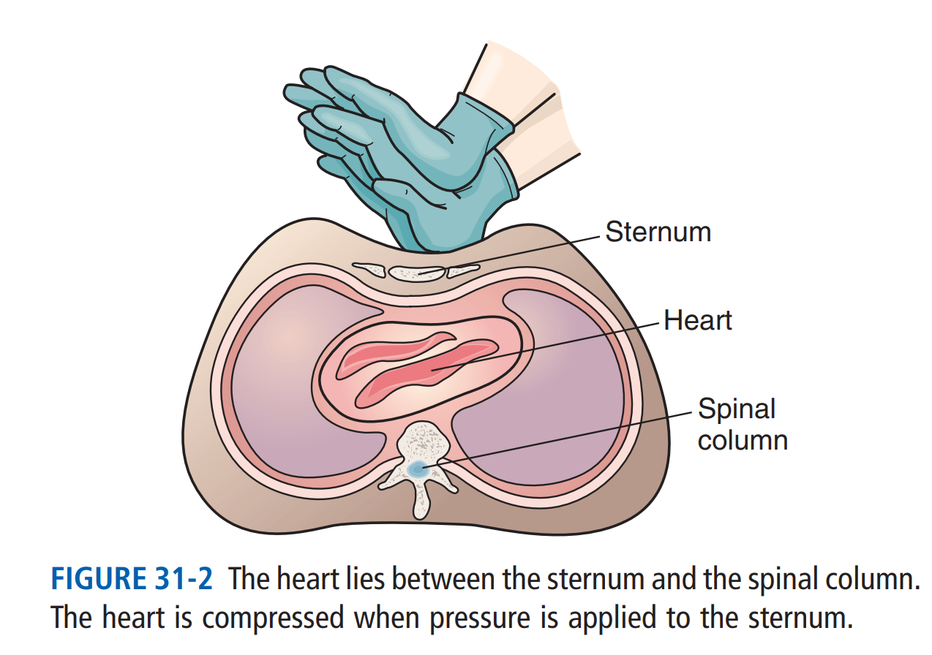
CONT…
Hand position is important for effective chest compressions (Fig. 31-3, p. 486).
You use the heels of your hands— 1 on top of the other—for chest compressions.
For proper placement:
Expose the person’s chest.
Remove clothing or move it out of the way.
You need to see the person’s bare skin for proper hand position.
Place the heel of 1 hand (usually your dominant hand) in the center of the bare chest.
The heel of this hand is placed on the sternum between the nipples.
Place the heel of your other hand on top of the heel of the first hand.

Slide 37
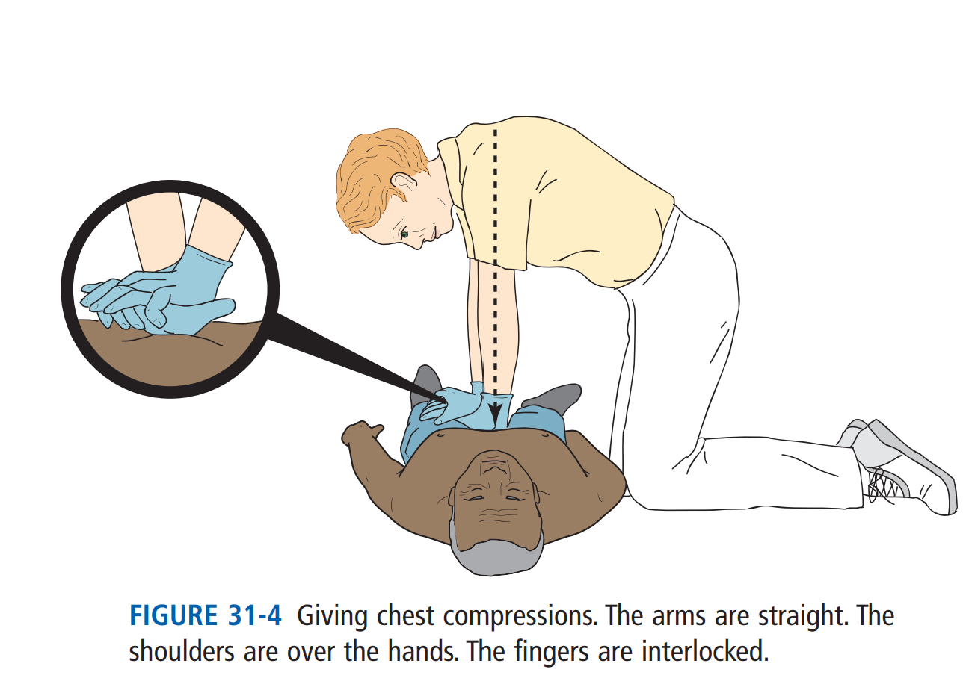
CONT…
To give chest compressions, your arms are straight.
Your shoulders are directly over your hands.
And your fingers are interlocked (Fig. 31-4).
Exert firm downward pressure to depress the adult sternum at least 2 inches.
Then release pressure without removing your hands from the chest.
Releasing pressure allows the chest to recoil—to return to its normal position. Recoil lets the heart fill with blood.
The AHA recommends that you:
• Give compressions at a rate of at least 100 per minute.
• Push hard and push fast.
• Push deeply into the chest.
• Interrupt chest compressions only when necessary.
Interruptions should be less than 10 seconds.
When there are no chest compressions, blood does not flow to the heart, brain, and other organs.

Slide 38
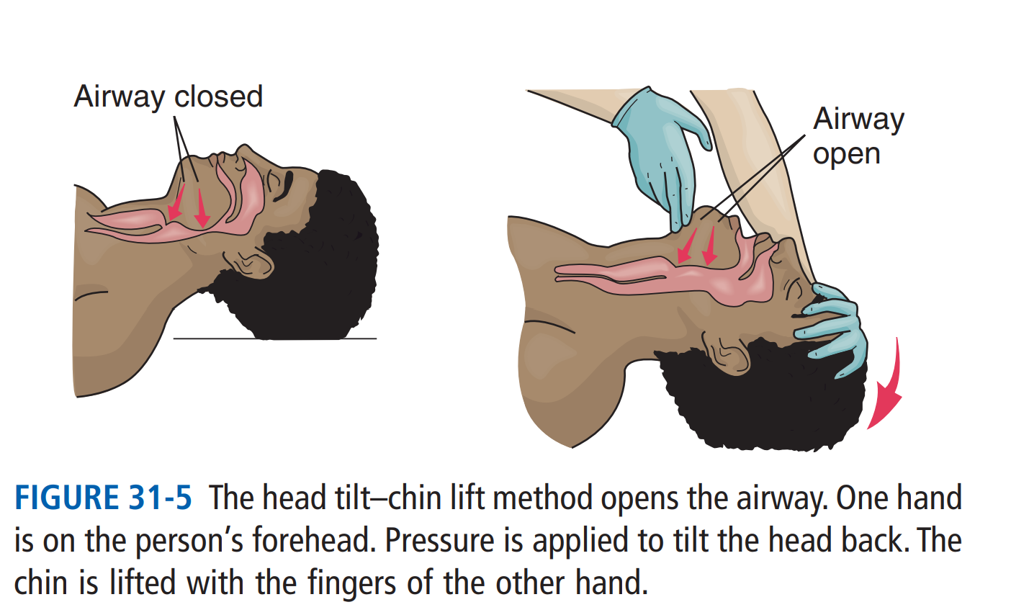
Airway:
The respiratory passages (airway) must be open to restore breathing.
The airway is often obstructed (blocked) during SCA.
The person’s tongue falls toward the back of the throat and blocks the airway.
The head tilt–chin lift method opens the airway (Fig. 31-5).
Place the palm of 1 hand on the forehead.
Tilt the head back by pushing down on the forehead with your palm.
Place the fingers of your other hand under the lower jaw.
Use your index and middle fingers.
Do not use your thumb.
Lift the jaw. This brings the chin forward.
Do not close the person’s mouth. The mouth should be slightly open.

Slide 39
Breathing:
Air is not inhaled when breathing stops.
The person must get oxygen.
If not, permanent heart, brain, and other organ damage occurs.
The person is given breaths. That is, a rescuer inflates the person’s lungs.
Each breath should take 1 second.
You should see the chest rise with each breath.
Two breaths are given after every 30 chest compressions.

Slide 42
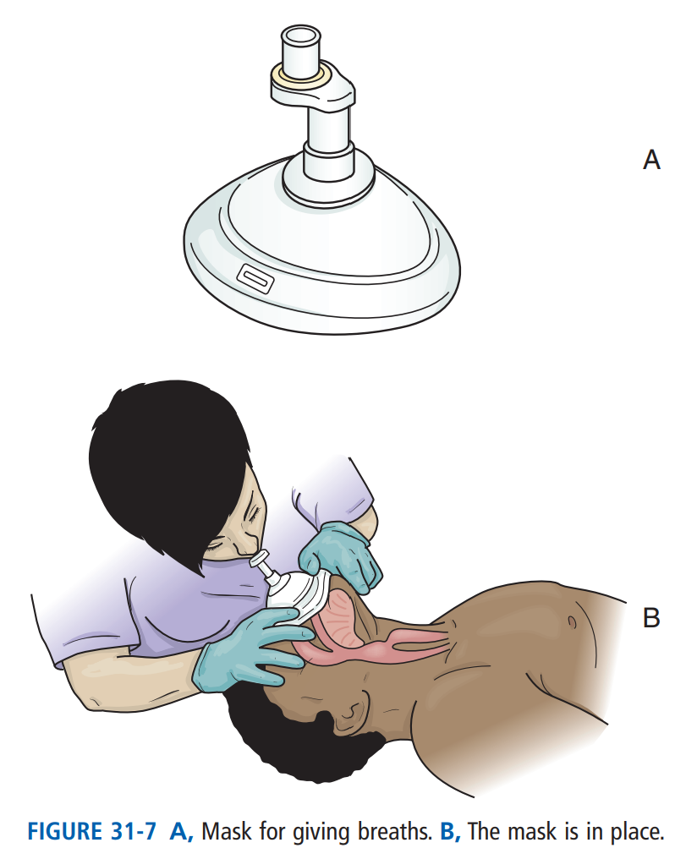
Barrier Device Breathing:
A barrier device: is used for giving breaths whenever possible.
The device prevents contact with the person’s mouth and blood, body fluids, secretions, or excretions.
A face mask is an example of a barrier device (Fig. 31-7, A).
When using a barrier device, seal the device against the person’s face (Fig. 31-7, B).
The seal must be tight.
Then open the airway with the head tilt–chin lift method.

Slide 43
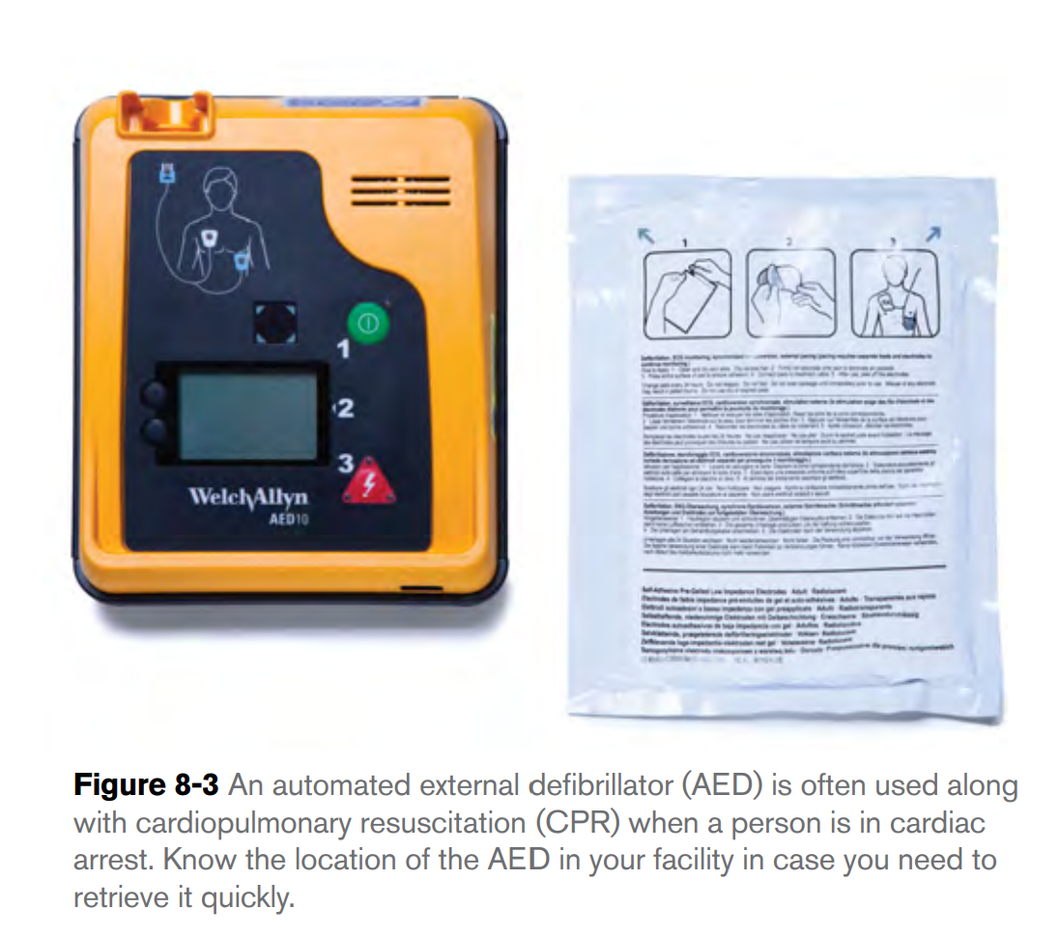
Automated External Defibrillator (AED):
Is a portable electronic device that delivers a defibrillation shock automatically or with a push of a button to help the heart restore an effective pumping rhythm (Figure 8-3).
The proper use of an AED along with CPR has been shown to improve survival rates among people experiencing cardiac arrest.
You should know the location of AEDs in your facility, because you may be asked to retrieve the AED in an emergency while a coworker administers CPR.
You should also know where CPR breathing barrier devices (used to protect both the person being resuscitated and the rescuer from the spread of microbes in saliva, blood and other body fluids) are kept so you can access them in a hurry.
The skills for administering CPR and using an AED are not taught as part of this course, but you are strongly encouraged to take the American Red Cross First Aid/CPR/AED course to learn these skills.

Slide 44
Automated External Defibrillator (AED):
AEDs are found in hospitals, nursing centers, dental offices, and other health agencies.
They are on airplanes and in airports, health clubs, malls, and many other public places.
Some people have them in their homes.
You will learn more about using an AED in the AHA’s BLS for Healthcare Providers course.

Slide 45
Defibrillation:
Ventricular fibrillation (VF, V-fib): is an abnormal heart rhythm (Fig. 31-8, p. 488).
It causes sudden cardiac arrest.
Rather than beating in a regular rhythm, the heart shakes and quivers like a bowl of Jell-O.
The heart does not pump blood.
The heart, brain, and other organs do not receive blood and oxygen.
A defibrillator: is used to deliver a shock to the heart.
The shock stops the VF (V-fib).
This allows the return of a regular heart rhythm.
Defibrillation as soon as possible after the onset of VF (V-fib) increases the person’s chance of survival.

Slide 47
Defibrillation:
For adults, the AHA recommends that rescuers:
• Use an automated external defibrillator (AED) as soon as possible.
• Minimize interruptions in chest compressions before and after a shock is given.
• Give 1 shock. Then resume CPR at once.
Begin with chest compressions. Do 5 cycles of 30 compressions and 2 breaths.
• Check for a heart rhythm.

Slide 48
Performing Adult CPR:
CPR is done only for cardiac arrest.
You must determine if cardiac arrest or fainting (p. 492) has occurred.
CPR is done if the person does not respond, is not breathing (or has no normal breathing), and has no pulse.
CPR is done alone or with another person.
When done alone, chest compressions and rescue breathing are done by 1 rescuer.
With 2 rescuers, 1 person gives chest compressions and the other does rescue breathing (Fig. 31-10).
Rescuers switch tasks about every 2 minutes to avoid fatigue and inadequate compressions.
The second rescuer uses the AED if one is available

Slide 50
Procedures:

Slide 55
Hands-Only CPR:
When an adult has sudden cardiac arrest, the person’s survival depends on others nearby.
Outside of the health care setting, persons trained in BLS are often not available.
Bystanders may worry that they will not do CPR correctly or that they may injure the person.
The AHA developed “Hands-Only CPR” to improve the response of by standers who witness an adult collapse suddenly in the out-of-hospital stetting.
In “Hands-Only CPR,” CPR involves 2 steps. 1 Call 911. 2 Push hard and fast in the center of the chest.
“Hands-Only CPR” is used to educate persons not trained in BLS. As a health care provider.

Slide 56
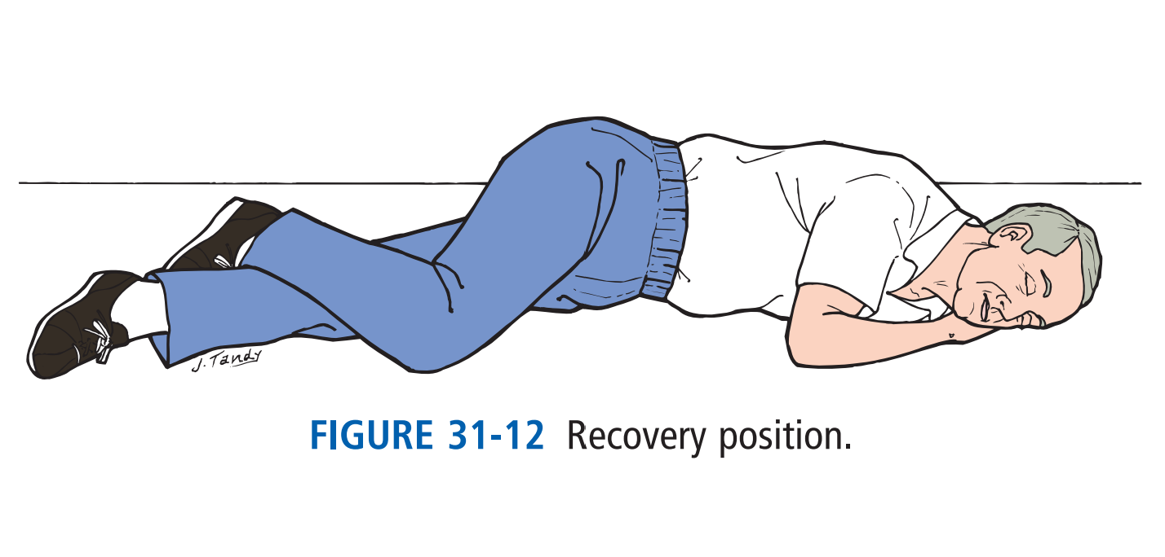
Recovery Position
Recovery Position: The recovery position is used when the person is breathing and has a pulse but is not responding (Fig. 31-12).
The position helps keep the airway open and prevents aspiration.
Logroll the person into the recovery position. Keep the head, neck, and spine straight. A hand supports the head. Do not use this position if the person might have neck injuries or other trauma.

Slide 57
Any Questions ?

Slide 58
Thank You!

Slide 59
Reference:
Mosby’s essentials for nursing assistants / Sheila A. Sorrentino, Leighann N. Remmert.—5th edition.
American Red Cross. First Aid/CPR/AED Participant’s Manual. StayWell Health and Safety Solutions. 2011.

