Slide 1
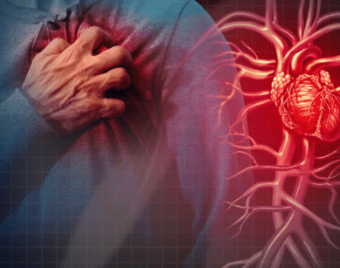
Cardiovascular system and disorders
Module 5, special care situations
Prepared by:
Ms.Jamilah Allehaib
BSN, RN

Slide 2
Learning Objectives:
Review of the cardiovascular body system.
Mention cardiovascular disorders.
Explain cardiovascular disorder on children and older person
List Risk factors of cardiovascular disorders.
Describe Hypertension, signs and symptoms and management (HTN).
Describe coronary artery disease, signs and symptoms and management (CAD).
Describe Angina and Myocardial infarction (MI), signs and symptoms and management .
Explain Heart failure and dysrhythmias

Slide 3
The Cardiovascular Body System:
The circulatory system is made up of the blood, heart, and blood vessels.
The heart pumps blood through the blood vessels.
The circulatory system has many functions.
• Blood carries food, hormones, and other substances to the cells.
Blood transports (carries) the gases of respiration (p. 81). It brings oxygen to the cells.
Blood removes waste products from cells.
Blood plays a role in maintaining the body’s fluid balance.
Blood and blood vessels help regulate body temperature.
The blood carries heat from muscle activity to other body parts, Blood vessels in the skin dilate to cool the body. They constrict to retain heat.
The system produces and carries cells that defend the body from microbes that cause disease.

Slide 4
The Blood:
The blood consists of blood cells and plasma.
Plasma is mostly water. It carries blood cells to other body cells.
Plasma also carries substances that cells need to function. This includes food (proteins, fats, and carbohydrates), hormones (p. 85), and chemicals.
Red blood cells (RBCs) are called erythrocytes.
Hemoglobin is the substance in RBCs that carries oxygen and gives blood its red color.
As RBCs circulate through the lungs, hemoglobin picks up oxygen. Hemoglobin carries oxygen to the cells.
When blood is bright red, hemoglobin in the RBCs is saturated (filled) with oxygen. As blood circulates through the body, oxygen is given to the cells. Cells release carbon dioxide (a waste product). It is picked up by the hemoglobin. RBCs saturated with carbon dioxide make the blood look dark red

Slide 5
Red Blood Cells (RBCS):
The body has about 25 trillion (25,000,000,000,000) RBCs. About 4½ to 5 million cells are in a cubic millimeter of blood (the size of a tiny drop).
RBCs live for 3 to 4 months. They are destroyed by the liver and spleen as they wear out.
New RBCs are formed in the bone marrow.
About 1 million RBCs are produced every second.
White blood cells (WBCs) are called leukocytes.
They have no color. They protect the body against infection.
There are about 5,000 to 10,000 WBCs in a cubic millimeter of blood.
At the first sign of infection, WBCs rush to the infection site.
There they multiply rapidly. The number of WBCs increases when there is an infection.
WBCs are formed by the bone marrow. They live about 9 days.
Platelets (thrombocytes) are needed for blood clotting.
They are formed by the bone marrow. There are about 200,000 to 400,000 platelets in a cubic millimeter of blood. A platelet lives about 4 days.

Slide 6
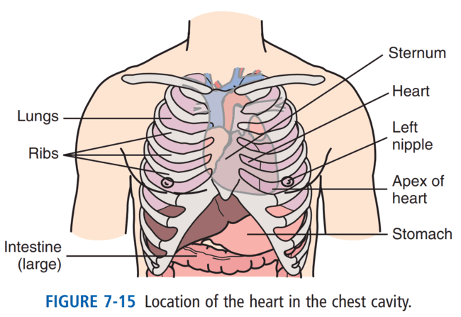
The Heart :
The heart is a muscle. It pumps blood through the blood vessels to the tissues and cells.
The heart lies in the middle to lower part of the chest cavity toward the left side (Fig. 7-15).
The heart is hollow and has 3 layers (Fig. 7-16).
• The pericardium: is the outer layer. It is a thin sac covering the heart.
• The myocardium: is the second layer. It is the thick, muscular part of the heart.
• The endocardium is the inner layer. A membrane, it lines the inner surface of the heart

Slide 7
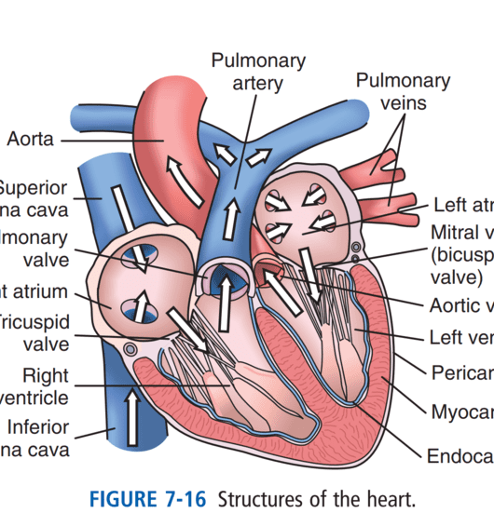
Champers of the heart:
The heart has 4 chambers (see Fig. 7-16).
Upper chambers receive blood and are called atria.
The right atrium receives blood from body tissues.
The left atrium receives blood from the lungs.
Lower chambers are called ventricles. Ventricles pump blood.
The right ventricle pumps blood to the lungs for oxygen.
The left ventricle pumps blood to all parts of the body

Slide 8
Valves:
Valves are between the atria and ventricles.
The valves allow blood flow in 1 direction.
They prevent blood from flowing back into the atria from the ventricles.
The tricuspid valve is between the right atrium and the right ventricle.
The mitral valve (bicuspid valve) is between the left atrium and left ventricle.
Heart action has 2 phases.
Diastole: It is the resting phase. Heart chambers fill with blood.
Systole: It is the working phase. The heart contracts. Blood is pumped through the blood vessels when the heart contracts.

Slide 9
The Blood Vessels :
Blood flows to body tissues and cells through the blood vessels.
There are 3 groups of blood vessels: arteries, capillaries, and veins.
Arteries carry blood away from the heart.
Arterial blood is rich in oxygen.
The aorta is the largest artery. It receives blood directly from the left ventricle.
The aorta branches into other arteries that carry blood to all parts of the body (Fig. 7-17).
These arteries branch into smaller parts within the tissues.
The smallest branch of an artery is an arteriole.
Arterioles connect to capillaries. Capillaries are very tiny blood vessels.
Food, oxygen, and other substances pass from capillaries into the cells.
The capillaries pick up waste products (including carbon dioxide) from the cells.

Slide 10
Veins:
Veins carry waste products back to the heart.
Veins return blood to the heart.
They connect to the capillaries by venules.
Venules are small veins. Venules branch together to form veins.
The many veins also branch together as they near the heart to form 2 main veins (see Fig. 7-17).
The 2 main veins are the inferior vena cava and the superior vena cava.
Both empty into the right atrium.
The inferior vena cava carries blood from the legs and trunk. The superior vena cava carries blood from the head and arms.
Venous blood is dark red. It has little oxygen and a lot of carbon dioxide.

Slide 11
Path of blood flow:
Blood flow through the circulatory system is shown in Fig. 7-16.
The path of blood flow is as follows:
Venous blood poor in oxygen, empties into the right atrium.
Blood flows through the tricuspid valve into the right ventricle.
The right ventricle pumps blood into the lungs to pick up oxygen.
Oxygen-rich blood from the lungs enters the left atrium.
Blood from the left atrium passes through the mitral valve into the left ventricle.
The left ventricle pumps the blood into the aorta. It branches off to form other arteries.
Arterial blood is carried to the tissues by arterioles and to the cells by capillaries.
Cells and capillaries exchange oxygen and nutrients for carbon dioxide and waste products.
Capillaries connect with venules. Venules carry blood that has carbon dioxide and waste products.
Venules form veins. Veins return blood to the heart.

Slide 13
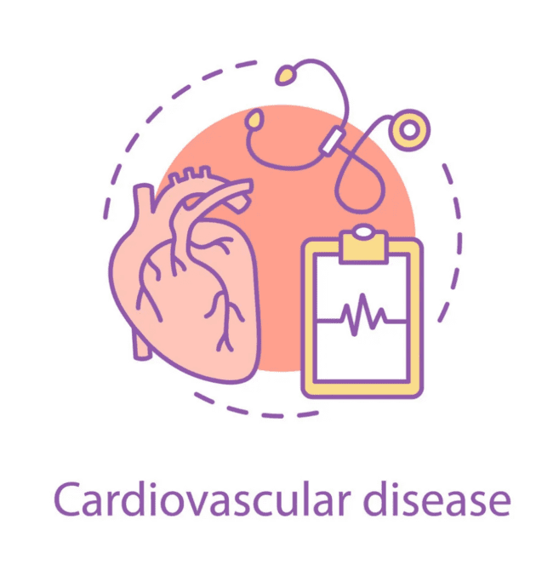
CARDIOVASCULAR CONDITIONS :
The cardiovascular system transports nutrients and oxygen to all the tissues of the body and then carries away the wastes from these same tissues.
Common conditions that affect the cardiovascular system include angina, chronic heart failure and hypertension.
Cardiovascular disorders are leading causes of death in the United States. Problems occur in the heart or blood vessels.

Slide 14
Cardiovascular disorders in children:
Cardiovascular conditions of childhood could be modifiable or non-modifiable.
The common non-modifiable types found in children are Arrhythmia, Deletion Disorders, Cardiomyopathy, Heart Failure, Kawasaki Disease, Congenital Heart Defects, Heart Murmurs and Rheumatic Fever.
Several of the cardiovascular consequences that describe the onset of adult obesity are preceded by abnormalities that commence in childhood. In the United States, obesity is nowadays the most predominant nutritional disease of children and adolescents. It has been proven by research over the last 40 years that most of the clinical problem of CVD occurs in adults

Slide 16
Hypertension (HTN):
With hypertension (high blood pressure), the resting blood pressure is too high.
The systolic pressure is 140 mm Hg (millimeters of mercury) or higher (hyper).
Or the diastolic pressure is 90 mm Hg or higher.
Such measurements must occur several times;
- Pre-hypertension is when the systolic pressure is between 120 and 139 mm Hg, or the diastolic pressure is between 80 and 89 mm Hg.
- Pre-hypertension will likely develop into hypertension in the future.
Narrowed blood vessels are a common cause.
The heart pumps with more force to move blood through narrowed vessels.

Slide 17
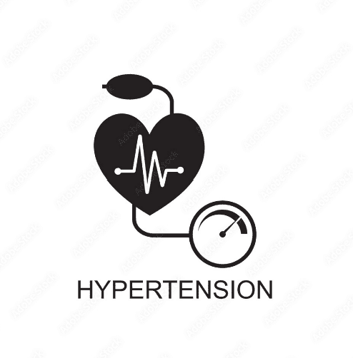
CONT…
Hypertension: is chronically high blood pressure.
Blood pressure that remains elevated over time places a great deal of stress on the heart and blood vessels.
Hypertension often does not cause symptoms but can cause serious health problems.
Many people who have been diagnosed with hypertension take medications to lower blood pressure.
It is important that the person take these medications as ordered.

Slide 18
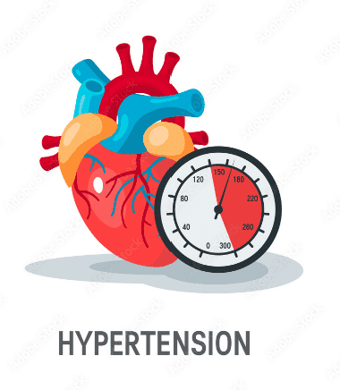
Causes and S/S of Hypertension:
Kidney disorders.
Head injuries.
Some pregnancy problems.
Adrenal gland tumors.
Signs and symptoms develop over time;
Headache.
Blurred vision.
Dizziness
Nose bleeds.
Hypertension can lead to;
Stroke.
Hardening of the arteries.
Heart attack.
Heart failure.
Kidney failure.
Blindness.

Slide 19
Management of Hypertension:
Life-style changes can lower blood pressure.
A diet low in fat and salt.
A healthy weight.
Regular exercise are needed.
No smoking is allowed.
Alcohol and caffeine are limited.
Managing stress and sleeping well also lower blood pressure.
Certain drugs lower blood pressure.
If a person tells you that he has stopped taking blood pressure medication (for example, because he is not having any symptoms, or because the medication causes unwanted side effects), report this to the nurse right away.
The nurse can help explain to the person the importance of taking the medication. If the person has stopped taking the medication because of unpleasant side effects, the nurse can work with the person’s primary care provider to adjust the person’s medication regimen to eliminate or reduce the side effects.

Slide 20
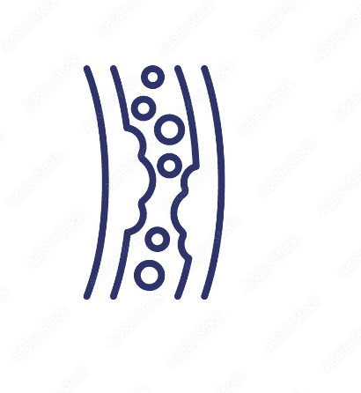
Coronary artery disease(CAD):
The coronary arteries supply the heart muscle with blood.
In coronary artery disease (CAD), the coronary arteries become hardened and narrow.
One or all are affected. The heart muscle gets less blood and oxygen (O2).
CAD also is called coronary heart disease and heart disease.
In CAD, narrowed vessels prevent increased blood flow.

Slide 21
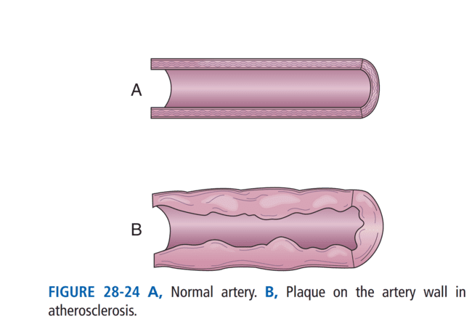
Causes of coronary artery disease:
The most common cause is atherosclerosis (Fig. 28-24).
Plaque—made up of cholesterol, fat, and other substances, collects on artery walls.
The narrowed arteries block blood flow.
Blockage may be total or partial.
Blood clots can form along the plaque and block blood flow.
The major complications of CAD are;
Angina.
Myocardial infarction(heart attack).
Irregular heartbeats.
Sudden death.
The more risk factors (see Box 28-12), the greater the chance of CAD and its complications.

Slide 22
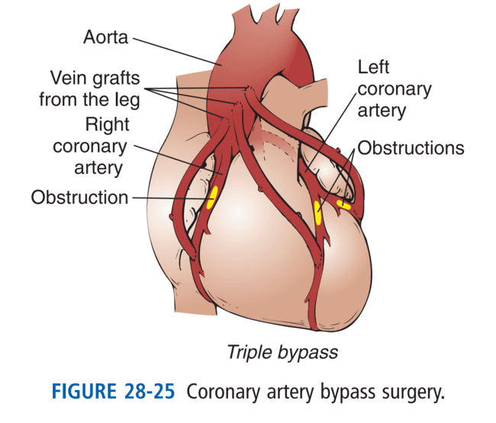
Management of coronary artery disease (CAD):
CAD can be treated, treatment goals are to:
Relieve symptoms (see “Angina”).
Slow or stop atherosclerosis.
Lower the risk of blood clots.
Widen or bypass clogged arteries.
Reduce cardiac events (see “Angina” and “Myocardial Infarction,” p. 446).
CAD requires life-style changes.
Drugs may be used to decrease the heart’s workload, relieve symptoms, prevent a heart attack or sudden death, or to delay the need for procedures that open or bypass diseased arteries (Fig. 28-25)

Slide 23
Angina:
Angina (pain) is chest pain from reduced blood flow to part of the heart muscle (myocardium). It occurs when the heart needs more O2.
Angina is chest pain that occurs because the heart is not getting enough oxygen.
Normally blood flow to the heart increases when O2 needs increase.
An angina attack can be caused by activity, exercise or stress.
Exertion, a heavy meal, stress, and excitement increase the heart’s need for O2. So do smoking and very hot or very cold temperatures.
Things that cause angina are avoided. These include over-exertion, heavy meals and over-eating, and emotional stress. The person stays indoors during cold weather or during hot, humid weather.

Slide 24
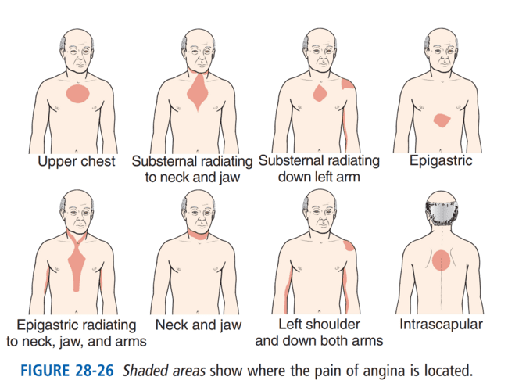
Signs and symptoms of angina:
Chest pain: is described as a tightness, pressure, squeezing, or burning in the chest (Fig. 28-26).
Pain can occur in the shoulders, arms, neck, jaw, or back.
Pain in the jaw, neck, and down 1 or both arms is common.
The person may be pale, feel faint, and perspire.
Dyspnea is common.
Nausea, fatigue, and weakness may occur.
Some persons complain of “gas” or indigestion.
Rest often relieves symptoms in 3 to 15 minutes.

Slide 25
Nitroglycerin:
A person who has angina may take nitroglycerin to relieve the chest pain.
The nitroglycerin may be in the form of a pill that is placed under the tongue or in the form of a patch that is applied to the skin.
Besides rest, a nitroglycerin tablet is taken when angina occurs.
It is placed under the tongue, it dissolves and is rapidly absorbed into the bloodstream.
Tablets are kept within the person’s reach at all times.
The person takes a tablet and then tells the nurse.
Some persons have nitroglycerin patches, the nurse applies and removes them.

Slide 26
Measure care of Angina:
When caring for a person with angina, be aware that the person may try to limit activity out of fear of bringing on an angina attack.
Encourage the person to be as independent as possible by allowing him to move at his own pace.
If he does feel any chest discomfort with activity, encourage him to rest and breathe deeply to help relieve the pain, and then report the episode of angina to the nurse.
A doctor-supervised exercise program (cardiac rehabilitation) is helpful.
See “Coronary Artery Disease” for the treatment of angina, the goal is to increase blood flow to the heart. Doing so may prevent or lower the risk of heart attack and death.
Chest pain lasting longer than a few minutes and not relieved by rest and nitroglycerin may signal heart attack. The person needs emergency care.

Slide 27
Myocardial Infarction (MI):
Myocardial refers to the heart muscle. Infarction means tissue death.
With myocardial infarction (MI), blood flow to the heart muscle is suddenly blocked.
Part of the heart muscle dies. Sudden cardiac death (sudden cardiac arrest) can occur.
MI is an emergency.
MI also is called:
Heart attack.
• Acute myocardial infarction (AMI).
• Acute coronary syndrome (ACS).

Slide 28
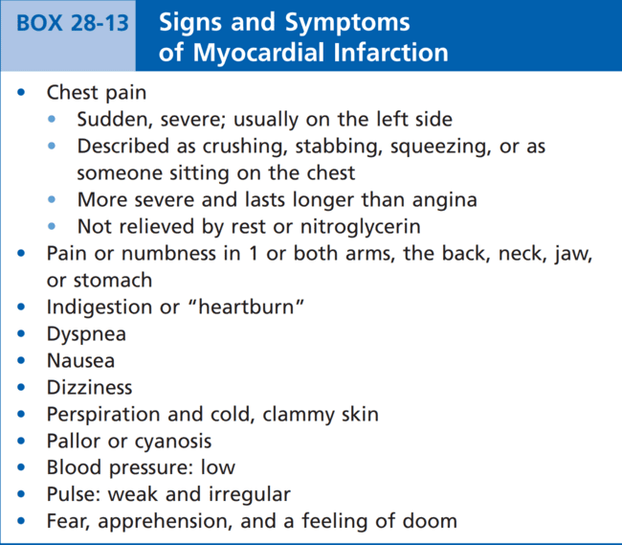

Slide 29
Measure care of Myocardial Infarction (MI):
Efforts are made to:
Relieve pain.
Restore blood flow to the heart.
Stabilize vital signs.
Give O2.
Calm the person.
Prevent death and life-threatening problems.
The person may need medical or surgical procedures to open or bypass the diseased artery.
Cardiac rehabilitation is needed.
The goals are to:
Recover and resume normal activities.
Prevent another MI.
Prevent complications such as heart failure or sudden cardiac arrest.

Slide 30
Dysrhythmia (Arrythmia):
Dysrhythmia: are deviations from normal heartbeat pattern.
They include;
Abnormality of impulse formation, such as: heart rate, rhythm, or site of impulse origin and conduction disturbances, which disrupt the normal sequence of atrial and ventricular activation.
Causes:
Physiological - Exercise, exertion, emotion, temperature, etc.
Others- Metabolic disorders, electrolyte imbalance, emotional crisis, acid-base imbalance, sympathetic over activity, hemodynamic abnormalities. dehydration, thyrotoxicosis, anemia

Slide 31
Heart failure
Heart failure or congestive heart failure (CHF) occurs when the weakened heart cannot pump normally, then blood backs, tissue congestion occurs.
When the left side of the heart cannot pump blood normally, blood backs up into the lungs. Respiratory congestion occurs.
The person has dyspnea, increased sputum, cough, and gurgling sounds in the lungs.
The body does not get enough blood.
Pulmonary edema (fluid in the lungs) can result from heart failure.
It is an emergency, the person can die.

Slide 32
Signs and symptoms of Heart Failure:
Signs and symptom occur from the effects on other organs.
Poor blood flow to the brain causes confusion, dizziness, and fainting.
The kidneys produce less urine.
The skin is pale.
Blood pressure falls.
When the right side of the heart cannot pump blood normally, blood backs up into the venous system.
Feet and ankles swell.
Neck veins bulge.
Liver congestion affects liver function.
The abdomen is congested with fluid.
Less blood is pumped to the lungs, the left side of the heart receives less blood from the lungs, the left side has less blood to pump to the body.
As with left-sided heart failure, organs receive less blood, the signs and symptoms of left sided failure occurs.

Slide 33
Management of Heart Failure:
Drugs strengthen the heart, also reduce the amount of fluid in the body.
A sodium-controlled diet is ordered.
Oxygen is given.
Semi-Fowler’s position is preferred for breathing.
Intake and output (I&O).
Daily weight.
Elastic stockings.
ROM exercises are part of the care plan.

Slide 34
Chronic Heart Failure:
In people with chronic heart failure, the heart muscle is weak and cannot pump effectively.
Heart failure may cause fluids to build up in the body, resulting in swelling of the feet, legs, hands, and face and difficulty breathing.
Shortness of breath can cause the person to feel anxious and restless. The shortness of breath and anxiety may be worse when the person lies down.
If you notice that a person in your care becomes anxious and short of breath only when lying down, report this to the nurse, this could be an early sign of heart failure.

Slide 35
Plan of care for Chronic Heart Failure:
When you provide care for a person who has chronic heart failure, do the following things:
Provide frequent rest periods when helping the person with daily care activities.
People with chronic heart failure often become tired after only a little exertion.
Help the person see that by pacing her activities during the day, she accomplishes more.
Help the person maintain a position that lets her breathe more comfortably.
Many people find a sitting position supported by pillows to be best.
Keep the person’s legs elevated to reduce swelling of the legs and feet.

Slide 36
CONT…
Provide frequent opportunities for the person to use the toilet. The medications used to manage chronic heart failure can increase both urinary output and frequency of urination. As always, answer requests for help promptly.
Provide regular mouth care. A person with chronic heart failure may breathe through the mouth or receive oxygen, which makes the mouth dry.
Measure and record the person’s intake, output and weight every day, or according to the person’s care plan. These measurements are used to determine how well the person is eliminating excess fluid.
Be aware that a person with chronic heart failure may also have fluid restrictions in place.
Provide diversion (such as enjoyable activities) to calm the person and reduce strain on the heart.

Slide 37
Sorrentino, S. A., Remmert, L., & Wilk, L. S. (2014). Mosby's Textbook for Nursing Assistants (5th ed.). St. Louis, MO: Elsevier.)
A Richards, A. and Garg, V., 2010. Genetics of congenital heart disease. Current cardiology reviews, 6(2), pp.91-97.
American Red Cross (2013). American Red Cross Nurse Assistant Training Textbook: Third Edition.United States of America: Krames Stay Well Strategic Partnerships Division. ISBN: 978-1584805823,

Slide 38
Any Question ?

Slide 39
Thank you !

